Slide 1




© TURNED-E! Education Limited 育教創科有限公司 2025
KOI2 AI Lens smart city
Lesson8-9：Personal AI IoT Product Design

Slide 2


© TURNED-E! Education Limited 育教創科有限公司 2025
Agenda
Introduction to IoT Design Contest
Design Thinking and Five Steps
Background Research
Programing Time
Debug Time

Slide 3




Rules
請尊重你的同學和導師
Be respectful.
Respect your classmates and teacher.
請正確使用器材
Use equipment
only for class activities.
盡情享受課堂樂趣吧！
Be creative, active
and have fun!
© TURNED-E! Education Limited 育教創科有限公司 2025

Slide 4

Revision
© TURNED-E! Education Limited 育教創科有限公司 2025

Slide 5
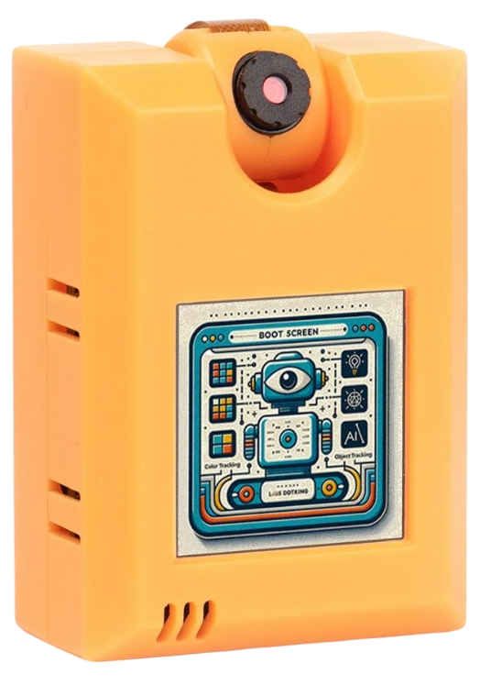
KOI2 Functions
KOI 2 lens is an offline AI camera released by Kittenbot at 2024, it has 5 main abilities:
Visual recognition
Face Detection and Recognition
Object Classification
Speech Recognition
Text to Speech
© TURNED-E! Education Limited 育教創科有限公司 2025

Slide 6

Introduction to Personal IoT Design Contest
© TURNED-E! Education Limited 育教創科有限公司 2025

Slide 7
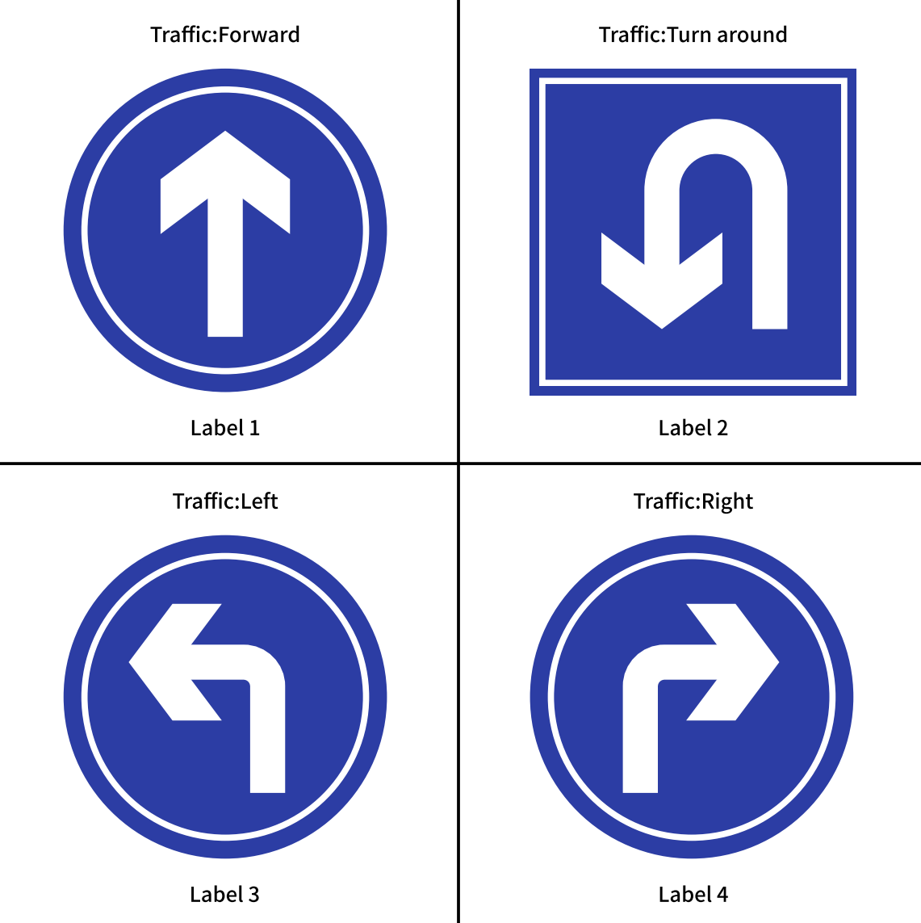
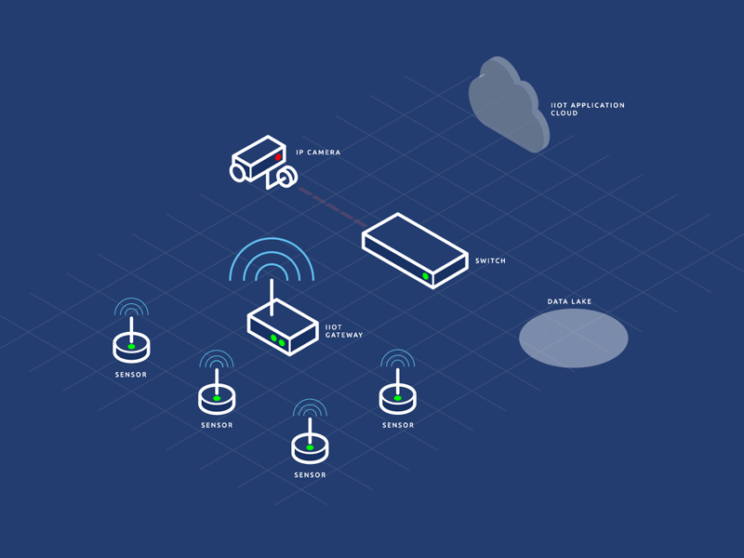
IoT Devices and Problem Solving
In previous lessons, we used KOI2 to design and build various small devices to help visually impaired people walk safely on the road, and it is clear that KOI2 can solve more problems in real life.
© TURNED-E! Education Limited 育教創科有限公司 2025

Slide 8

Design Thinking and Five Steps
© TURNED-E! Education Limited 育教創科有限公司 2025

Slide 9

What is Design Thinking?
Design Thinking is a human-centered approach to innovation.
© TURNED-E! Education Limited 育教創科有限公司 2025

Slide 10
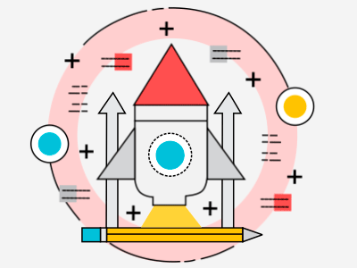
What is Design Thinking?
The Core Philosophy
❤️Empathy First
You can only design a solution after understand others.
🎯Bias Toward Action Don't just talk about it—build it.
  ♻️Iterative Process
  It's a cycle. You build, you test, you fail, you learn, and you build again.
© TURNED-E! Education Limited 育教創科有限公司 2025

Slide 11
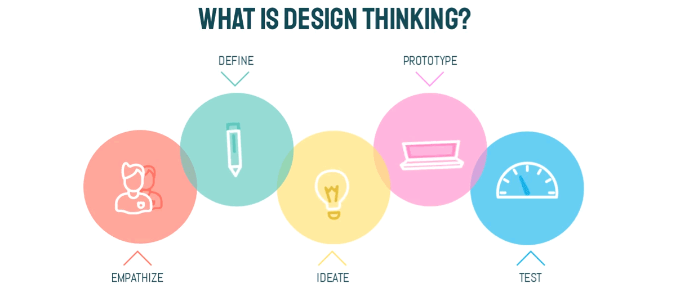
The 5 Stages to Use Design Thinking
© TURNED-E! Education Limited 育教創科有限公司 2025

Slide 12

The 5 Stages to Use Design Thinking
🧐 Empathize
What are the real difficulties users face? Don't just listen to what he says, watch what him do!
Identify the moments in your users' lives when they are most frustrated or helpless.
© TURNED-E! Education Limited 育教創科有限公司 2025

Slide 13
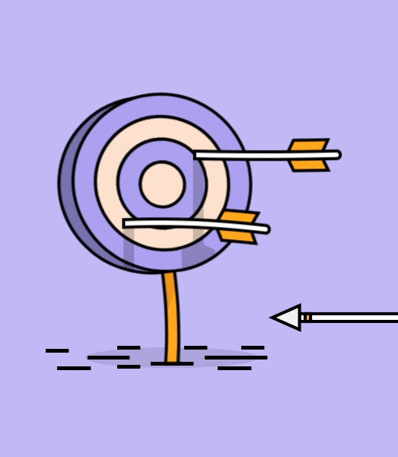
The 5 Stages to Use Design Thinking
🎯 Define
Based on the observed pain points, identify a specific target.
Fill in this formula:
User needs to do something because of a reason/pain point.
© TURNED-E! Education Limited 育教創科有限公司 2025

Slide 14

The 5 Stages to Use Design Thinking
🧠 Ideate
What methods can we use to solve this problem?
Brainstorming: Each group should draw at least 10 ideas.
Leveraging AI Capabilities: See what KOI2 can do?
Selection: Choose the "coolest" and "achievable" idea.
© TURNED-E! Education Limited 育教創科有限公司 2025

Slide 15

The 5 Stages to Use Design Thinking
🛠️ Prototype
How can you quickly bring your ideas to life with minimal cost?
Low-fidelity model: The structure is built using cardboard, tape, and LEGO bricks.
Core function: It only needs to display "Input" and "Output".
💡 Fail Fast: If you find the cardboard structure unstable, you can fix it in just 1 minute.
© TURNED-E! Education Limited 育教創科有限公司 2025

Slide 16

The 5 Stages to Use Design Thinking
📝 Test
Does this design really solve the user's problem?
Test: Don't explain how to use it; see if others can use it.
A failed test is a good thing! It means you discovered a vulnerability before the competition and can fix it quickly.
© TURNED-E! Education Limited 育教創科有限公司 2025

Slide 17

Background Research
Look for social issues that need to be addressed
© TURNED-E! Education Limited 育教創科有限公司 2025

Slide 18

Social issues
Find the social issue, define it and try to solve it with KOI2.
Do not forget the formula:
User needs to do something because of a reason/pain point.
© TURNED-E! Education Limited 育教創科有限公司 2025

Slide 19
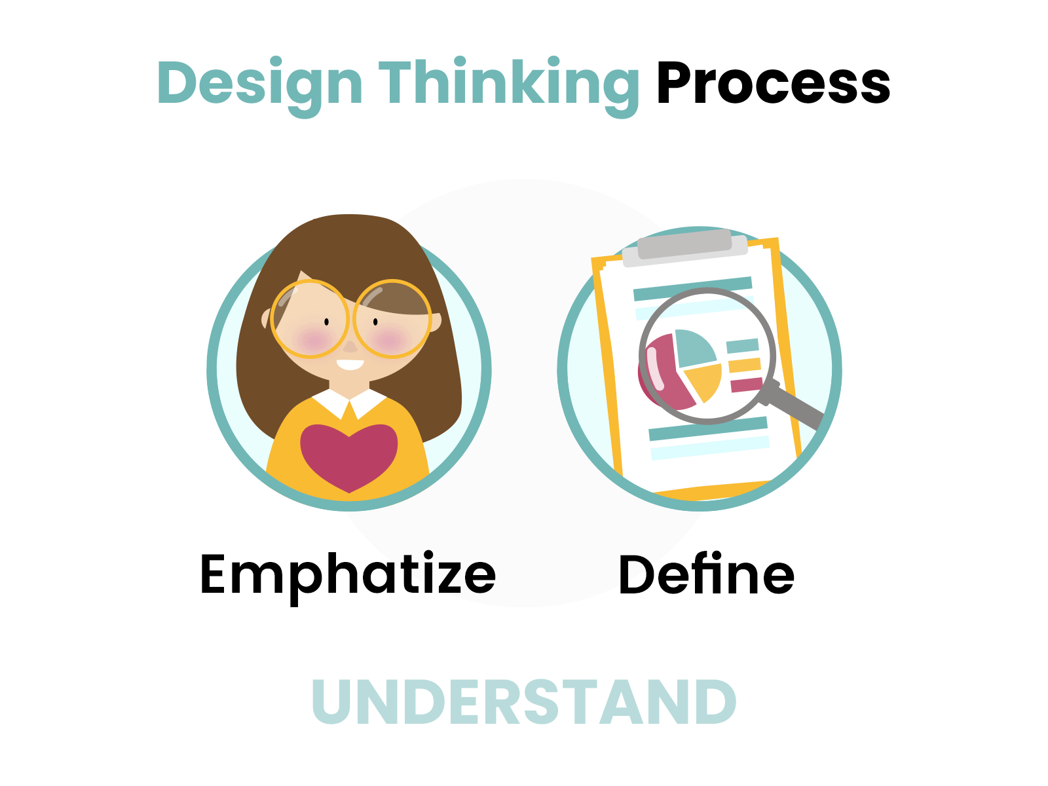
Utilize the five stages
Utilize the 5 stages to have a solution.
❤️ Empathize
In our society, who might face what problems?
🎯Define
What he need to do to solve these problems?
© TURNED-E! Education Limited 育教創科有限公司 2025

Slide 20
Utilize the five stages
💡Ideate
What methods in KOI2 can we use to solve this problem?
⚙️ Prototype
Can you make a small tool to solve this problem as soon as possible?
📝Test
Does this design really solve the user's problem?
© TURNED-E! Education Limited 育教創科有限公司 2025

Slide 21

Programing Time
© TURNED-E! Education Limited 育教創科有限公司 2025

Slide 22

Programing Time
Use programming to realize your wildest ideas.
Try to make a quick protype.
© TURNED-E! Education Limited 育教創科有限公司 2025

Slide 23

Debug Time
© TURNED-E! Education Limited 育教創科有限公司 2025

Slide 24

Programing Time
Debug your program, solve the problems and test again.
© TURNED-E! Education Limited 育教創科有限公司 2025

Slide 25

Summarize
© TURNED-E! Education Limited 育教創科有限公司 2025

