Slide 1


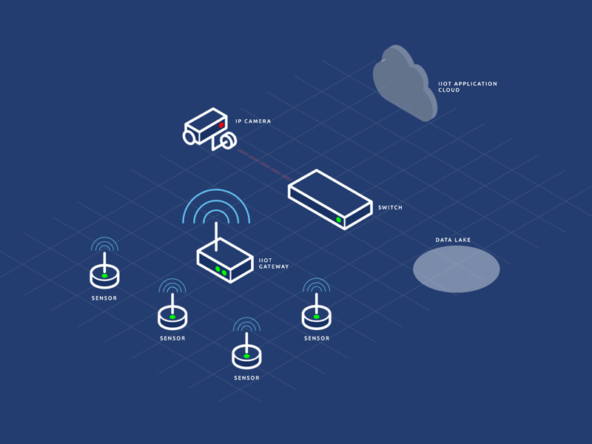
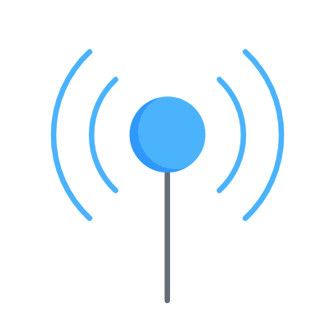
© TURNED-E! Education Limited 育教創科有限公司 2025
KOI2 AI Lens smart city
Lesson 7：Wi-Fi Connection and IoT Applications

Slide 2


© TURNED-E! Education Limited 育教創科有限公司 2025
Agenda
Reviewing time
Connect KOI2 with Wi-Fi
IoT, ThingSpeak and MQTT
KOI2 and MQTT message
Pedestrian Counter

Slide 3




Rules
請尊重你的同學和導師
Be respectful.
Respect your classmates and teacher.
請正確使用器材
Use equipment
only for class activities.
盡情享受課堂樂趣吧！
Be creative, active
and have fun!
© TURNED-E! Education Limited 育教創科有限公司 2025

Slide 4

Reviewing Time
© TURNED-E! Education Limited 育教創科有限公司 2025

Slide 5
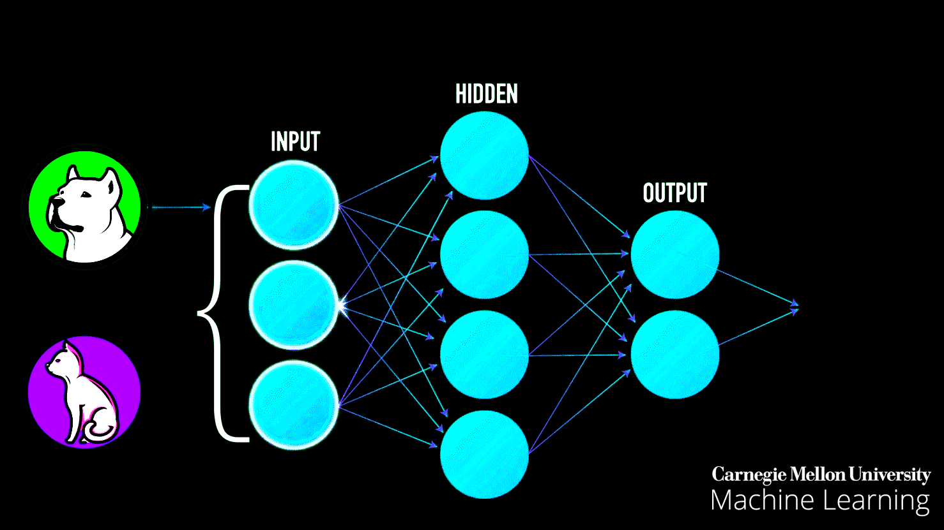
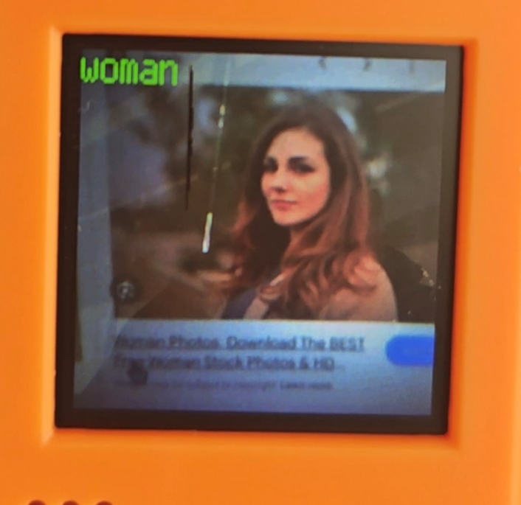
Customed AI Identification Model
We trained a model on ourselves and let KOI2 to identify different genders.
© TURNED-E! Education Limited 育教創科有限公司 2025

Slide 6

Connect KOI2 with Wi-Fi Network
© TURNED-E! Education Limited 育教創科有限公司 2025

Slide 7
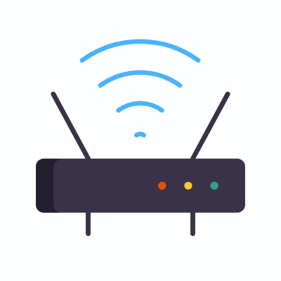
Wi-Fi Network and IP Address
Wi-Fi is a wireless networking technology based on the IEEE 802.11 family of standards that allows electronic devices to exchange data and access the internet using radio waves.
As of 2026, it has evolved into a critical global infrastructure, handling approximately 80% of all indoor data traffic.
© TURNED-E! Education Limited 育教創科有限公司 2025

Slide 8

Wi-Fi Network and IP Address
Frequency Bands:
2.4 GHz: Provides the longest range but slower speeds and is prone to interference from household appliances.
* KOI2 can only use 2.4GHz brand.
5 GHz: Offers faster data transfer with a shorter range than 2.4 GHz.
© TURNED-E! Education Limited 育教創科有限公司 2025

Slide 9

Wi-Fi Network and IP Address
Internet Protocol (IP) is a set of rules for routing and addressing packets of data so they can travel across networks and arrive at the correct destination.
KOI2 could show its IPv4 address.
© TURNED-E! Education Limited 育教創科有限公司 2025

Slide 10
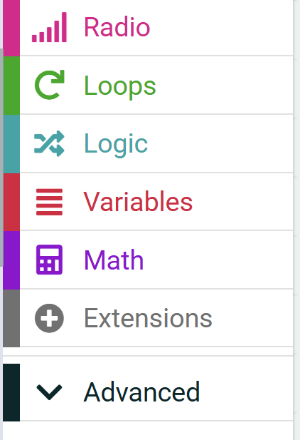
Use KOI2 in MakeCode
Open the extension tab in MakeCode.
1
© TURNED-E! Education Limited 育教創科有限公司 2025

Slide 11
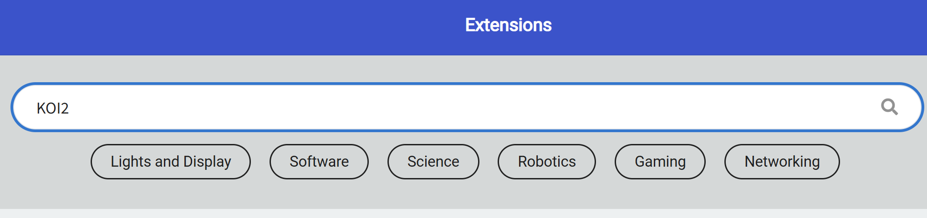
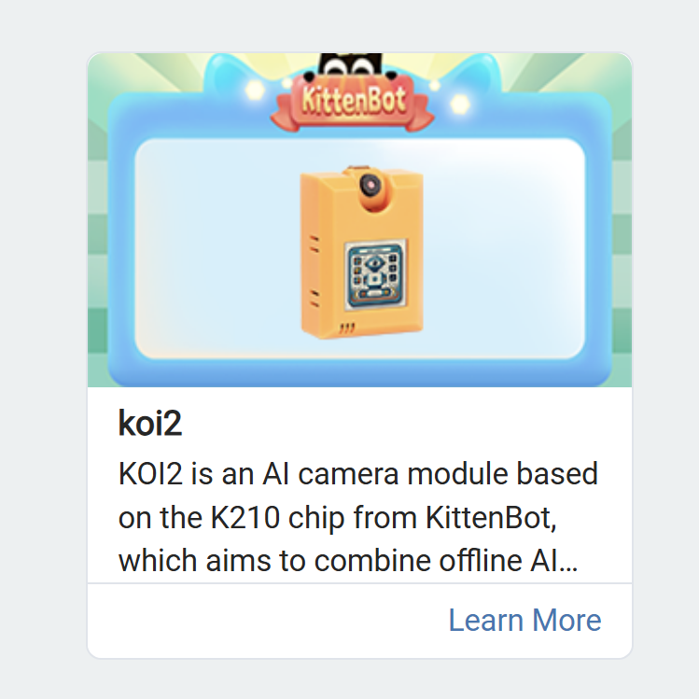
Use KOI2 in MakeCode
2
3
Search for KOI2 in the search bar, and select KOI2 extension
© TURNED-E! Education Limited 育教創科有限公司 2025

Slide 12
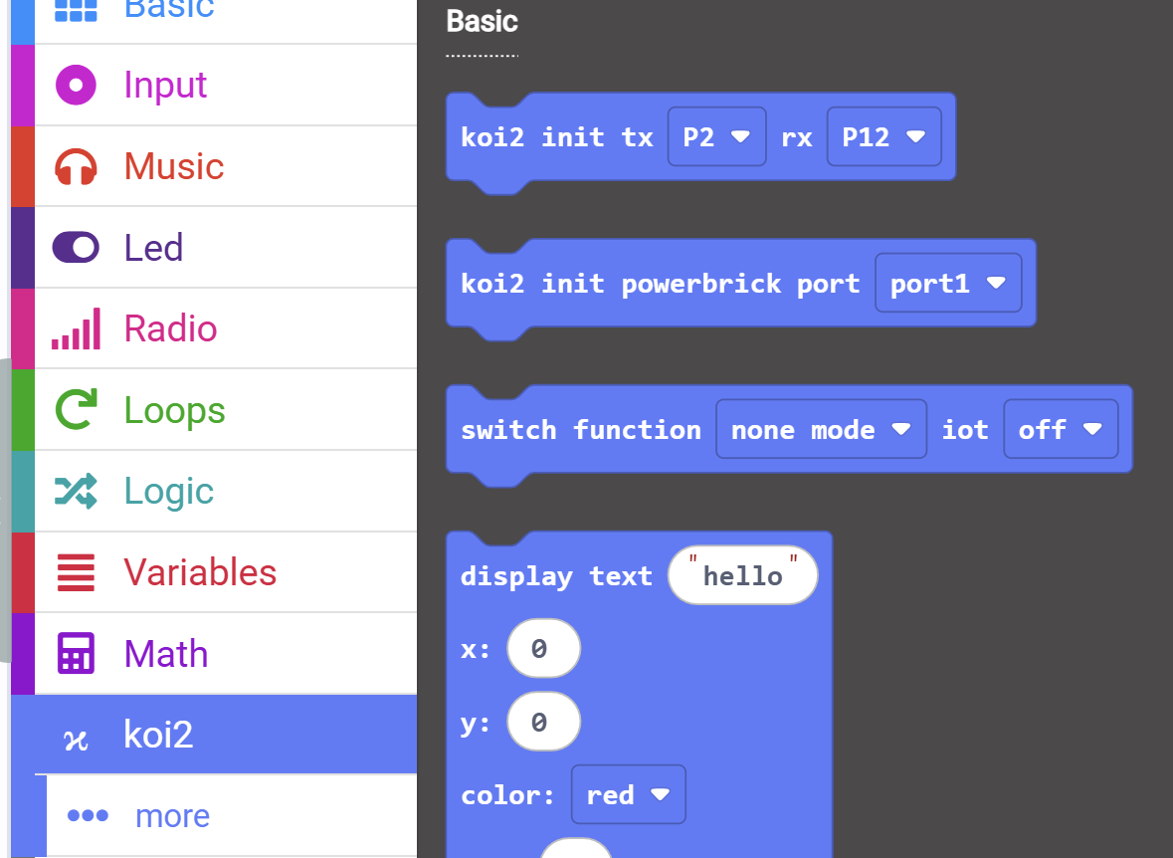
Initialize the Model Training
4
Open the koi2 tab and find “koi2 init tx P2 rx P12” and “switch function none mode iot off” blocks.
© TURNED-E! Education Limited 育教創科有限公司 2025

Slide 13
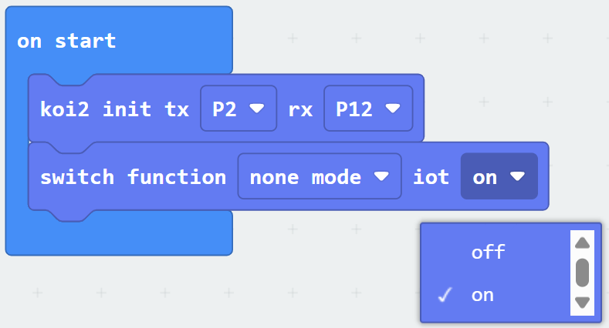
Initialize the Model Training
5
Drag them to on start block, and replace the “ iot off” with “iot on”.
We don’t need to change the function mode.
© TURNED-E! Education Limited 育教創科有限公司 2025

Slide 14
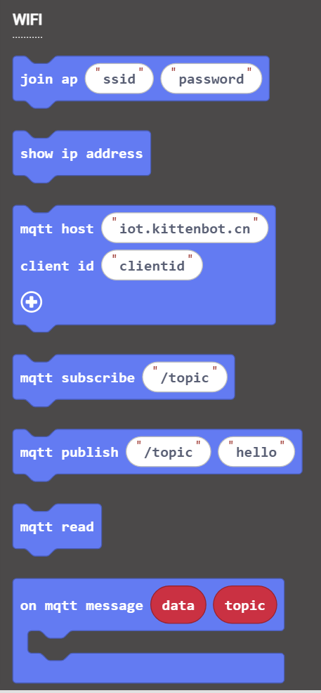
Classify image
6
Open the KOI2 tab and find the “WIFI” part.
We need the first two one to connect the Wi-Fi and show the IP information.
© TURNED-E! Education Limited 育教創科有限公司 2025

Slide 15
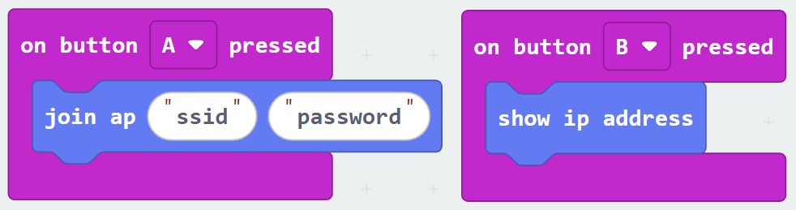
Model Training
7
Drag “join ap ssid password” and “show ip address” blocks to “on button pressed” block.
ssid refers the name of Wi-Fi. We can connect the Wi-Fi with this block.
© TURNED-E! Education Limited 育教創科有限公司 2025

Slide 16
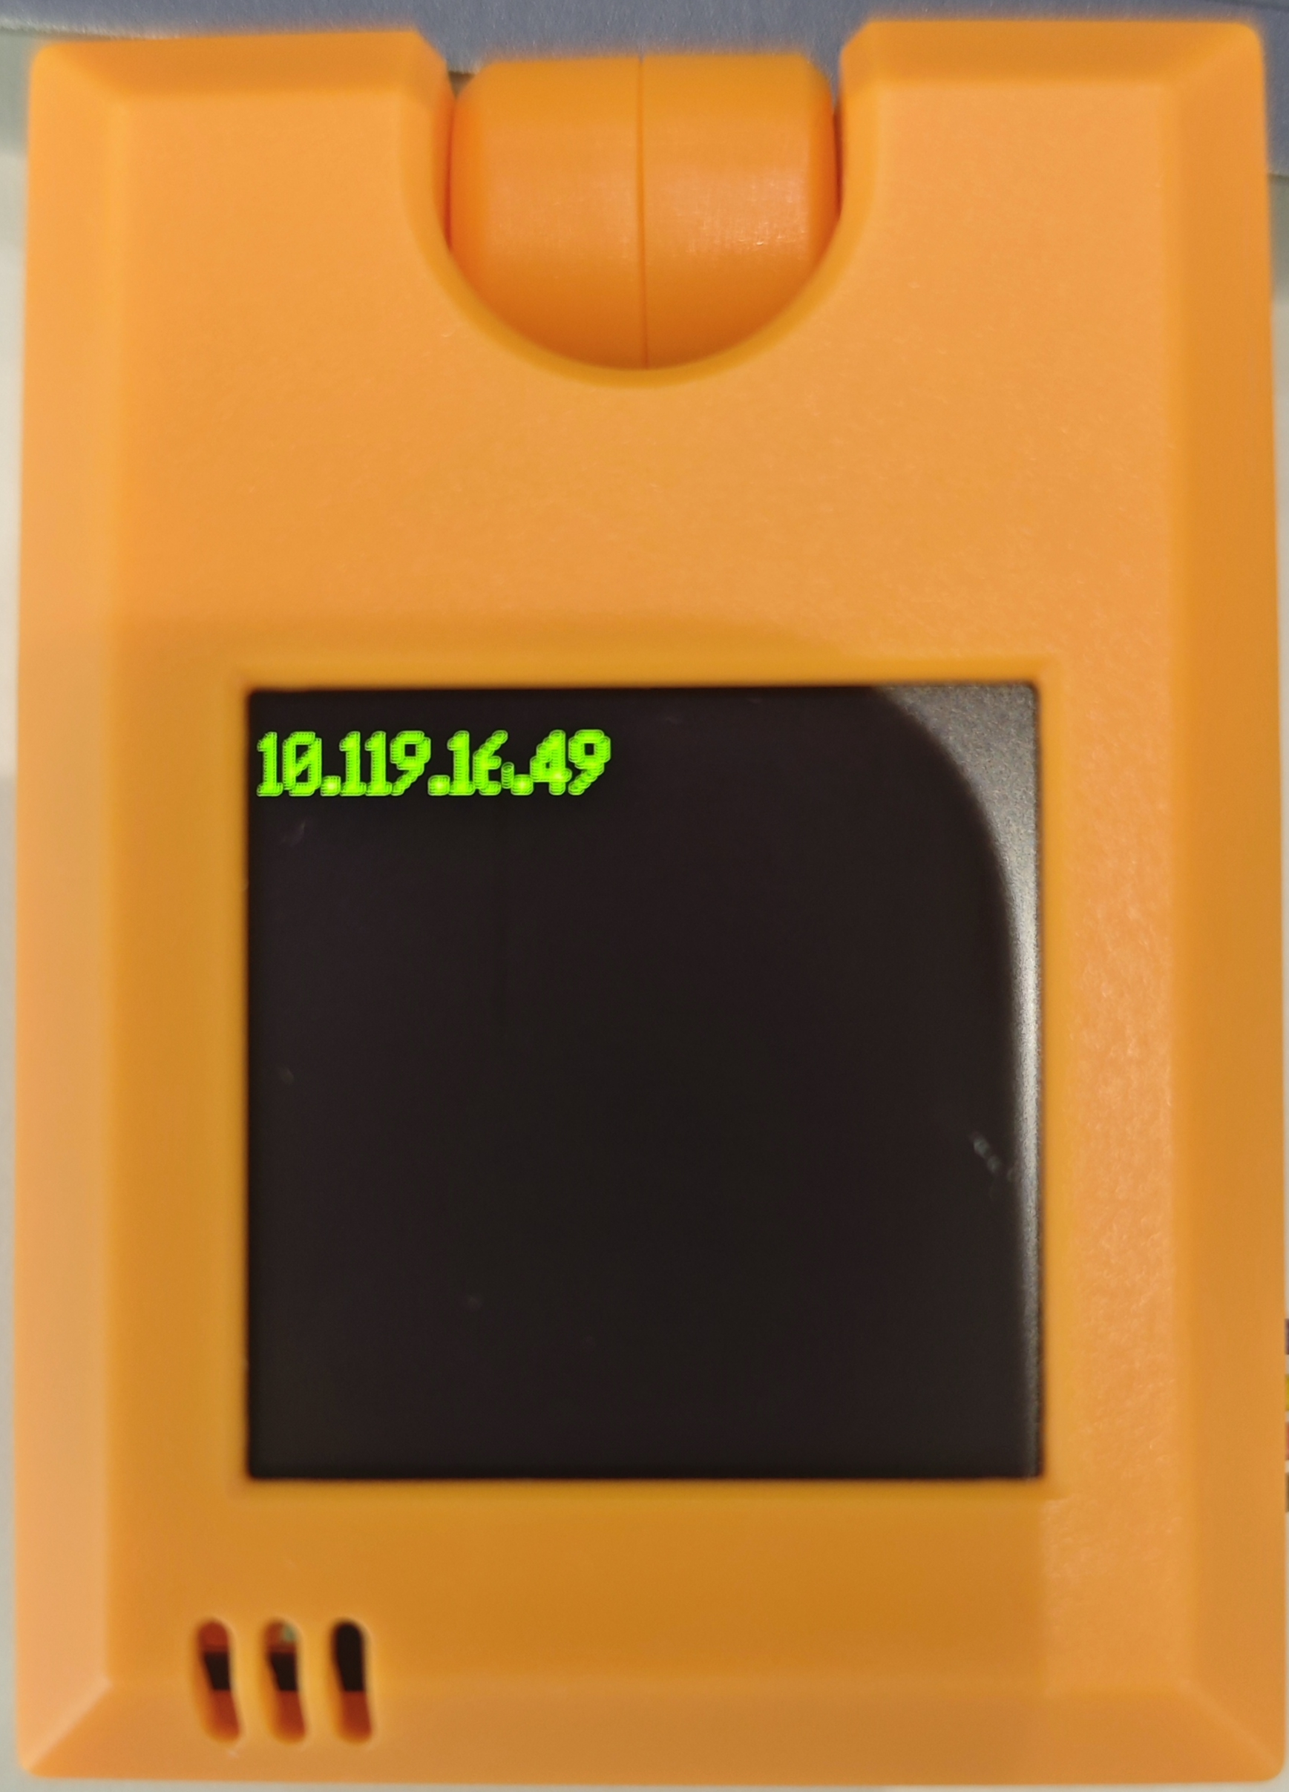
Model Training
8
The IP address would be showed after connection.
Ensure that the KOI2 is connected to the internet before using the IoT platform.
© TURNED-E! Education Limited 育教創科有限公司 2025

Slide 17

IoT, Thing Speak and MQTT
© TURNED-E! Education Limited 育教創科有限公司 2025

Slide 18
What is IoT
The Internet of Things (IoT) is a global network of physical objects—"things"—embedded with sensors, software, and other technologies to collect and exchange data with other devices and systems over the internet.
© TURNED-E! Education Limited 育教創科有限公司 2025

Slide 19

ThingSpeak platform
ThingSpeak is an online data collection platform that help us collect data derived from sensors.
Access the website: https://thingspeak.mathworks.com/ , and click “Get Started For Free” button to start.
1
© TURNED-E! Education Limited 育教創科有限公司 2025

Slide 20
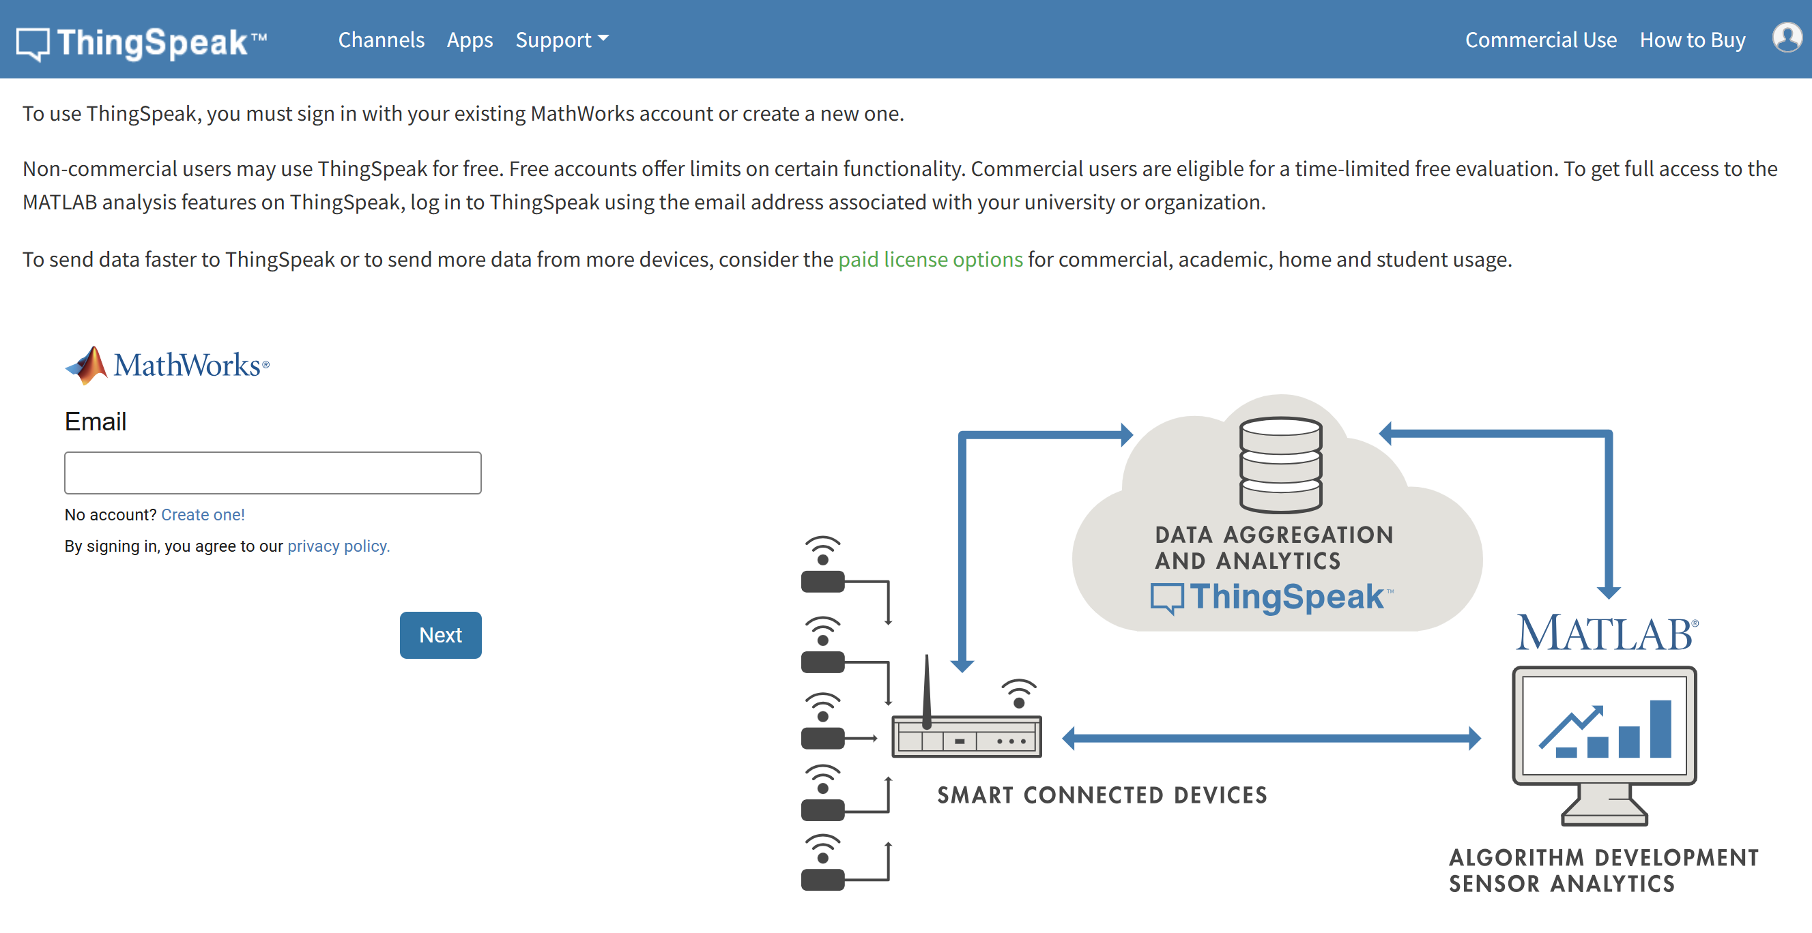
ThingSpeak platform
Use your student email to start using it.
Click Next and fulfill the password.
2
© TURNED-E! Education Limited 育教創科有限公司 2025

Slide 21
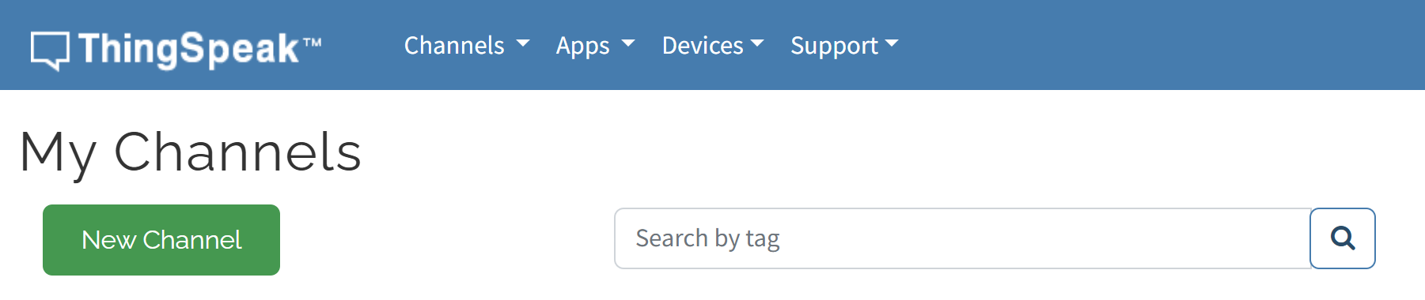
ThingSpeak Channels
3
After logging in, you will see My Channels and click the “New Channel” button.
© TURNED-E! Education Limited 育教創科有限公司 2025

Slide 22
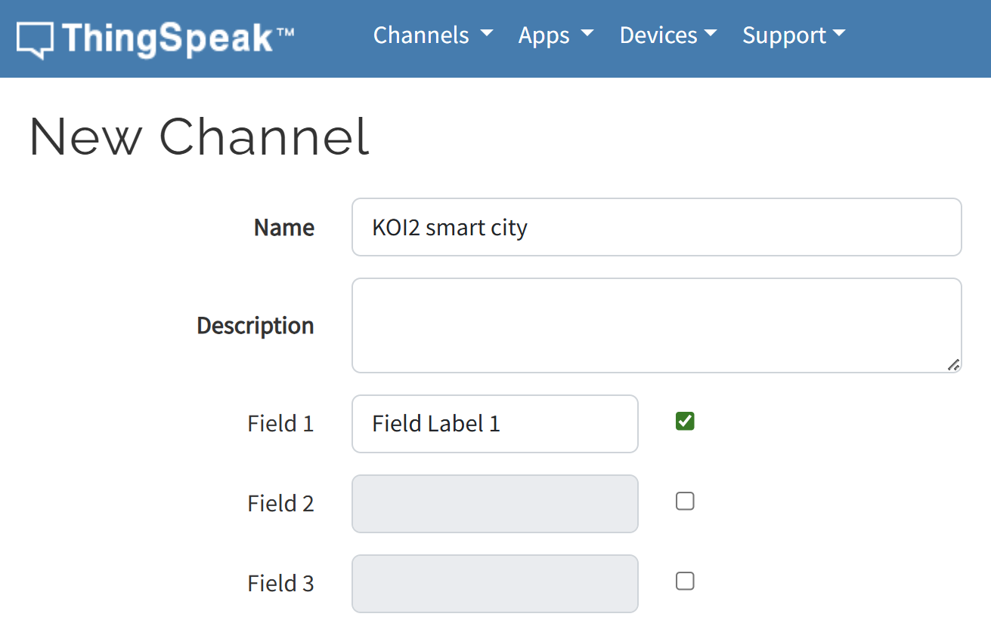
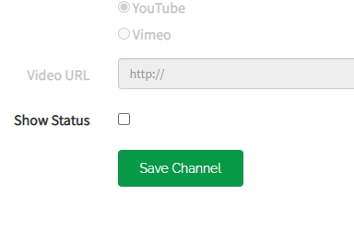
ThingSpeak Channels
We can change other information after create the channel, so we just need to fulfill the name.
Screw down and save the channel
4
© TURNED-E! Education Limited 育教創科有限公司 2025

Slide 23
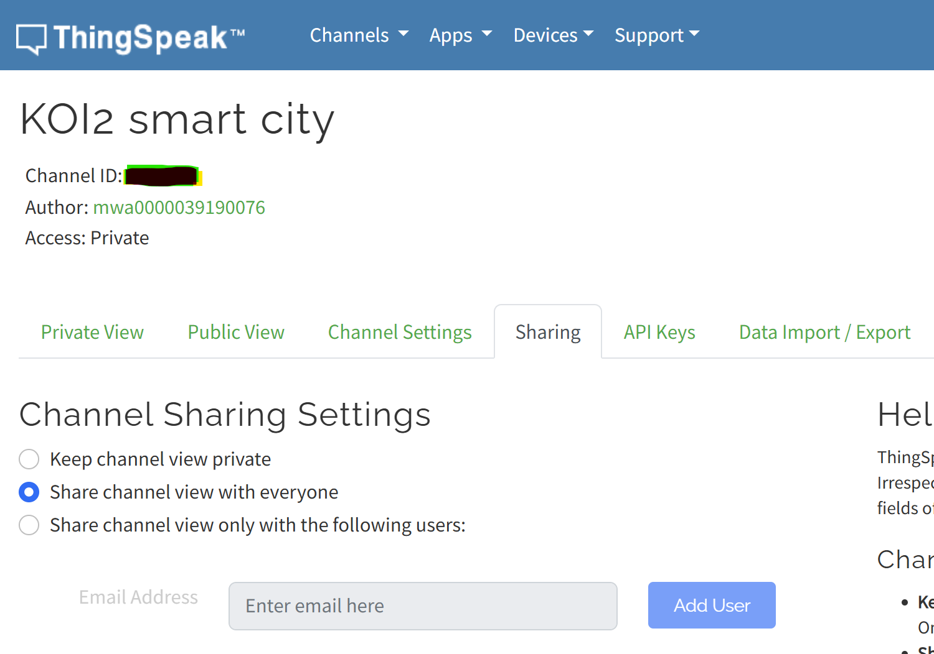
ThingSpeak Channels
5
Enter the Sharing tab and change the Sharing Setting from private to “with everyone”
6
© TURNED-E! Education Limited 育教創科有限公司 2025

Slide 24
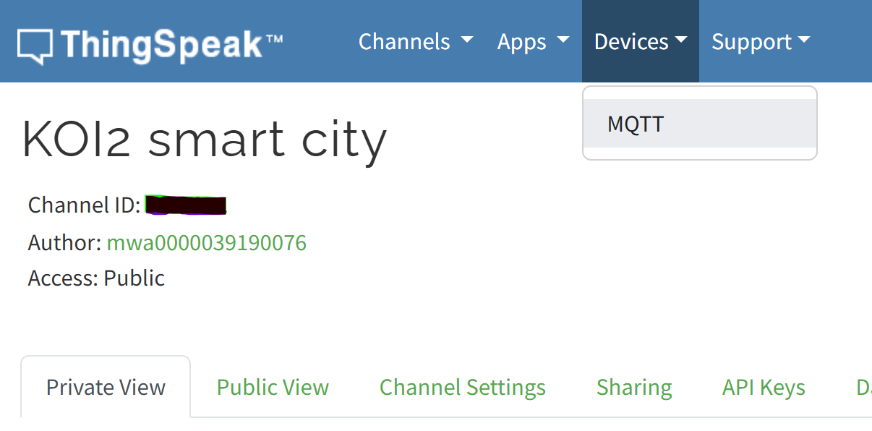
MQTT Accession
8
Make Sure the Access situation is “Public”, click the Devices at the top bar and click the “MQTT”
7
© TURNED-E! Education Limited 育教創科有限公司 2025

Slide 25
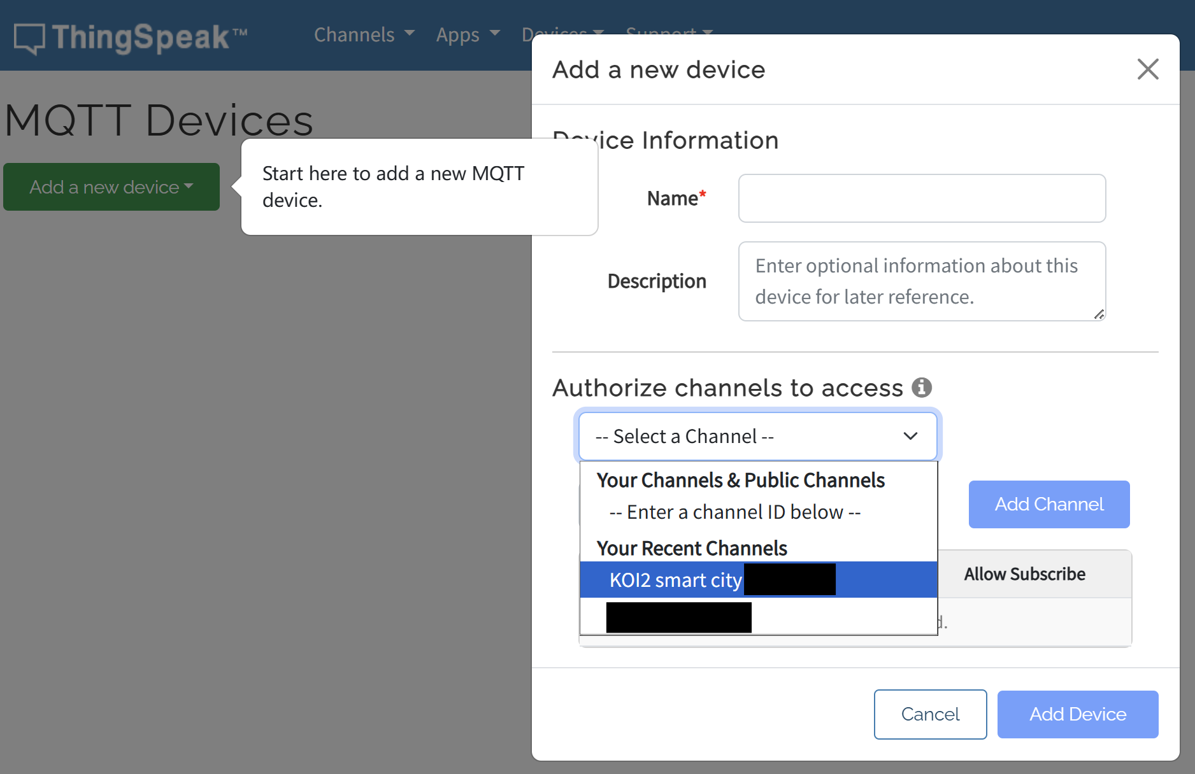
MQTT Accession
Click “Add a new device” button and select the “KOI2 smart city” channel we just created.
9
10
© TURNED-E! Education Limited 育教創科有限公司 2025

Slide 26
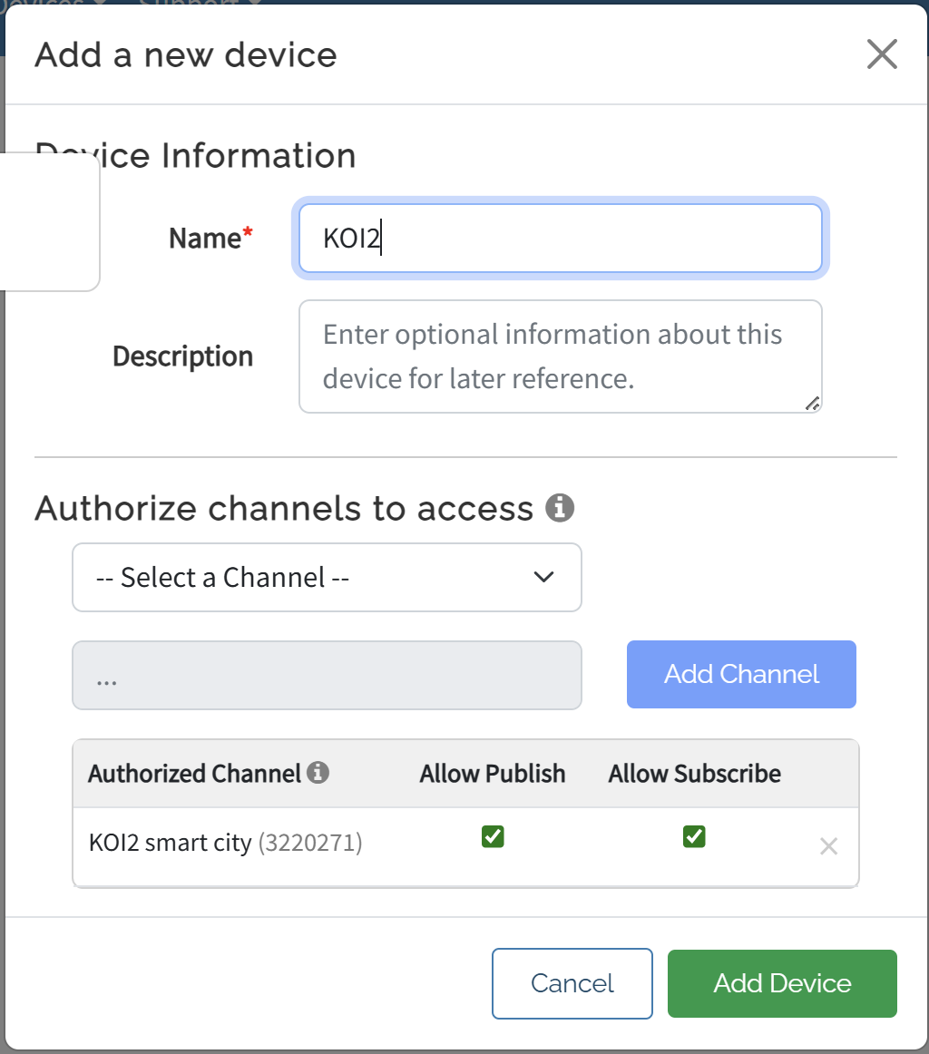
MQTT Accession
12
Click “Add Channel” button and fulfill the name “KOI2”.
Click “Add Device” at last
11
© TURNED-E! Education Limited 育教創科有限公司 2025

Slide 27
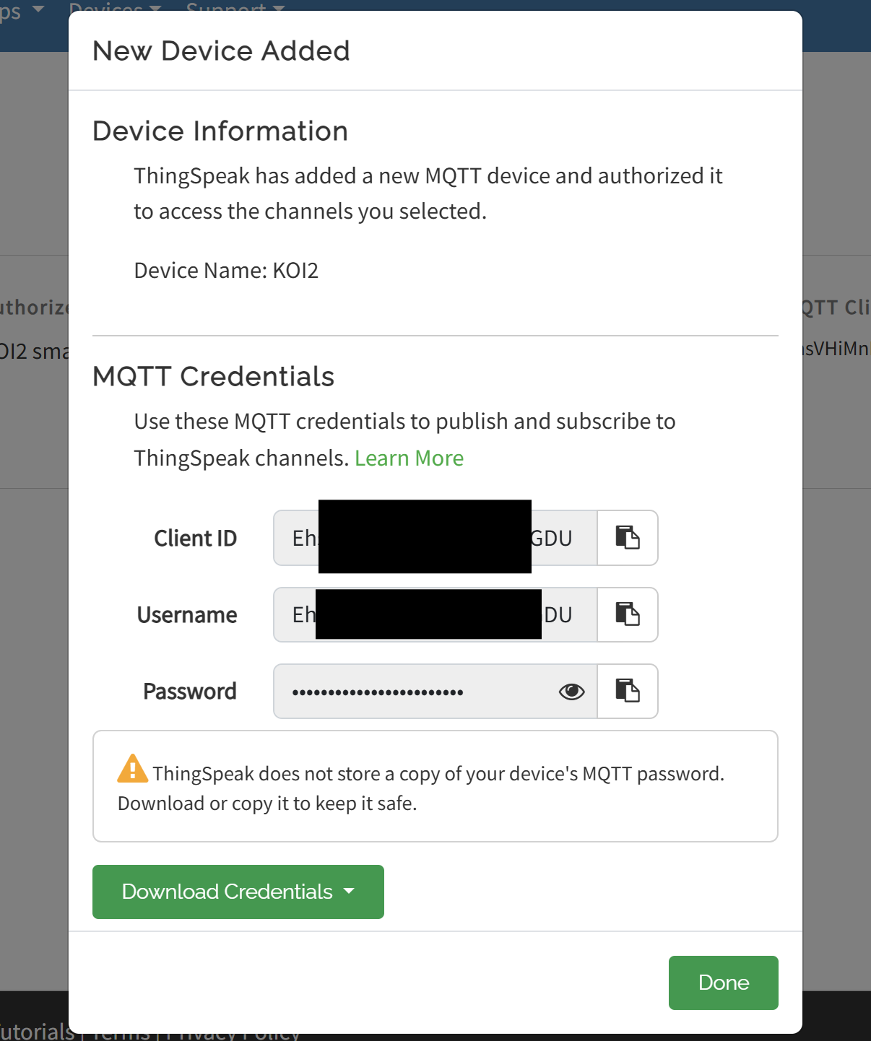
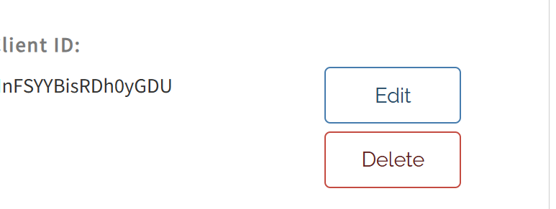
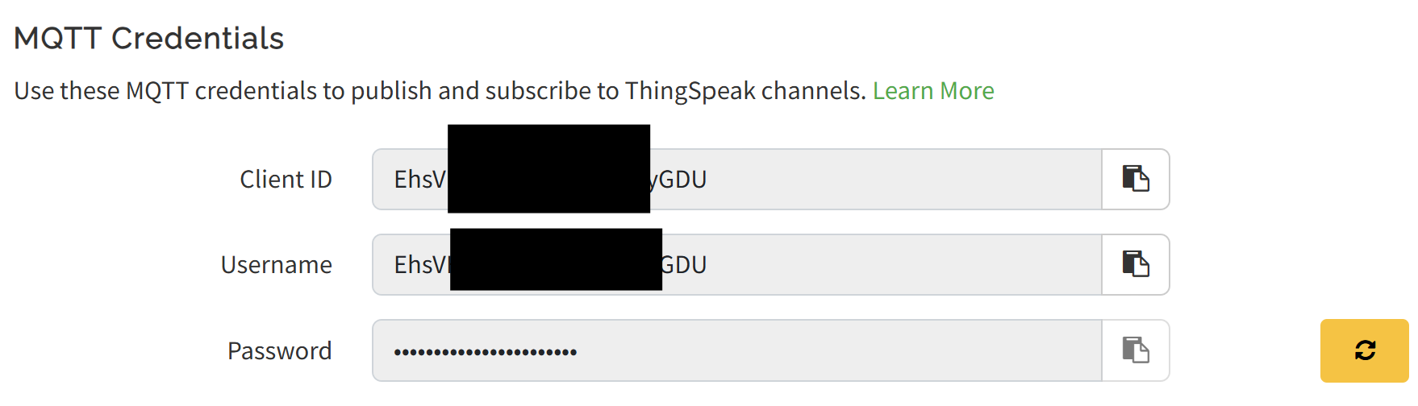
MQTT Connection
Remember the Client ID, “Username” and “Passowrd”, we will use it later. Or you can click the “Edit” button and see it again
13
14
15
© TURNED-E! Education Limited 育教創科有限公司 2025

Slide 28

KOI2 and MQTT message
© TURNED-E! Education Limited 育教創科有限公司 2025

Slide 29
KOI2 and MQTT Message
16
Open the KOI2 tab and find the “WIFI” part.
We need to connect the Wi-Fi and connect the mqtt platform.
© TURNED-E! Education Limited 育教創科有限公司 2025

Slide 30
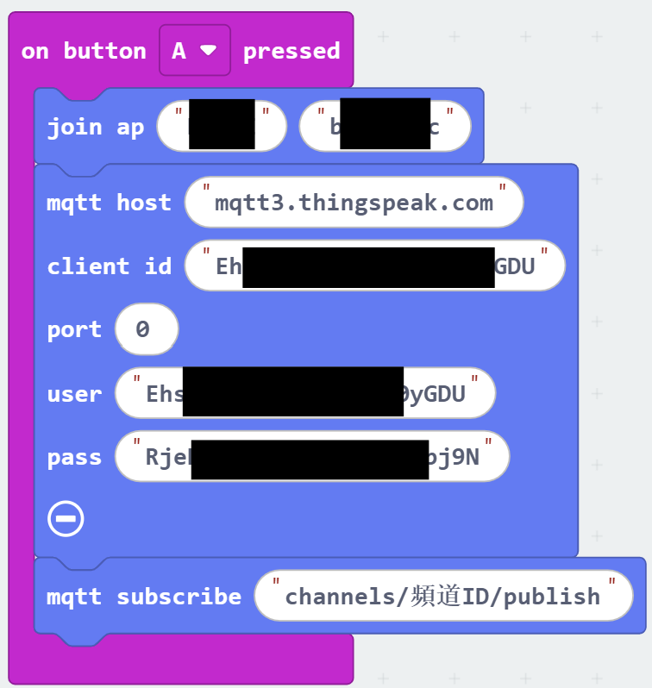
KOI2 and MQTT Message
17
Drag them to the “on Button A pressed” block, connect the Wi-Fi and MQTT platform.
The host is “mqtt3.thingspeak.com”
Client id, user and pass are the information we got from ThingSpeak (13,15 steps).
© TURNED-E! Education Limited 育教創科有限公司 2025

Slide 31
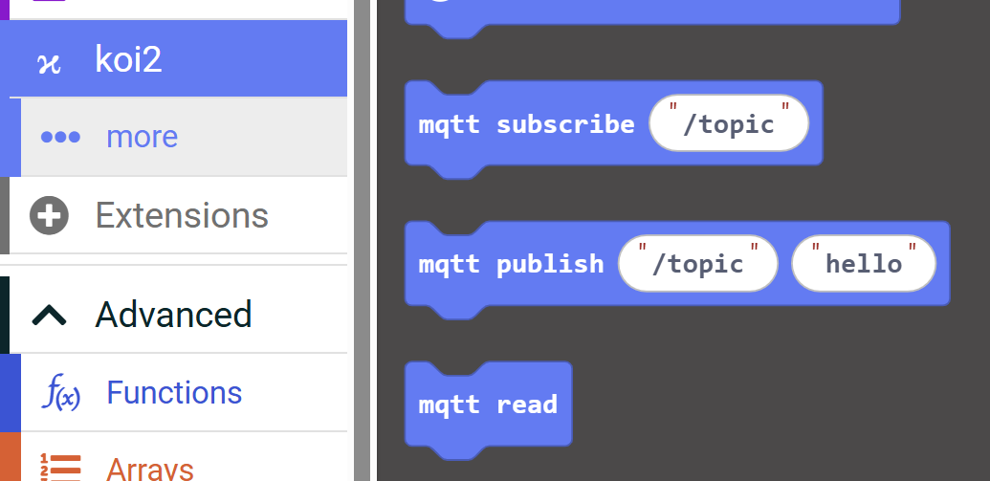
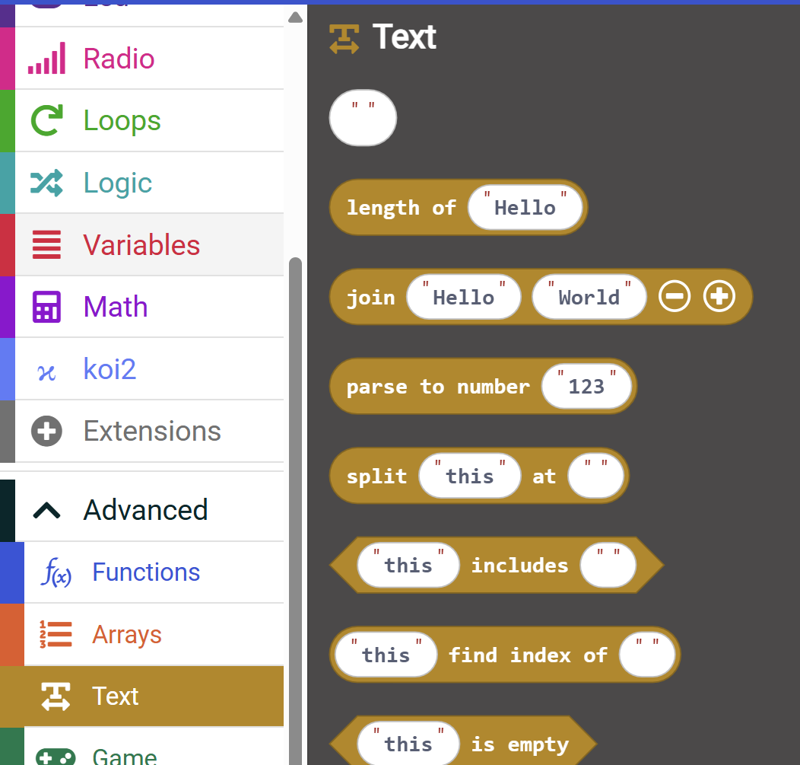
KOI2 and MQTT Message
18
19
Find “mqtt publish /topic hello” from the koi2 tab and “join Hello World” from the Text tab in advanced.
© TURNED-E! Education Limited 育教創科有限公司 2025

Slide 32
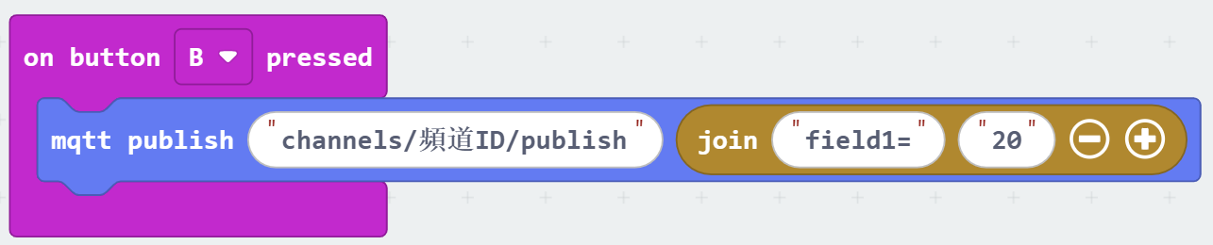
KOI2 and MQTT Message
20
Put them in the “on button B pressed” block, and the first space should be filled with “channels/channel ID/publish” the channel ID can be found at ThingSpeak Channel.
© TURNED-E! Education Limited 育教創科有限公司 2025

Slide 33
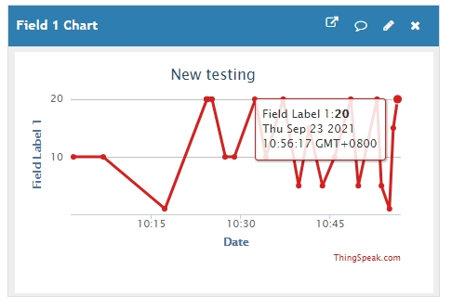
KOI2 and MQTT Message
21
You can also see the result at the index page of the Channel.
© TURNED-E! Education Limited 育教創科有限公司 2025

Slide 34

Smart Device: Pedestrian Counter
© TURNED-E! Education Limited 育教創科有限公司 2025

Slide 35
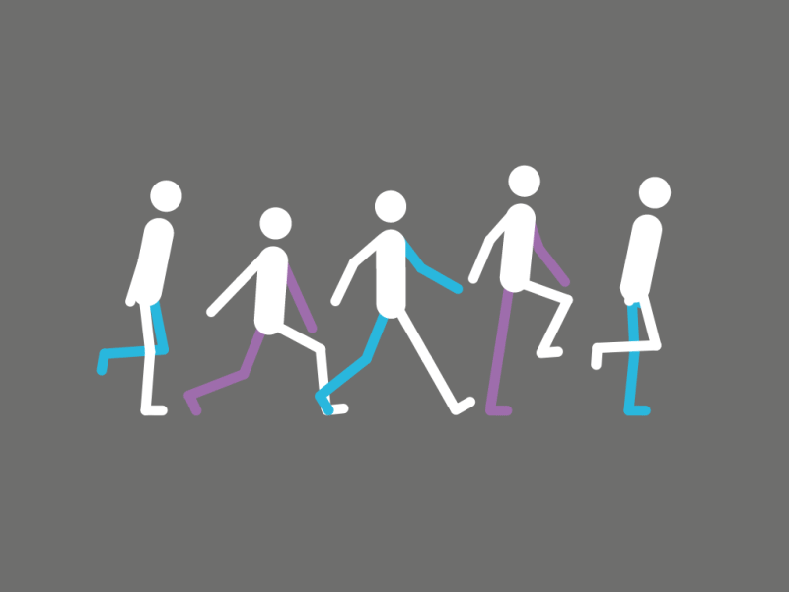
Pedestrian Counter
We can use micro:bit, KOI2 to make a pedestrian counter and send the data to the platrorm.
© TURNED-E! Education Limited 育教創科有限公司 2025

Slide 36

Function Analysis
Counter: When the KOI2 sees a people, the counts would add one automatically.
IoT: The IoT platform should be connected at the start, and it should send the data to the ThingSpeak platform as the counts changed.
© TURNED-E! Education Limited 育教創科有限公司 2025

Slide 37
Practice Task
When the KOI2 finds a person, send the counts to ThingSpeak MQTT platform.
© TURNED-E! Education Limited 育教創科有限公司 2025

Slide 38
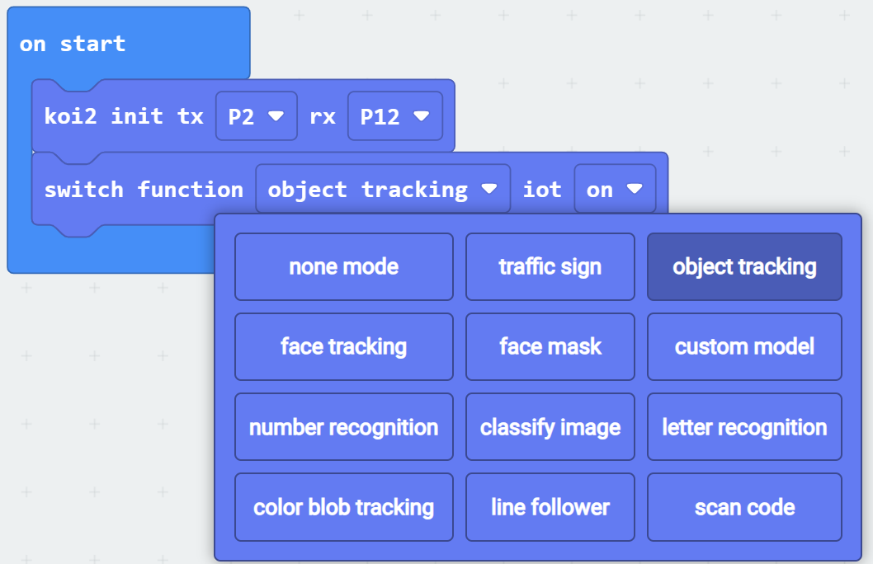
Initialize the Pedestrian Counter Function
Drag “koi2 init tx P2 rx P12” and “switch function none mode iot off” blocks to on start block.
Change the “none mode” to “object tracking”, iot “off” to iot ”on”.
1
© TURNED-E! Education Limited 育教創科有限公司 2025

Slide 39
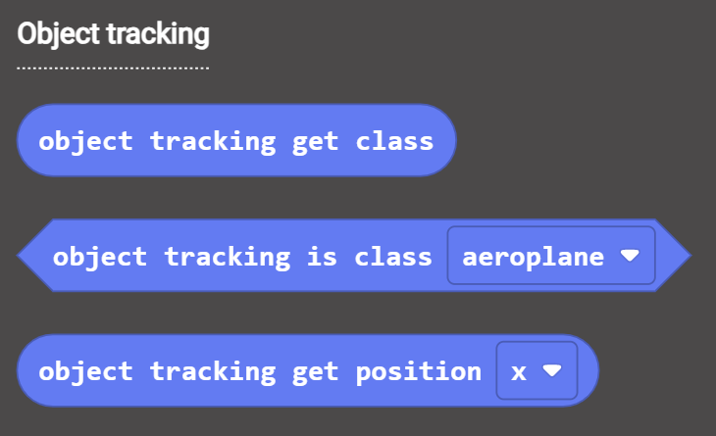
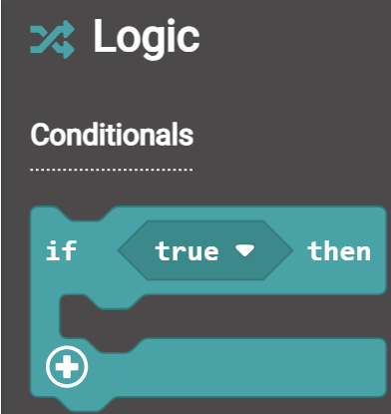
Counter Function
2
We need to use the KOI2 recognize the person and counts.
Open the KOI2 tab and find the “Object tracking” part, we need the Boolean block “object tracking is class aeroplane”
Open the Logic tab and find the first conditionals block.
© TURNED-E! Education Limited 育教創科有限公司 2025

Slide 40
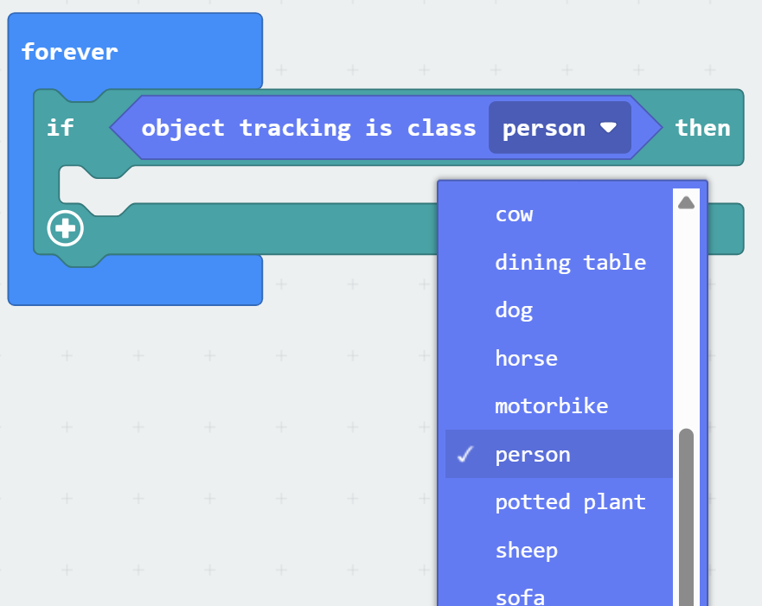
Counter Function
Drag the two blocks to “forever” block, and replace the “aeroplane” with “person”
3
© TURNED-E! Education Limited 育教創科有限公司 2025

Slide 41
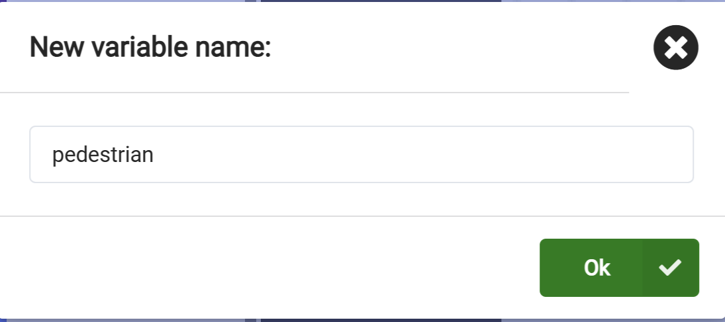
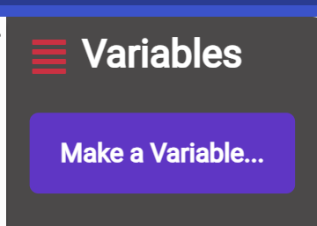
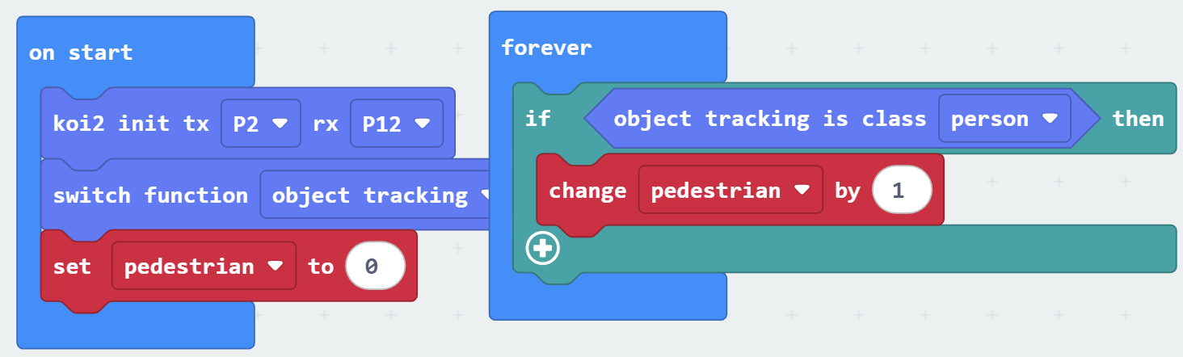
Counter Function
4
Open the “Variables” tab and make a new variable, names pedestrian.
Drag the “set pedestrian to 0” to on start block and “change pedestrian by 1” inside the Conditional block
5
© TURNED-E! Education Limited 育教創科有限公司 2025

Slide 42
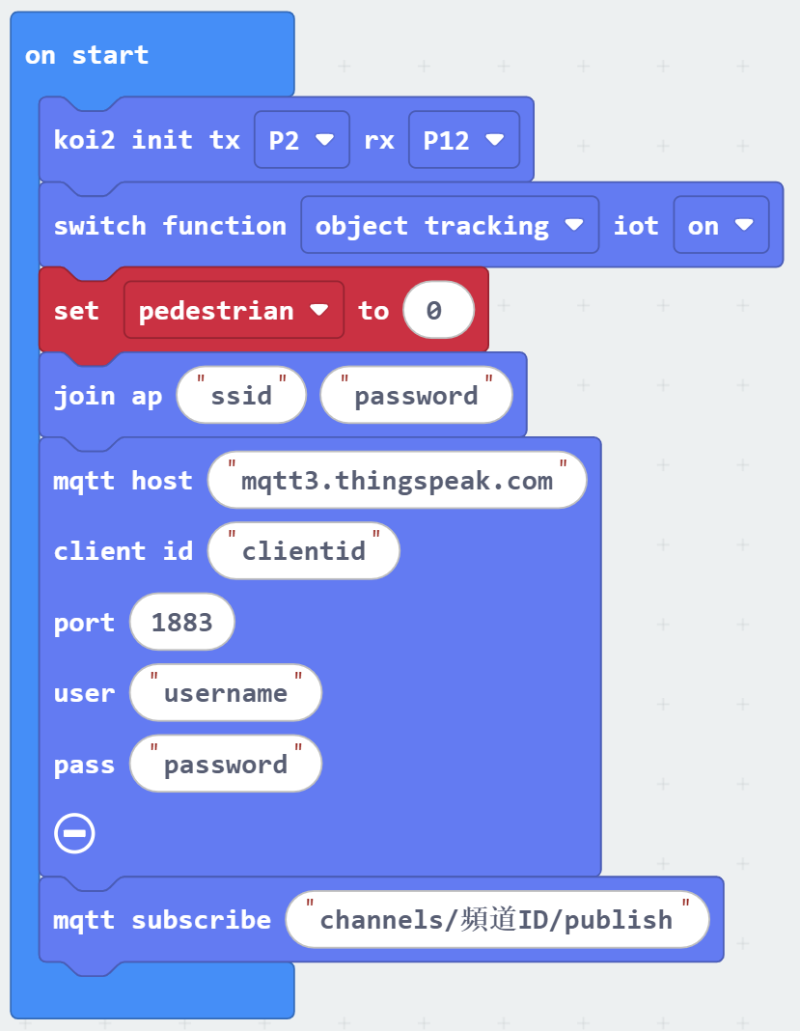
MQTT Message
6
7
Open the KOI2 tab and find the “WIFI” part.
Drag them to “on start” block, We need to connect the Wi-Fi and connect the mqtt platform, the information can be found at ThingSpeak platform.
5
© TURNED-E! Education Limited 育教創科有限公司 2025

Slide 43
KOI2 and MQTT Message
8
9
Find “mqtt publish /topic hello” from the koi2 tab and “join Hello World” from the Text tab in advanced.
© TURNED-E! Education Limited 育教創科有限公司 2025

Slide 44
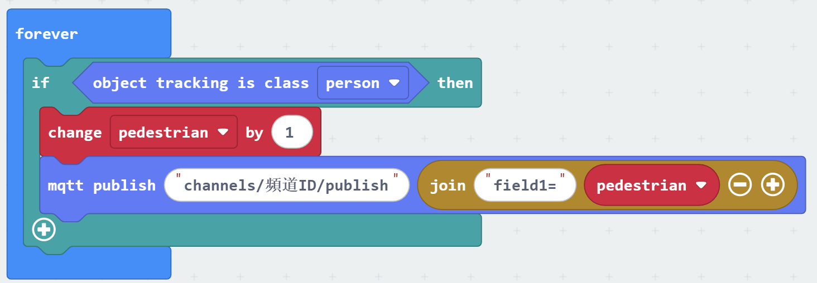
KOI2 and MQTT Message
10
Put them in the “forever” block, and follows the “change pedestrian by 1” block.
Replace the second space with the variability “pedestrian”.
© TURNED-E! Education Limited 育教創科有限公司 2025

Slide 45
KOI2 and MQTT Message
10
The first space should be filled with “channels/channel ID/publish”, and the channel ID can be found at your ThingSpeak Channel.
© TURNED-E! Education Limited 育教創科有限公司 2025

Slide 46
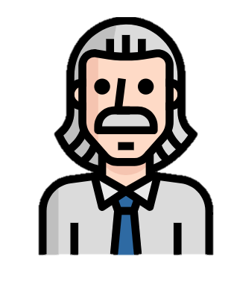
Free Creating Time
© TURNED-E! Education Limited 育教創科有限公司 2025

Slide 47
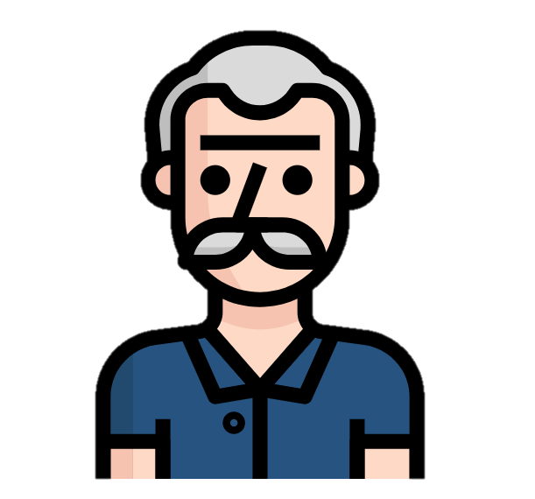
Summarize
© TURNED-E! Education Limited 育教創科有限公司 2025

