Slide 1



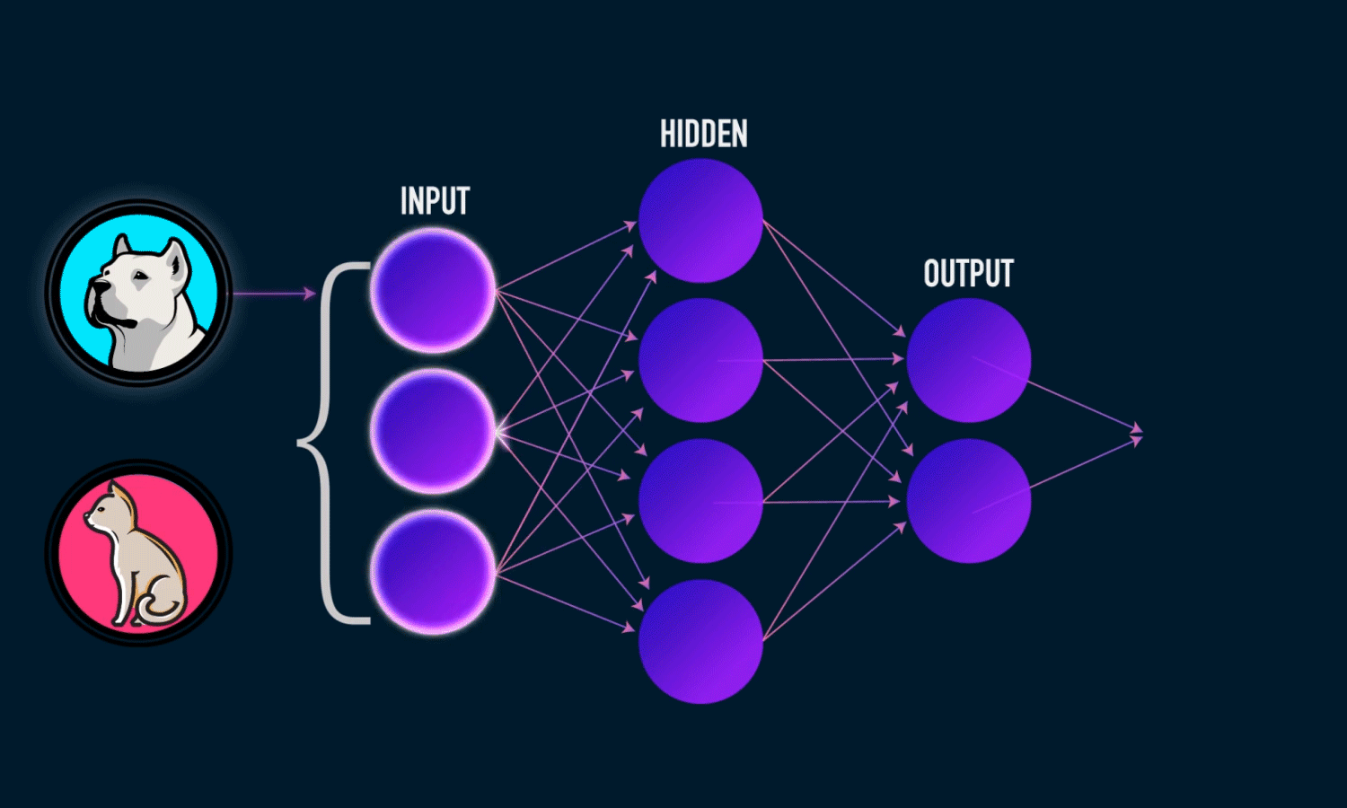
© TURNED-E! Education Limited 育教創科有限公司 2025
KOI2 AI Lens smart city
Lesson 6：Custom Item Recognition Training

Slide 2


© TURNED-E! Education Limited 育教創科有限公司 2025
Agenda
Reviewing time
Machine Learning
Learning Process
KOI2 Training Program
Model Testing

Slide 3




Rules
請尊重你的同學和導師
Be respectful.
Respect your classmates and teacher.
請正確使用器材
Use equipment
only for class activities.
盡情享受課堂樂趣吧！
Be creative, active
and have fun!
© TURNED-E! Education Limited 育教創科有限公司 2025

Slide 4

Revision
© TURNED-E! Education Limited 育教創科有限公司 2025

Slide 5

Number Recognition
We used KOI2 to recognize numbers and display on the micro:bit.
© TURNED-E! Education Limited 育教創科有限公司 2025

Slide 6

Item Recognition
We also used item tracing to recognize different objects, like cars, aero planes, cats, chairs and so on.
© TURNED-E! Education Limited 育教創科有限公司 2025

Slide 7
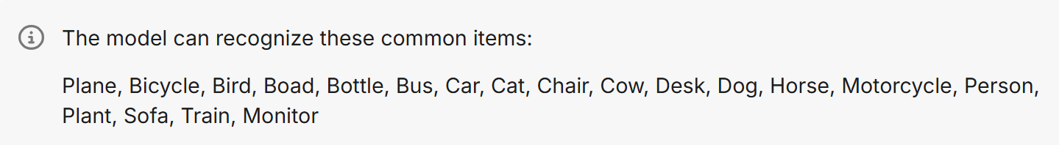
Item Recognition
KOI2 can identify: Plane, Bicycle, Bird, Boad, Bottle, Bus, Car, Cat, Chair, Cow, Desk, Dog, Horse, Motorcycle, Person, Plant, Sofa, Train, Monitor.
But there are still many items it can not recognize, so we need to train the model ourselves.
© TURNED-E! Education Limited 育教創科有限公司 2025

Slide 8

Machine Learning
© TURNED-E! Education Limited 育教創科有限公司 2025

Slide 9

What is Machine Learning
Machine learning (ML) is a branch of artificial intelligence (AI) that enables computers to learn from data, identify patterns, and make decisions or predictions with minimal human programming.
© TURNED-E! Education Limited 育教創科有限公司 2025

Slide 10


Applications of Machine Learning
Recommendation Systems: Suggesting products on Amazon or movies on YouTube.
Computer Vision: Facial recognition, medical image analysis, autonomous vehicles.
Natural Language Processing (NLP): Language translation, chatbots, sentiment analysis.
Finance: Fraud detection, stock market prediction
© TURNED-E! Education Limited 育教創科有限公司 2025

Slide 11

Learning Process
© TURNED-E! Education Limited 育教創科有限公司 2025

Slide 12
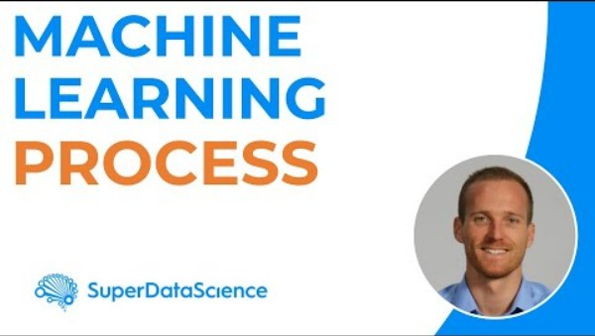
What is Learning Process
© TURNED-E! Education Limited 育教創科有限公司 2025

Slide 13
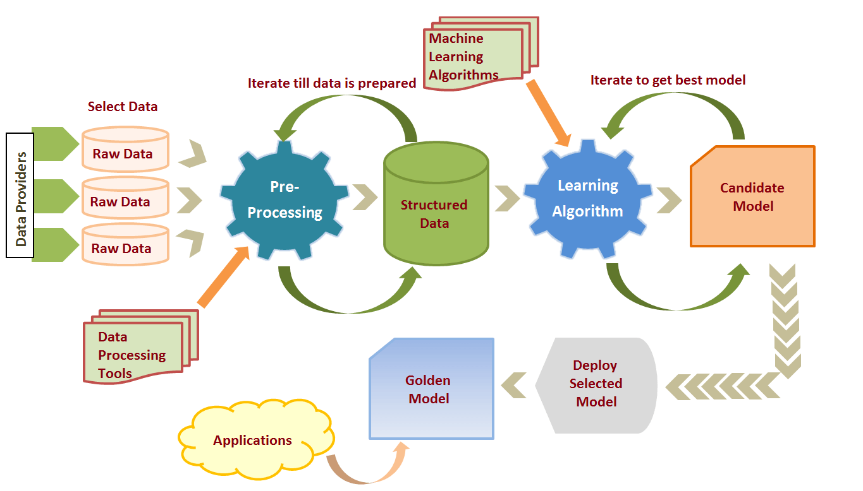
What is Learning Process
Overall, the process is divided into three main stages: data processing, model training, and result evaluation, each of which is crucial.
© TURNED-E! Education Limited 育教創科有限公司 2025

Slide 14
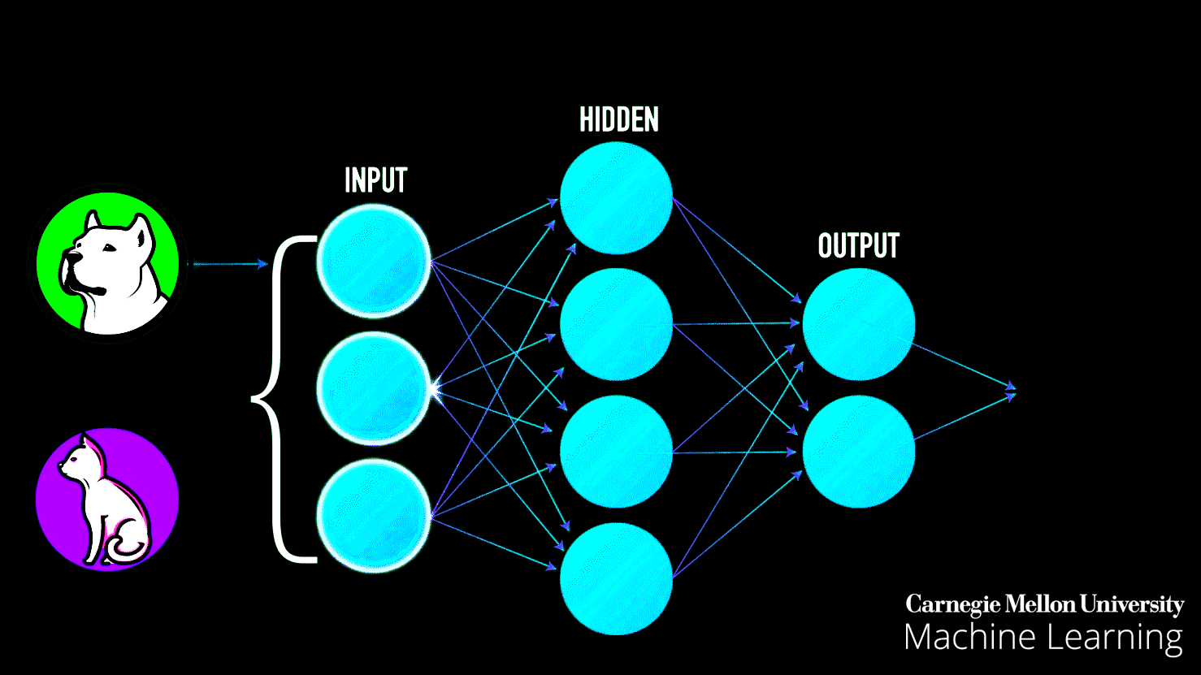
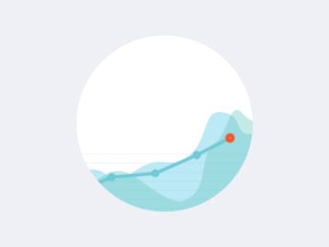
What is Learning Process
KOI2 already has relatively mature model algorithms, so our task is to collect the data and train the model.
© TURNED-E! Education Limited 育教創科有限公司 2025

Slide 15

KOI2 Training Program
© TURNED-E! Education Limited 育教創科有限公司 2025

Slide 16




Task Description
We hope that KOI2 can recognize different genders.
Man
Woman
© TURNED-E! Education Limited 育教創科有限公司 2025

Slide 17
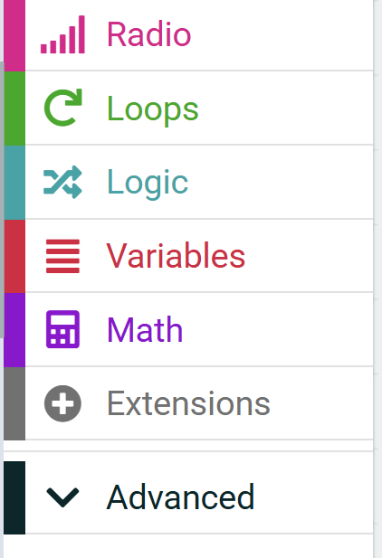
Use KOI2 in MakeCode
Open the extension tab in MakeCode.
1
© TURNED-E! Education Limited 育教創科有限公司 2025

Slide 18
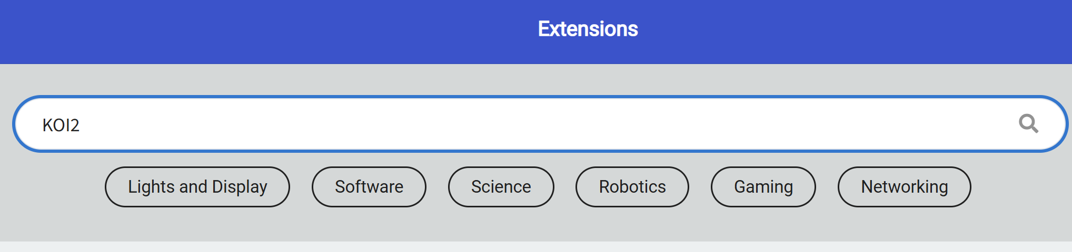
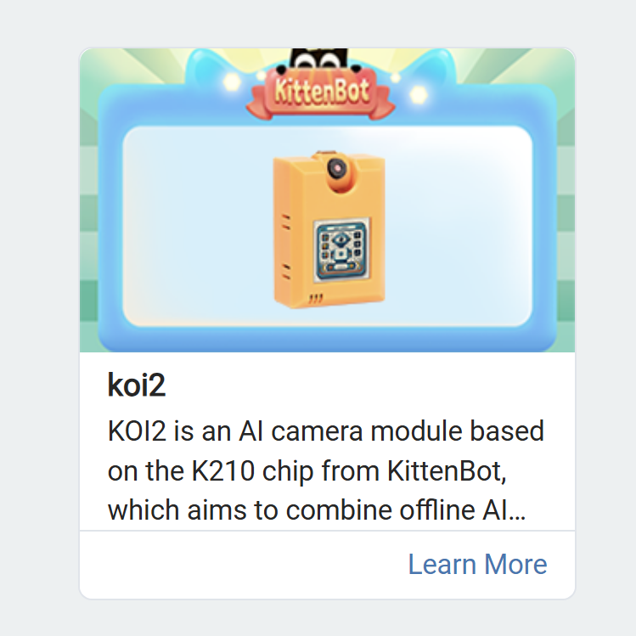
Use KOI2 in MakeCode
2
3
Search for KOI2 in the search bar, and select KOI2 extension
© TURNED-E! Education Limited 育教創科有限公司 2025

Slide 19
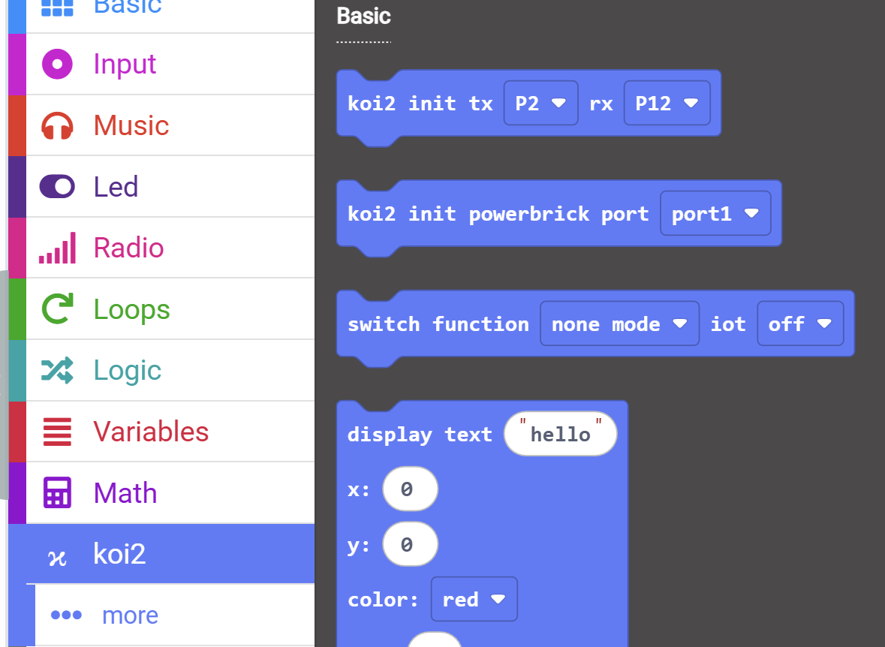
Initialize the Model Training
4
Open the koi2 tab and find “koi2 init tx P2 rx P12” and “switch function none mode iot off” blocks.
© TURNED-E! Education Limited 育教創科有限公司 2025

Slide 20
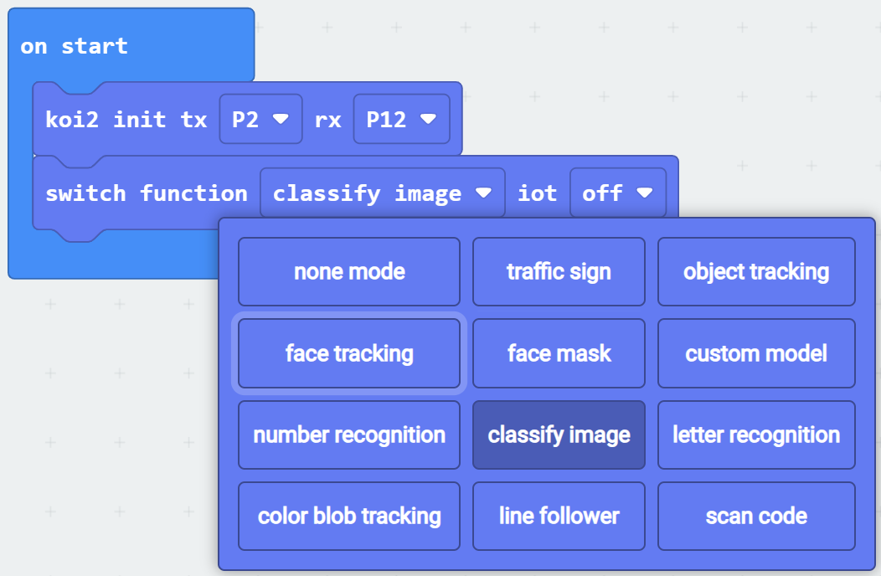
Initialize the Model Training
Drag them to on start block, and replace the “none mode” with “classify image”
5
© TURNED-E! Education Limited 育教創科有限公司 2025

Slide 21
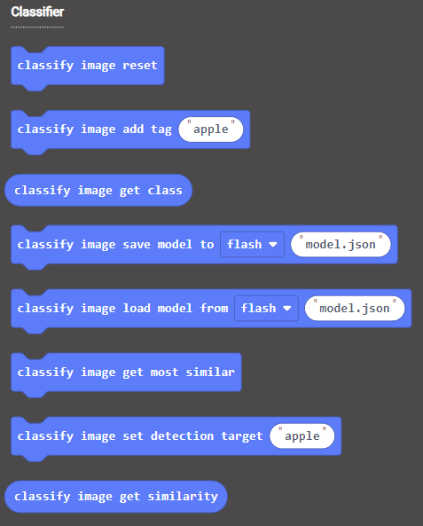
Classify image
6
Open the KOI2 tab and find the “classifier” part.
We need the second one to classify.
© TURNED-E! Education Limited 育教創科有限公司 2025

Slide 22
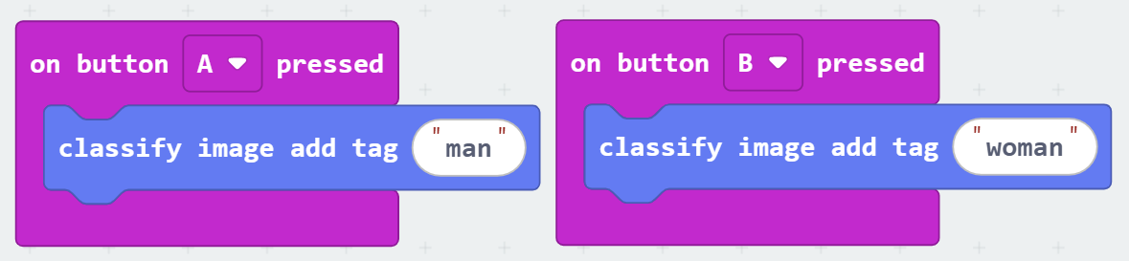
Model Training
7
Drag two of the “classify image add tag” blocks to “on button pressed” block.
After pressed the button, the KOI2 would learn the picture and identify man and woman.
© TURNED-E! Education Limited 育教創科有限公司 2025

Slide 23
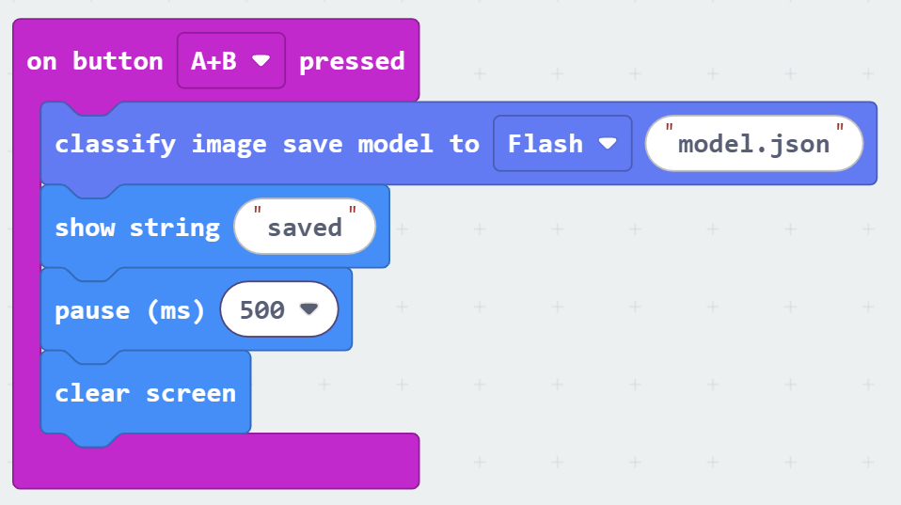
Model Training
9
Drag it into the “on button A+B pressed” block.
Some addition displays would help us understand whether the model is saved successfully.
© TURNED-E! Education Limited 育教創科有限公司 2025

Slide 24
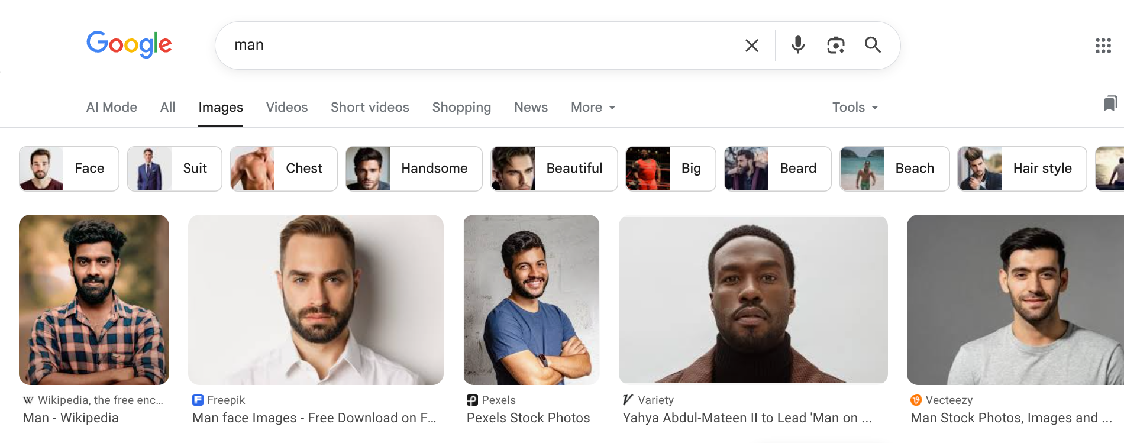
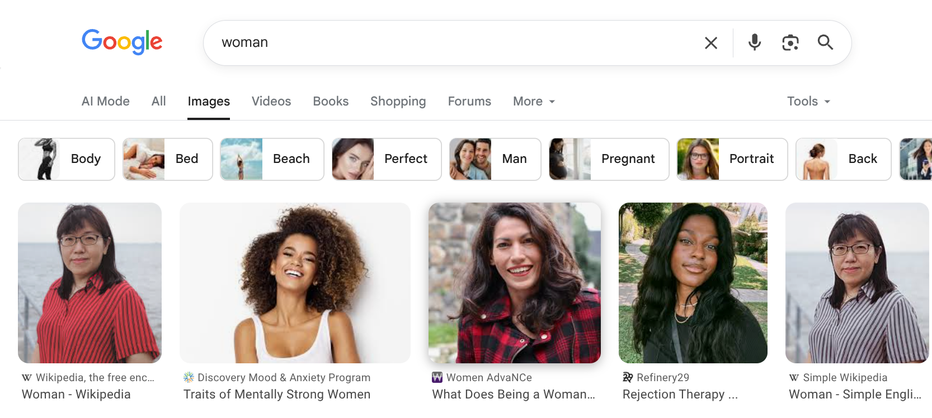
Model Training
10
Search for images of men and women separately on Google.
© TURNED-E! Education Limited 育教創科有限公司 2025

Slide 25
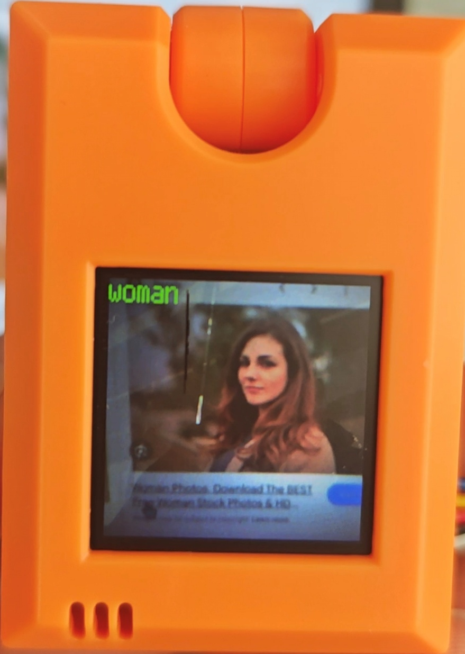
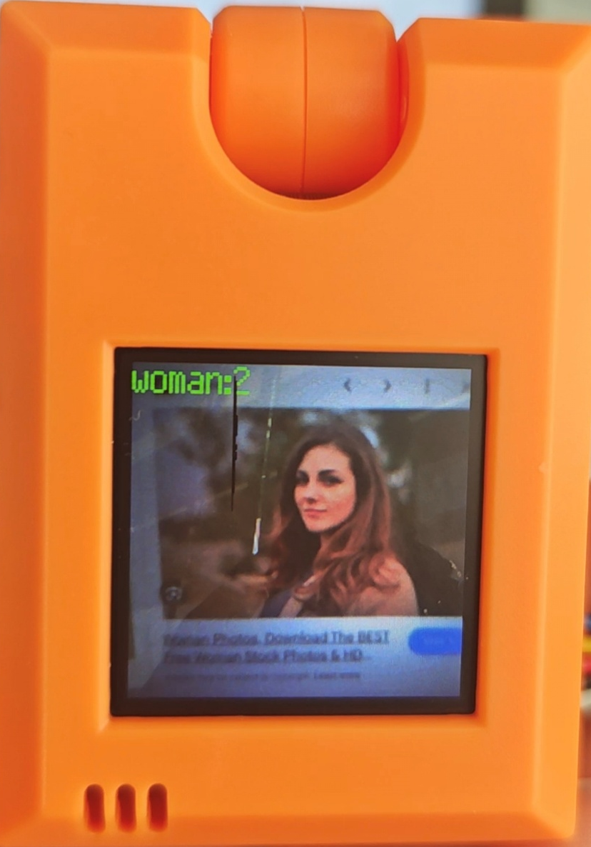
Model Training
11
Press the B button a and take a shoot, you may see a “woman” and “woman:2” shown at the top left conner, the “2” means it’s the second picture added into the model.
KOI2 allows to save at top of 40 pictures, so we need to save at top of 20 pictures under each tag.
© TURNED-E! Education Limited 育教創科有限公司 2025

Slide 26
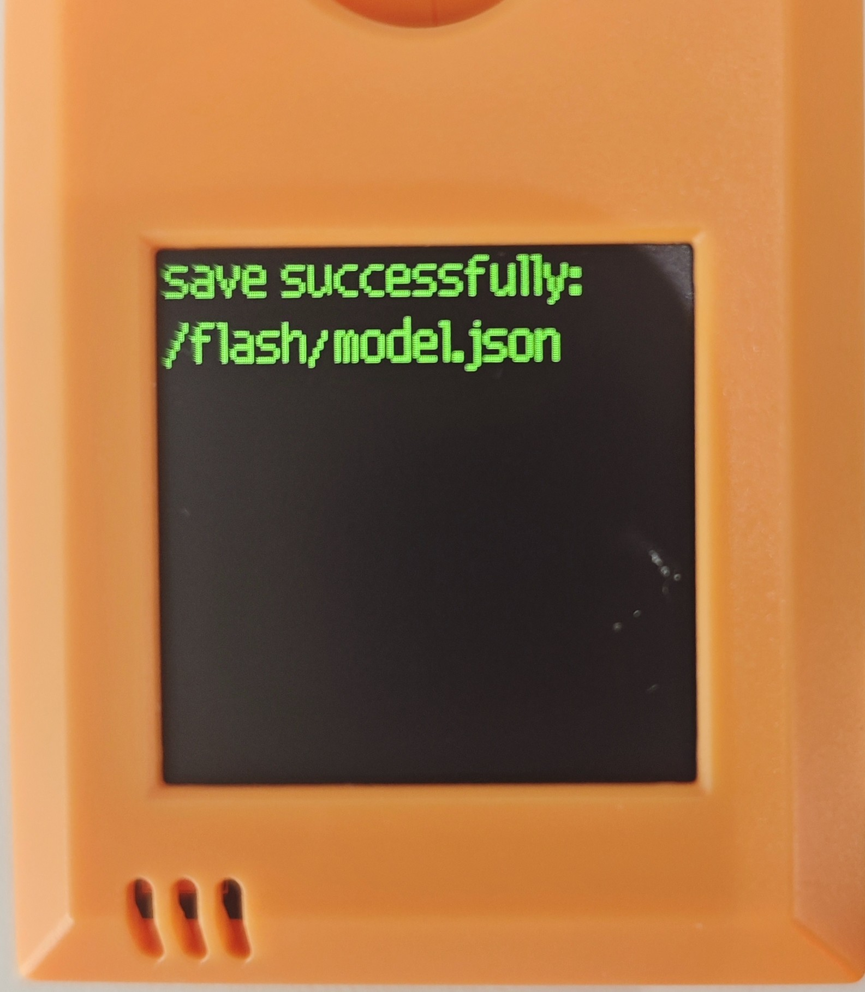
Classify image
12
After training and save the model (press A and B button at the same time), a notification would be displayed at the top left corner.
After that, we need to load the model and test it.
© TURNED-E! Education Limited 育教創科有限公司 2025

Slide 27

Model Testing
© TURNED-E! Education Limited 育教創科有限公司 2025

Slide 28
Lode the Model
1
We need the fifth and sixth blocks to load the model and get the result.
Two value blocks, ”classify image get class” and “classify image get similarity” are
© TURNED-E! Education Limited 育教創科有限公司 2025

Slide 29
Lode the Model
2
Drag the two “classify image load model from flash” and “classify image get most similar” blocks to “on button A pressed” block.
© TURNED-E! Education Limited 育教創科有限公司 2025

Slide 30
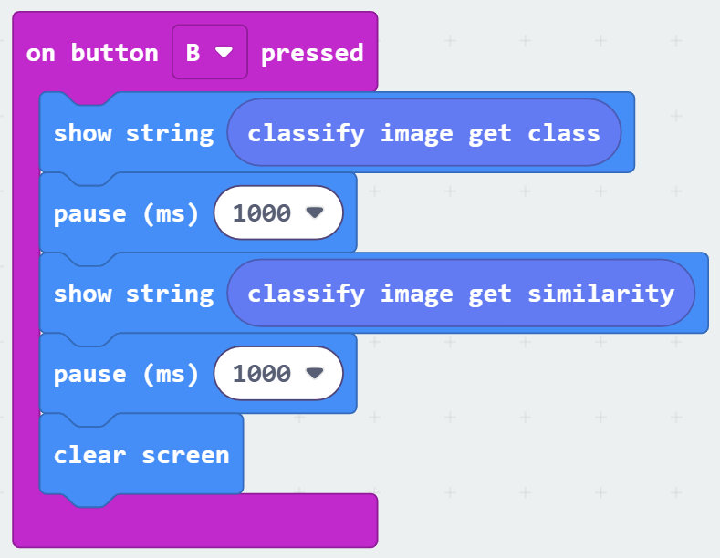
Lode the Model
3
We also need to show the class (tag) and the similarity.
The class (tag) would be shown as “man” or “woman”, and the “similarity” is a numerical value that represents the similarity between an image and a training result.
© TURNED-E! Education Limited 育教創科有限公司 2025

Slide 31
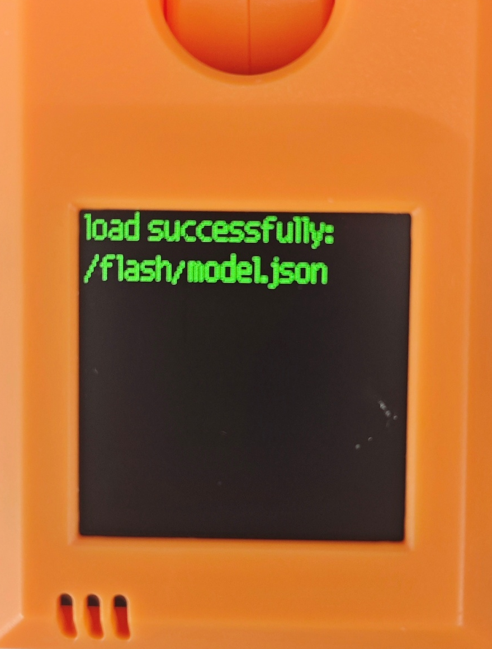
Model Testing
4
After pressed the button A, and saw the notify, the model would be loaded and start to identify the pictures.
© TURNED-E! Education Limited 育教創科有限公司 2025

Slide 32
Model Training
5
Search for images of men and women separately on Google.
And test the result.
© TURNED-E! Education Limited 育教創科有限公司 2025

Slide 33

Free Creating Time
© TURNED-E! Education Limited 育教創科有限公司 2025

Slide 34

Summarize
© TURNED-E! Education Limited 育教創科有限公司 2025

