Slide 1




© TURNED-E! Education Limited 育教創科有限公司 2025
KOI2 AI Lens smart city
Lesson 2：Input and Output of KOI2

Slide 2


© TURNED-E! Education Limited 育教創科有限公司 2025
Agenda
Reviewing time
Knowing about KOI’s Screen
Display Text on the Screen
KOI2 Photo Function
Play sound on KOI2

Slide 3




Rules
請尊重你的同學和導師
Be respectful.
Respect your classmates and teacher.
請正確使用器材
Use equipment
only for class activities.
盡情享受課堂樂趣吧！
Be creative, active
and have fun!
© TURNED-E! Education Limited 育教創科有限公司 2025

Slide 4

Revision
© TURNED-E! Education Limited 育教創科有限公司 2025

Slide 5

Machine Learning and AI
Machine learning (ML) is a branch of artificial intelligence (AI) that enables computers to learn from data, identify patterns, and make decisions or predictions with minimal human programming.
© TURNED-E! Education Limited 育教創科有限公司 2025

Slide 6
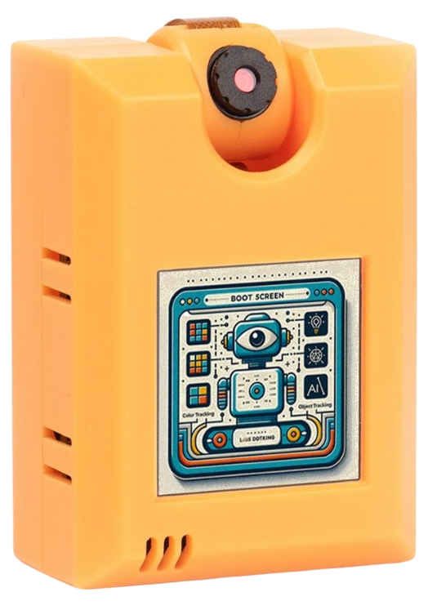
What is KOI 2 Lens
KOI 2 lens is an offline AI camera released by Kittenbot at 2024, it has 5 main abilities:
Visual recognition
Face Detection and Recognition
Object Classification
Speech Recognition
Text to Speech
© TURNED-E! Education Limited 育教創科有限公司 2025

Slide 7
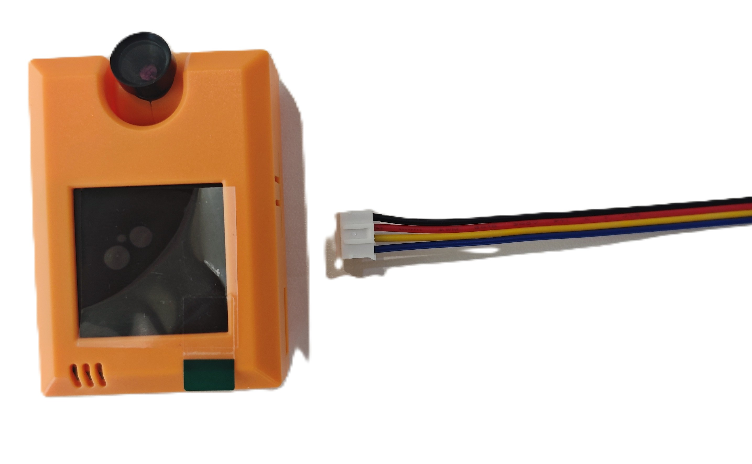
Connect KOI2 with Robotbit
Use specialized thread for splicing. Pay attention to identifying the interface and the corresponding thread color.
© TURNED-E! Education Limited 育教創科有限公司 2025

Slide 8
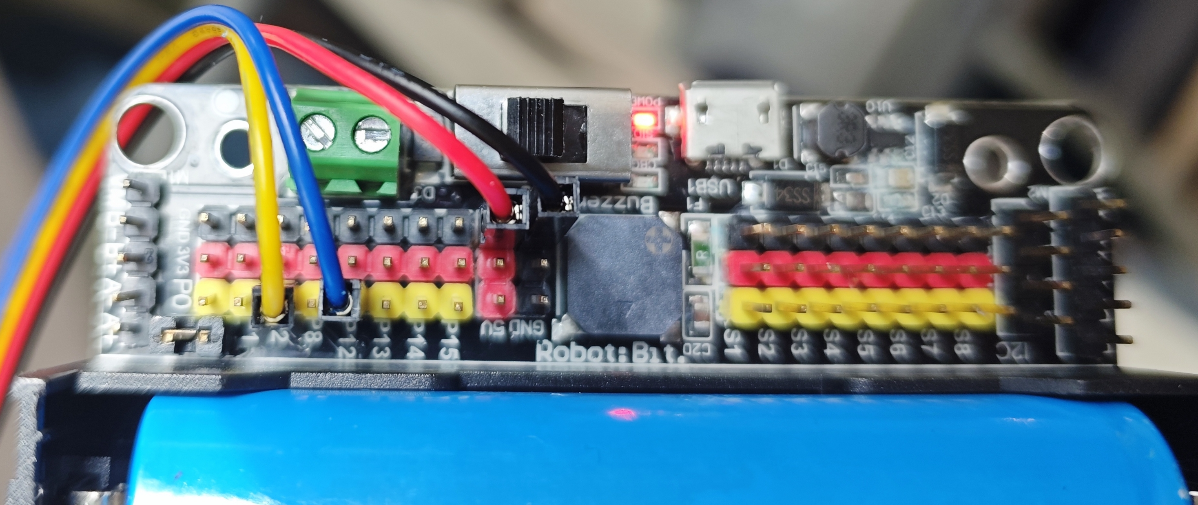
Connect KOI2 with Robotbit
color​ | Pins | functions​
Red​ | 5V | Positive power supply​
Black | GND​ | Negative power supply
Yellow | RX(P2) | Serial clock line​
​Blue | TX​(P12) | Serial data cable
© TURNED-E! Education Limited 育教創科有限公司 2025

Slide 9

Knowing about KOI’s Screen
© TURNED-E! Education Limited 育教創科有限公司 2025

Slide 10
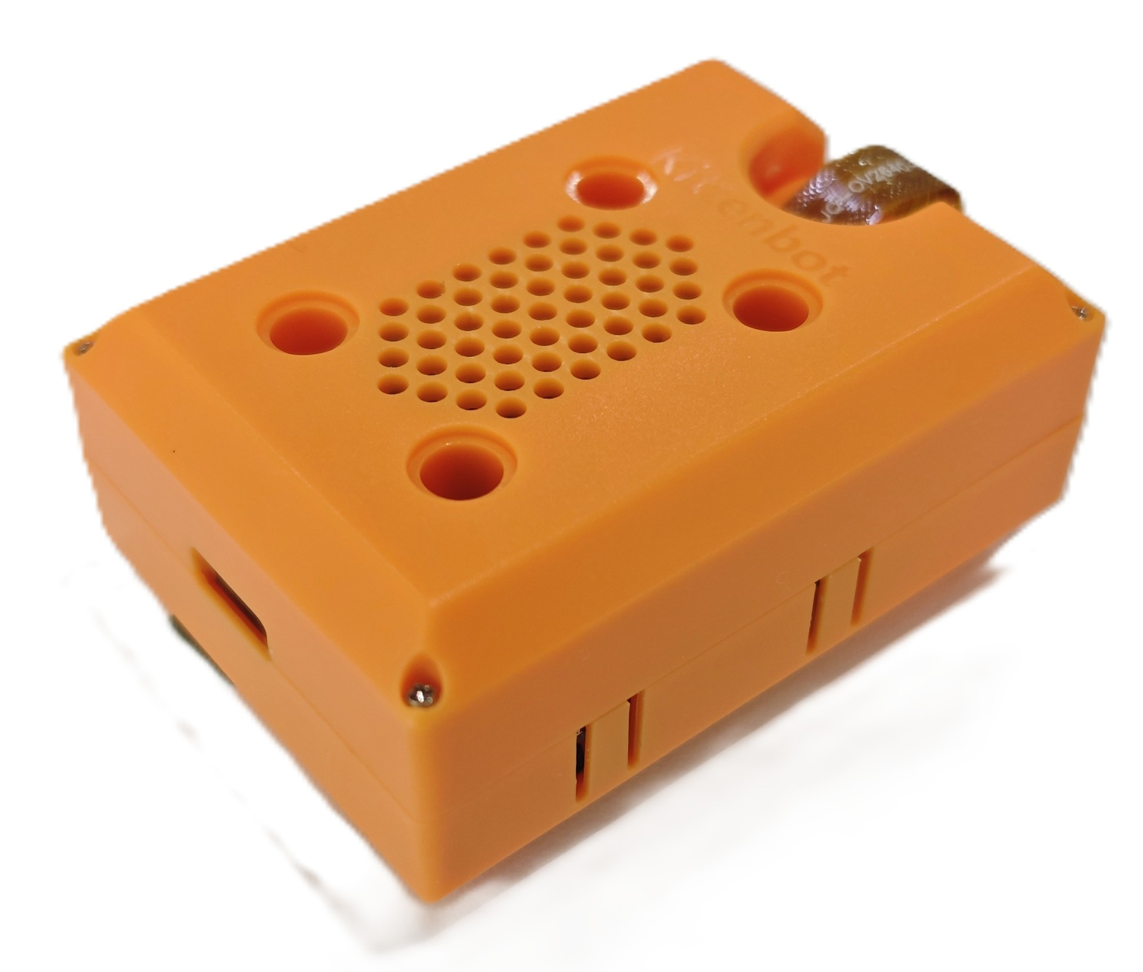
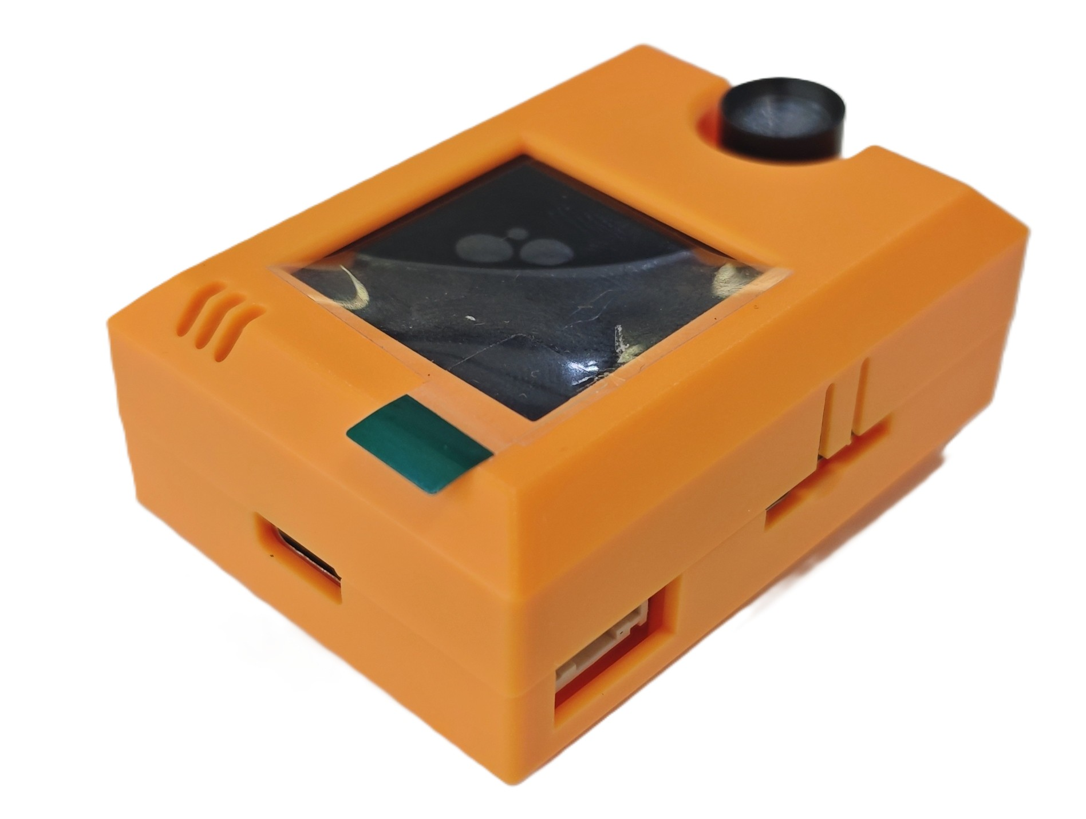
Details about KOI2
Speaker
Screen
Lens
LEGO Holes
microphone
Button B
Type-C
USB port
TF card
Button A
Serial port
Reset Button
© TURNED-E! Education Limited 育教創科有限公司 2025

Slide 11
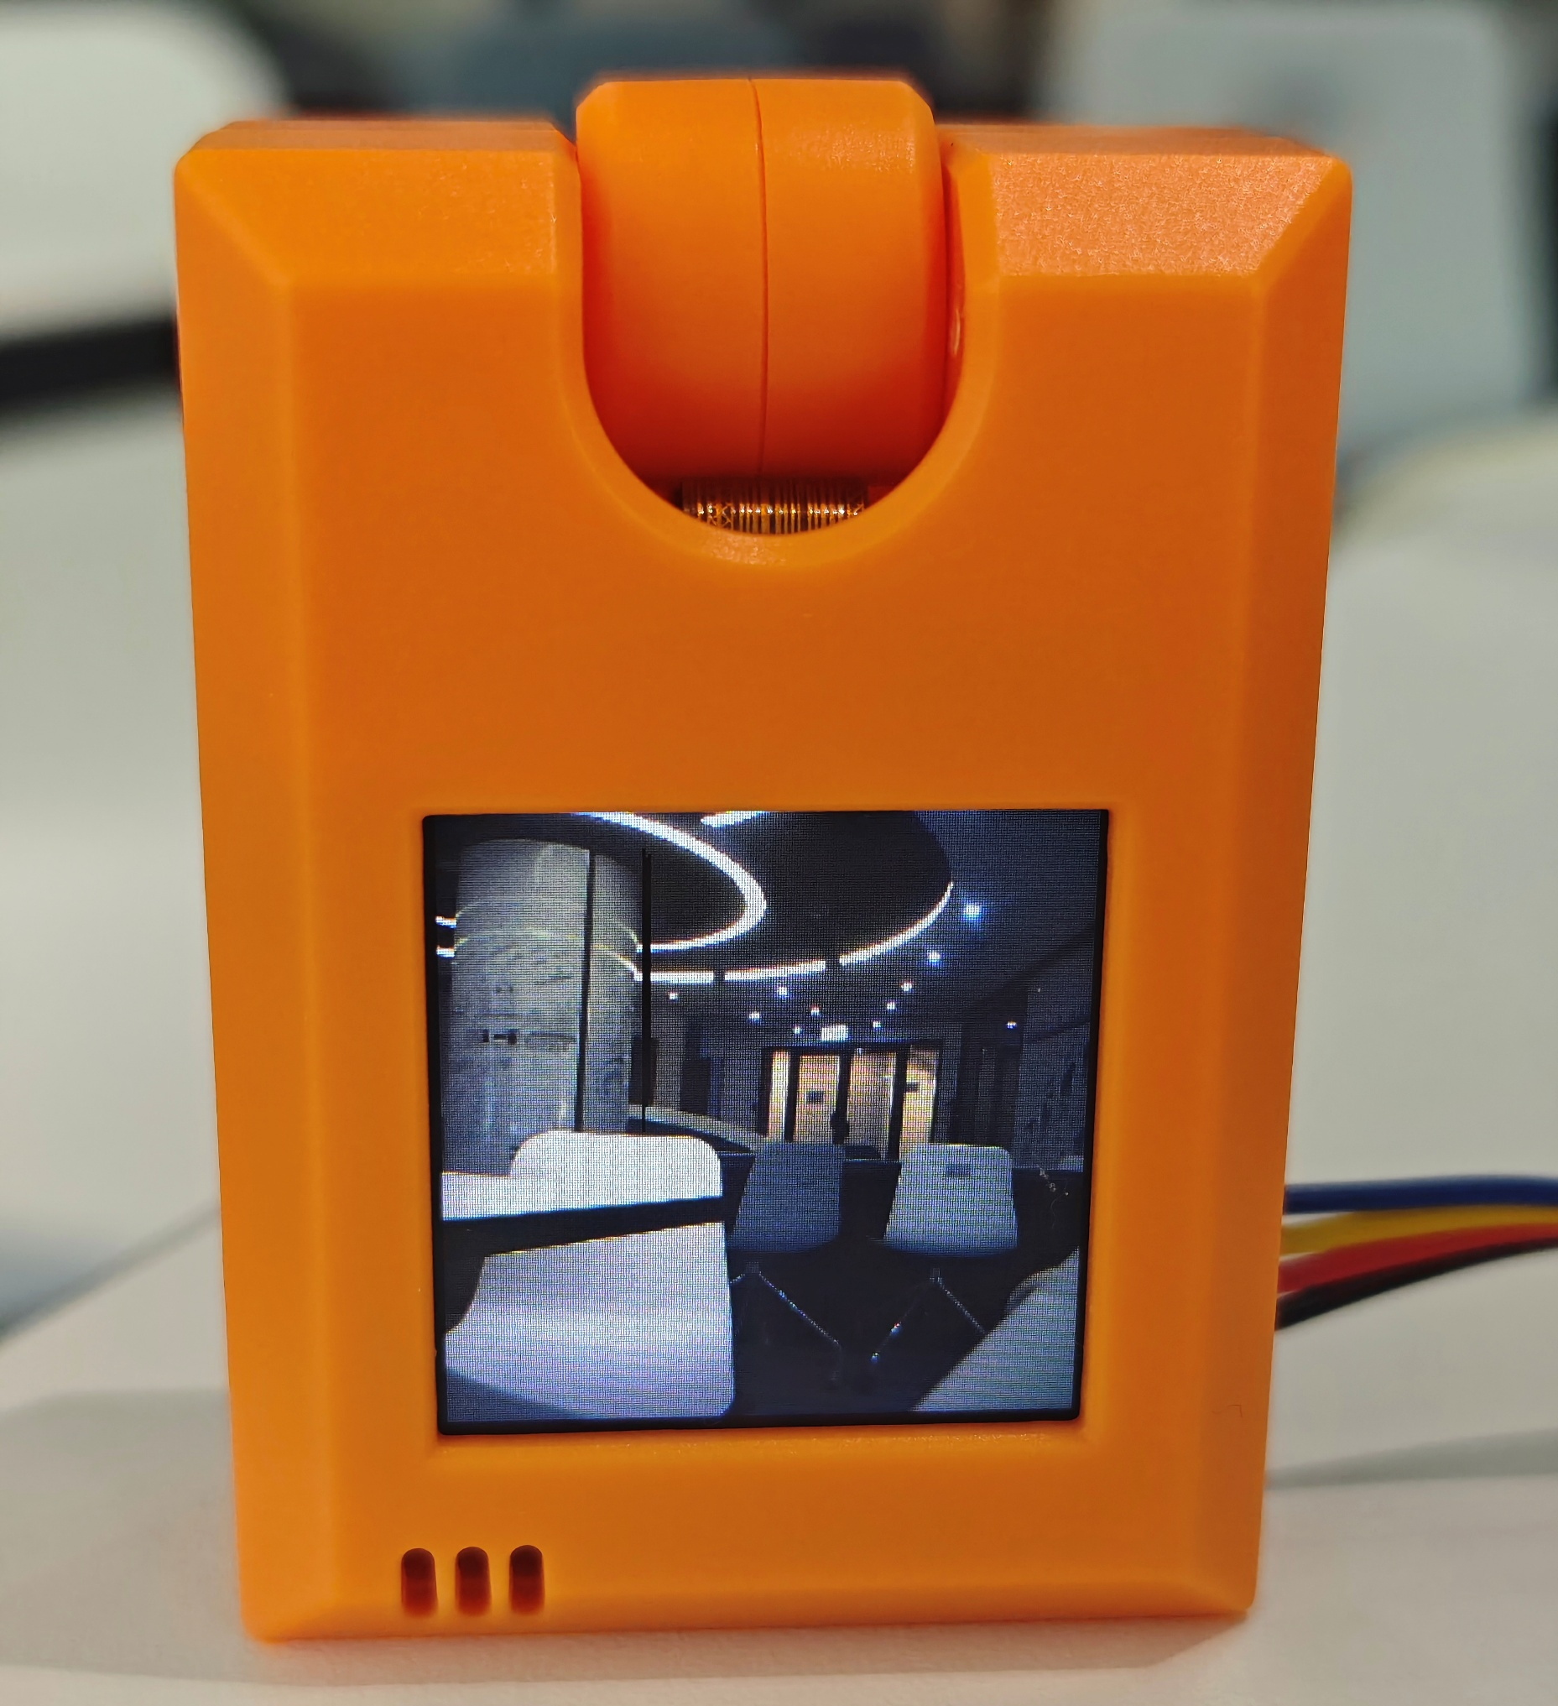
Screen Display
When you start the KOI2, it will display what the camera see on the screen.
Screen size: 1.3 inch 240x240 IPS
© TURNED-E! Education Limited 育教創科有限公司 2025

Slide 12
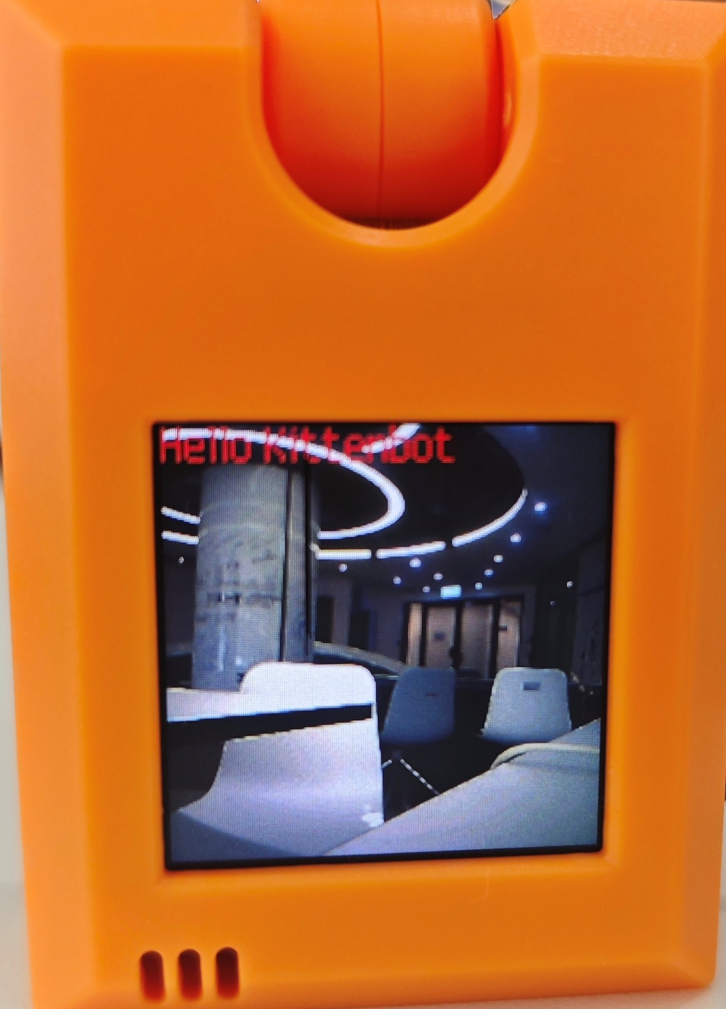
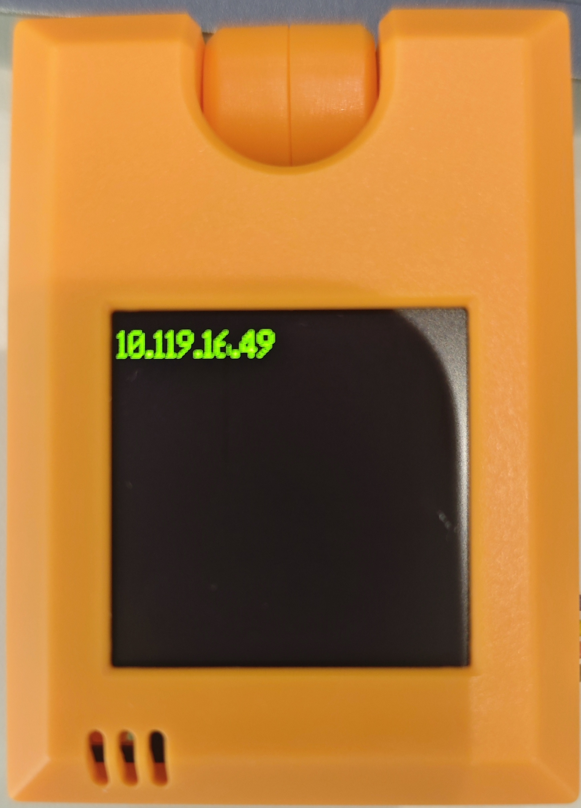
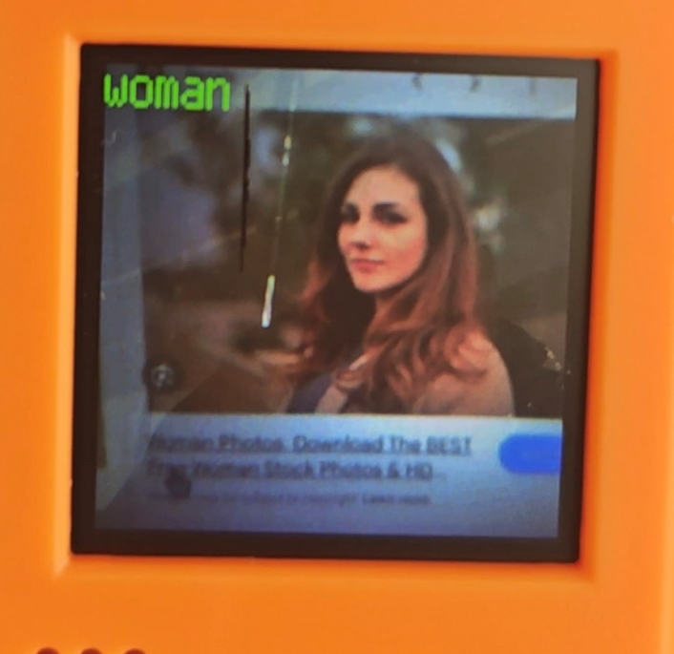
Screen Display
Text is default to be displayed at the top left corner.
© TURNED-E! Education Limited 育教創科有限公司 2025

Slide 13

Display Text on the Screen
© TURNED-E! Education Limited 育教創科有限公司 2025

Slide 14
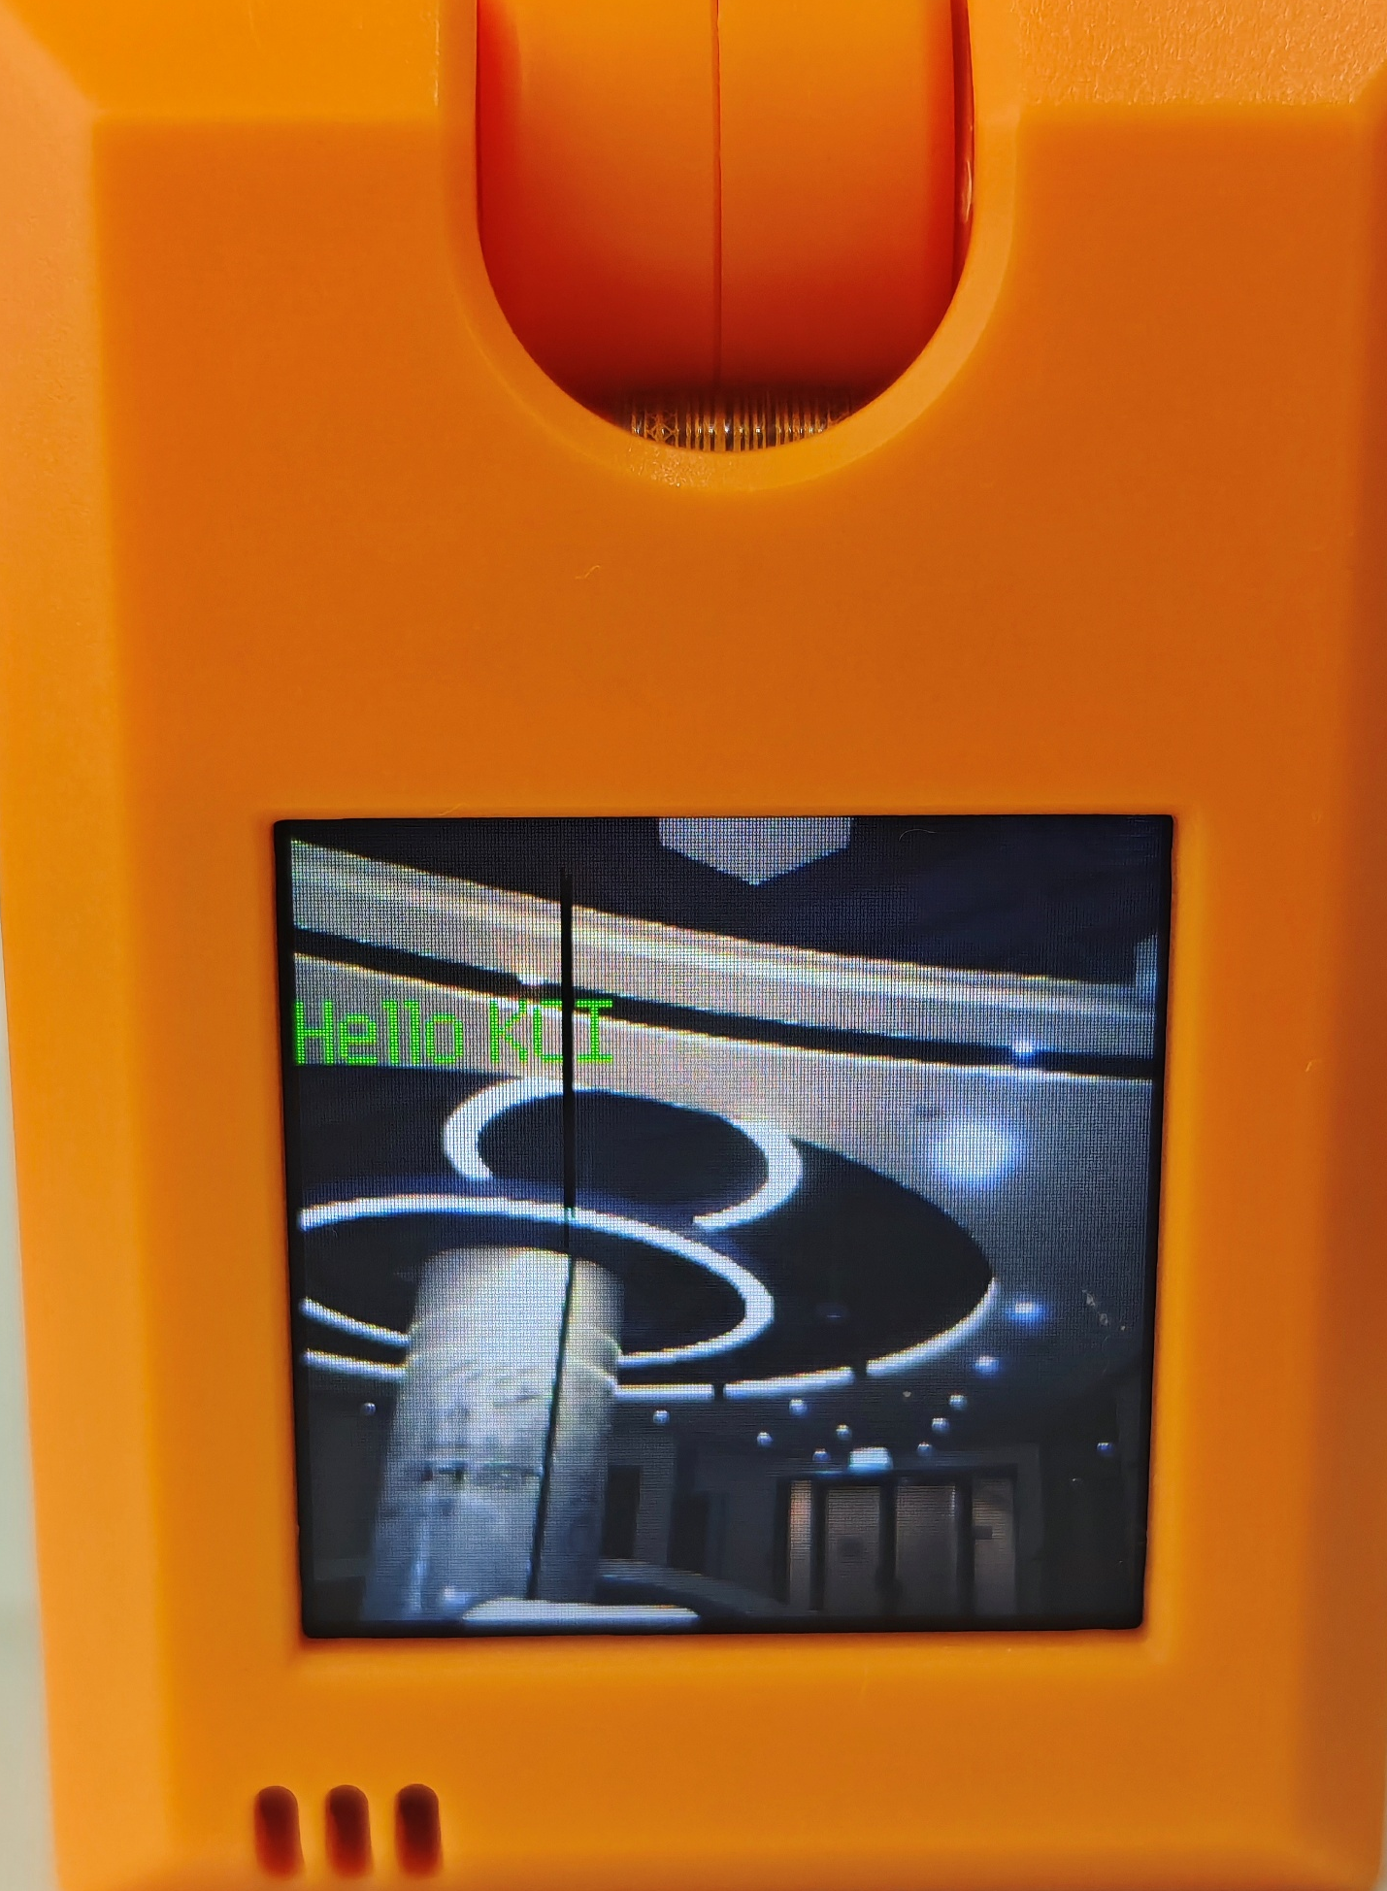
Screen Display
We can display different words and place them in different positions.
© TURNED-E! Education Limited 育教創科有限公司 2025

Slide 15
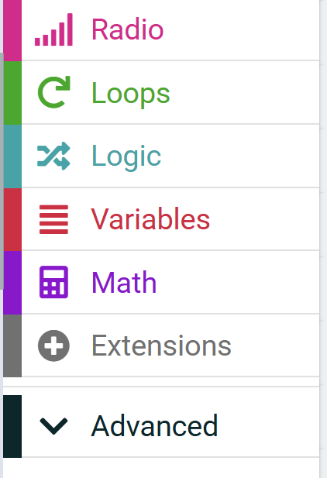
Use KOI2 in MakeCode
Open the extension tab in MakeCode.
1
© TURNED-E! Education Limited 育教創科有限公司 2025

Slide 16
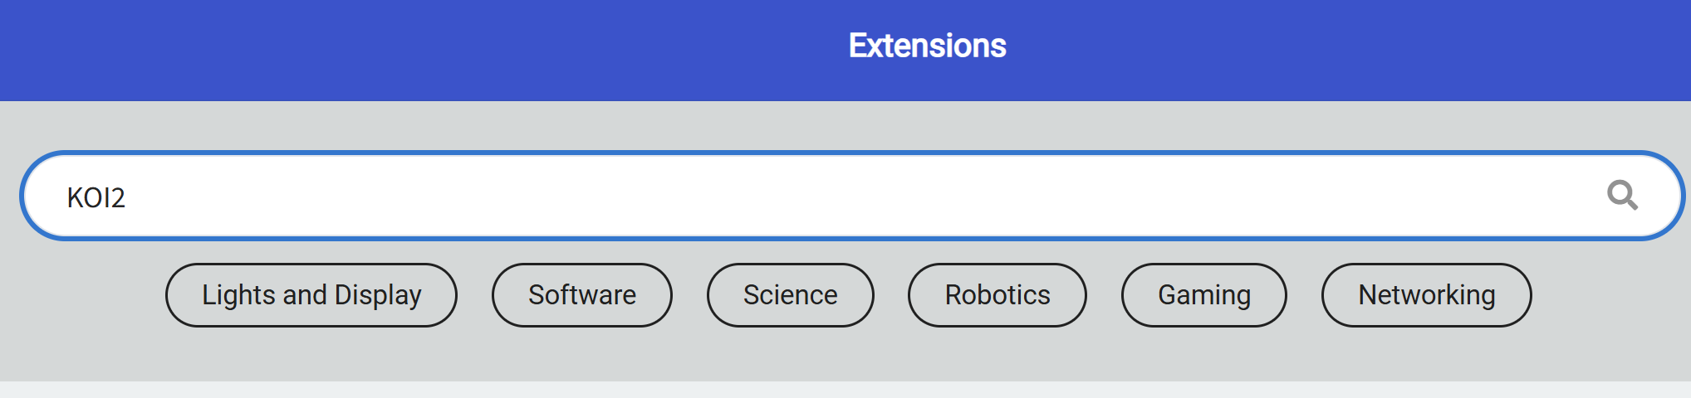
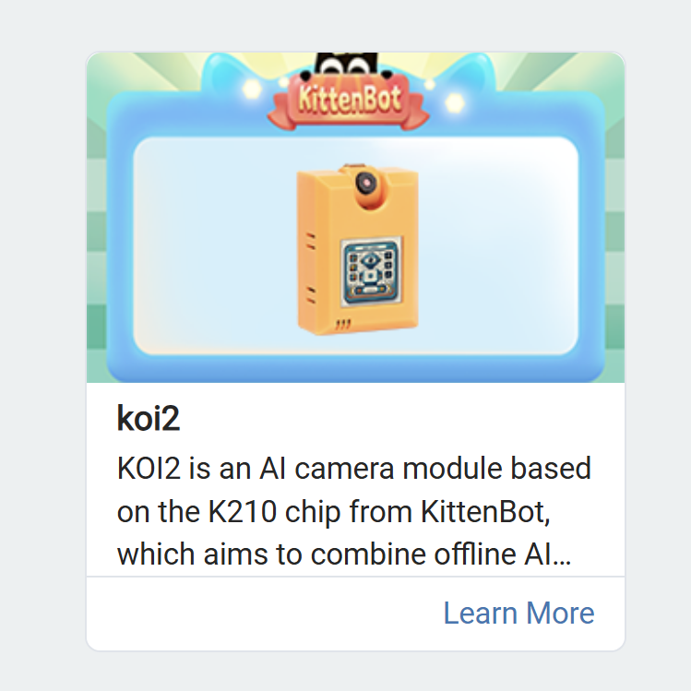
Use KOI2 in MakeCode
2
3
Search for KOI2 in the search bar, and select KOI2 extension
© TURNED-E! Education Limited 育教創科有限公司 2025

Slide 17
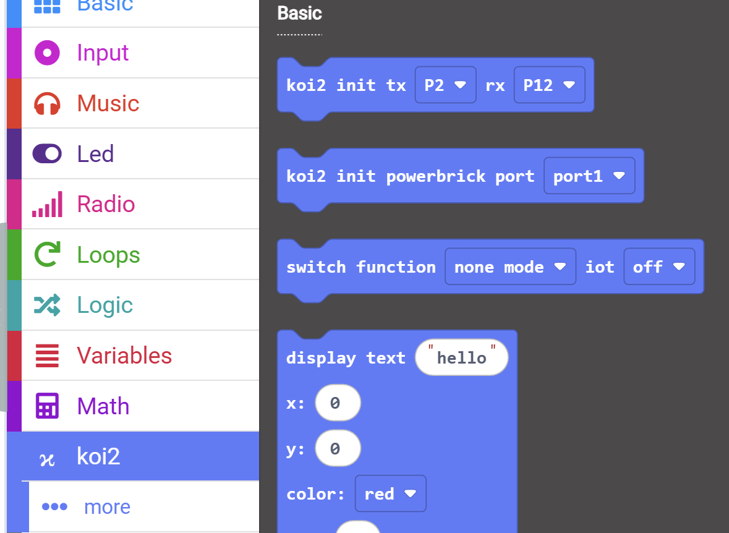
Initialize the Text Display
4
Open the koi2 tab and find “koi2 init tx P2 rx P12” and “switch function none mode iot off” blocks.
© TURNED-E! Education Limited 育教創科有限公司 2025

Slide 18
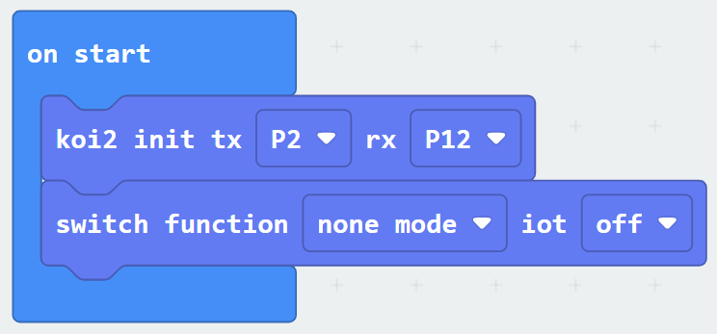
Initialize the Text Display
5
Drag them to “on start” block.
© TURNED-E! Education Limited 育教創科有限公司 2025

Slide 19
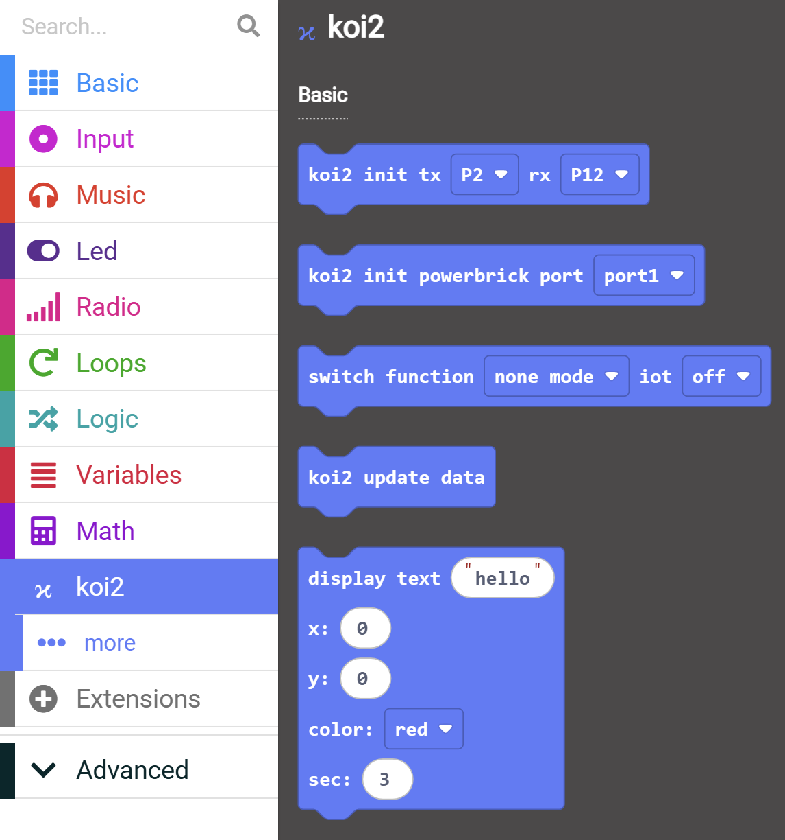
Text Display
6
Open the Logic tab and find the “display text hello” block
© TURNED-E! Education Limited 育教創科有限公司 2025

Slide 20
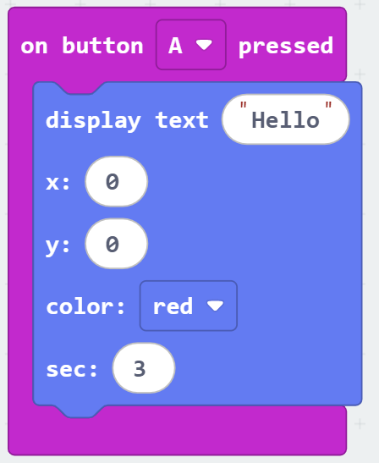
Parameter of the Text Block
7
Text content
The X-axis of the screen
The Y-axis of the screen
The color of the text
Duration of text display
© TURNED-E! Education Limited 育教創科有限公司 2025

Slide 21
Text Display
8
Drag it into the “on button A pressed” block, and you can also change the content, place, color and duration as you like.
© TURNED-E! Education Limited 育教創科有限公司 2025

Slide 22

KOI2 Photo Function
© TURNED-E! Education Limited 育教創科有限公司 2025

Slide 23

Photo Taking Function
KOI2 can also be used as a camera for taking pictures. The picture can be stored at a TF card or the flash storage.
© TURNED-E! Education Limited 育教創科有限公司 2025

Slide 24
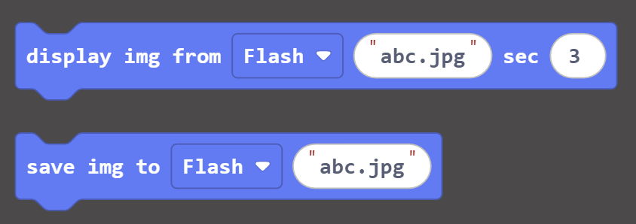
Photo Taking Function
We need “display img from flash” block and “save img to flash” block.
The statement above is used to display a photo, and the statement below is used to take a photo.
1
2
© TURNED-E! Education Limited 育教創科有限公司 2025

Slide 25
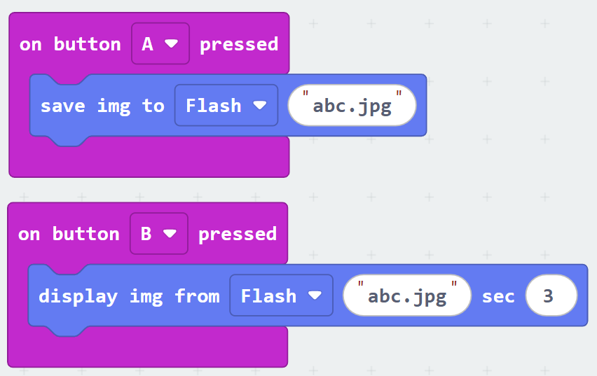
Photo Taking Function
Pressing button A takes a photo; pressing button B displays the photo.
We can use flash storage or TF(SD) card to store the image.
© TURNED-E! Education Limited 育教創科有限公司 2025

Slide 26
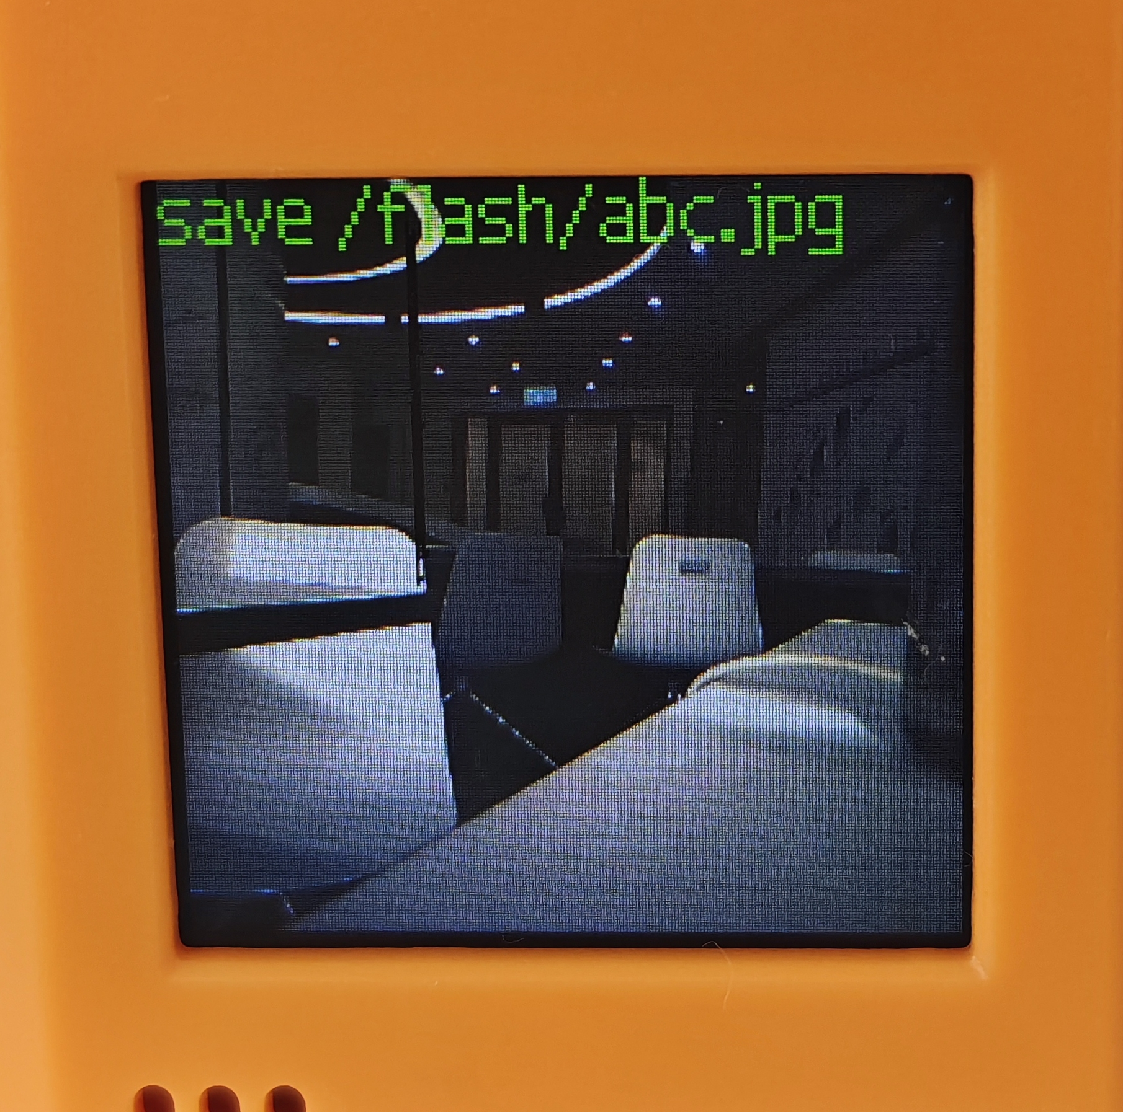
Photo Taking Function
You can see the text displayed at the top left corner after taking the picture.
© TURNED-E! Education Limited 育教創科有限公司 2025

Slide 27

Play sound on KOI2
© TURNED-E! Education Limited 育教創科有限公司 2025

Slide 28
Audio Record and Play
KOI2 can be used as a recorder and play the sound.
* To use this function, a TF card under 16GB is required.
© TURNED-E! Education Limited 育教創科有限公司 2025

Slide 29
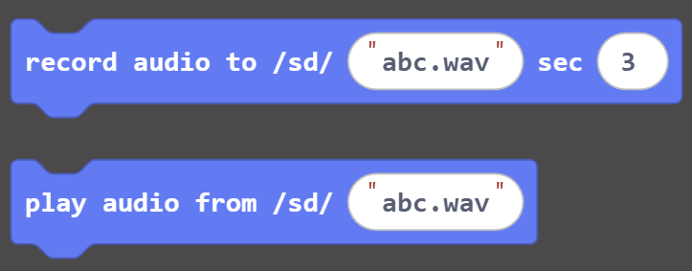
Utilization of Audio Record
1
The audio blocks are similar to images, but a SD card is required, and we can not use flash storage instead.
© TURNED-E! Education Limited 育教創科有限公司 2025

Slide 30
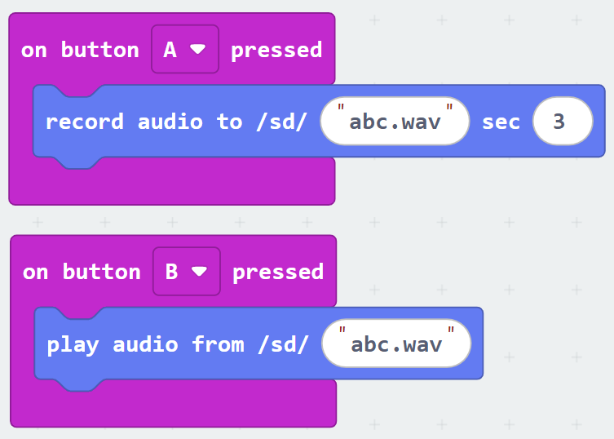
Utilization of Audio Record
2
Pressing button A records a audio for 3 seconds ;
pressing button B plays the audio.
© TURNED-E! Education Limited 育教創科有限公司 2025

Slide 31

Free Creating Time
© TURNED-E! Education Limited 育教創科有限公司 2025

Slide 32

Summarize
© TURNED-E! Education Limited 育教創科有限公司 2025

