Slide 1



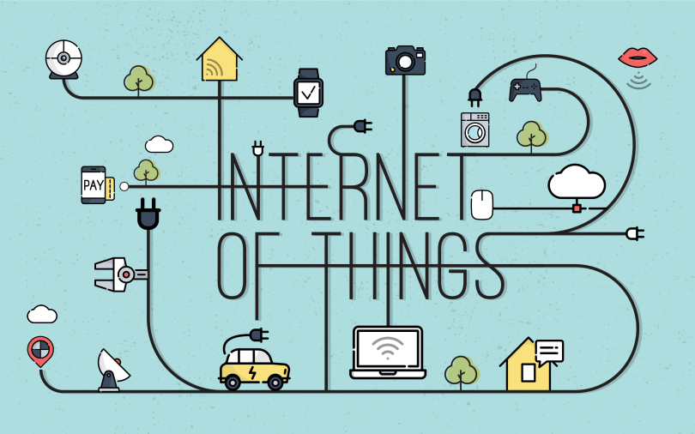
© TURNED-E! Education Limited 育教創科有限公司 2025
KOI2 AI Lens smart city
Lesson 10：AI IoT Product Launch Time

Slide 2


© TURNED-E! Education Limited 育教創科有限公司 2025
Agenda
Reviewing Time
What is a Product Launch
Presentation Skills Tutorial
Product Launch
Summary

Slide 3




Rules
請尊重你的同學和導師
Be respectful.
Respect your classmates and teacher.
請正確使用器材
Use equipment
only for class activities.
盡情享受課堂樂趣吧！
Be creative, active
and have fun!
© TURNED-E! Education Limited 育教創科有限公司 2025

Slide 4

Revision
© TURNED-E! Education Limited 育教創科有限公司 2025

Slide 5

What is Design Thinking?
Design Thinking is a human-centered approach to innovation.
© TURNED-E! Education Limited 育教創科有限公司 2025

Slide 6
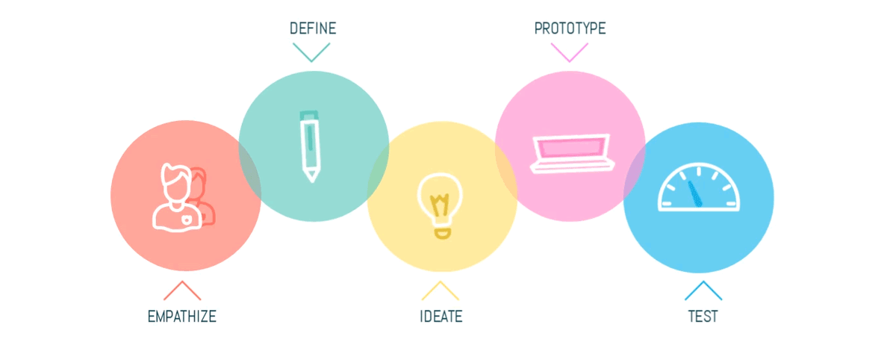
The 5 Stages to Use Design Thinking
© TURNED-E! Education Limited 育教創科有限公司 2025

Slide 7

What is a Product Launch
© TURNED-E! Education Limited 育教創科有限公司 2025

Slide 8
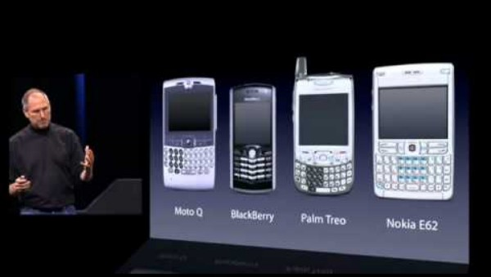
How Jobs Launched the iPhone?
© TURNED-E! Education Limited 育教創科有限公司 2025

Slide 9

What is a Product Launch
Make the audience feel something (Excitement? Relief? Curiosity?)
Tell a story about a problem and the solution.
© TURNED-E! Education Limited 育教創科有限公司 2025

Slide 10
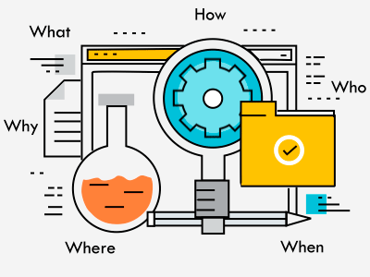
The "Golden Circle" of a Launch
WHY: Why does this exist? (The Problem)
HOW: How does it work? (The AI Tech)
WHAT: What is it?
(The Product)
© TURNED-E! Education Limited 育教創科有限公司 2025

Slide 11

Product Launch Presentation Skills
© TURNED-E! Education Limited 育教創科有限公司 2025

Slide 12

The Principle of Launch
❌Do NOT: Read your code line-by-line.
✔️Do: Tell a story about a problem and a solution.
© TURNED-E! Education Limited 育教創科有限公司 2025

Slide 13

The 4-Step Pitch Structure
The Hook: Start with a question or a shocking fact.
The Solution: Reveal your device.
The Demo: Show it working live or a video.
The Tech: Explain the KOI2 magic briefly.
© TURNED-E! Education Limited 育教創科有限公司 2025

Slide 14
Body Language & Voice
❌ Don't: Read off the slides. Look at the floor. Hide behind the computer.
✅ Do: Make eye contact. Speak LOUDLY. Smile. Point to your prototype.
© TURNED-E! Education Limited 育教創科有限公司 2025

Slide 15

Product Launch
My AI IoT Smart Design
© TURNED-E! Education Limited 育教創科有限公司 2025

Slide 16

My IoT Smart Design
Product Name:
Slogan: (One sentence describing it)
Target User: (Who is it for?)
AI Feature:
(Face Tracking / Classification / Voice?)
© TURNED-E! Education Limited 育教創科有限公司 2025

Slide 17

Course Summary
© TURNED-E! Education Limited 育教創科有限公司 2025

Slide 18

Rewards
Best Creative Reward:
Best Solution Reward:
Best Teammate Reward:
© TURNED-E! Education Limited 育教創科有限公司 2025

Slide 19
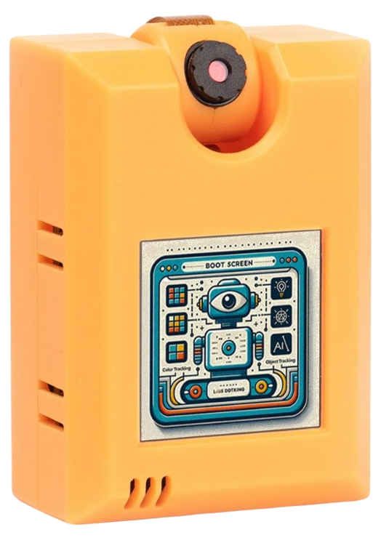
Final Reviews
We learned about KOI2 and how to program with it.
Some Key functions:
Visual recognition
Face Detection and Recognition
Object Classification
Speech Recognition
Text to Speech
© TURNED-E! Education Limited 育教創科有限公司 2025

Slide 20
The Journey We Took
Do you still remember what we learned in these lessons?
AI and KOI AI lens
Input and output of KOI2
Face and traffic sign recognition
Face mask and color blob recognition
Item and number recognition
Custom item recognition training
Wi-Fi connection and IoT applications
© TURNED-E! Education Limited 育教創科有限公司 2025

Slide 21

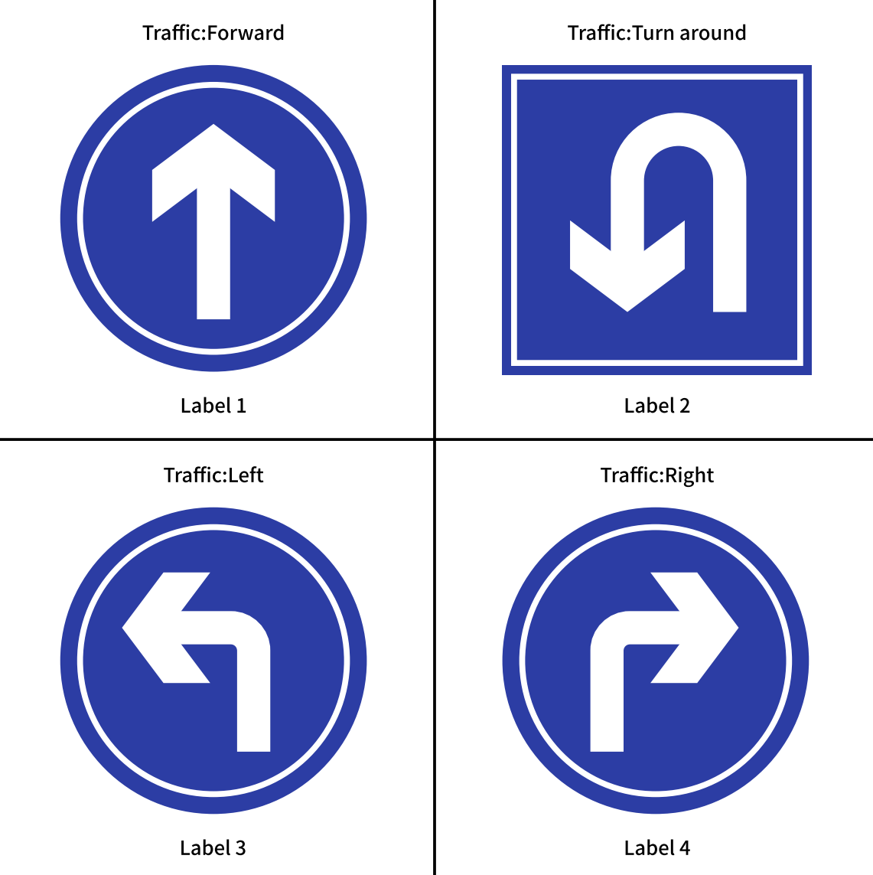
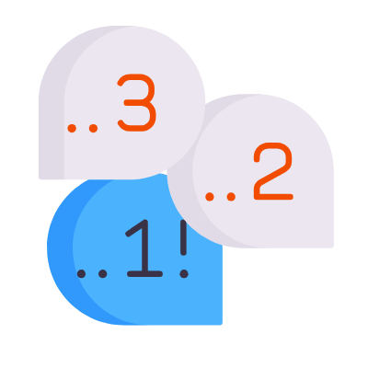

Final Reviews
We used it to solve many real-world problems.
Including traffic sing recognition, voice recoding, mask recognition, number recognition and so on.
© TURNED-E! Education Limited 育教創科有限公司 2025

Slide 22
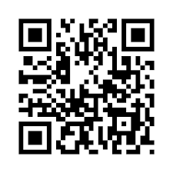
Feedback
Scan the QR code and tell us what you learned.
Fake QR code, replace it!
© TURNED-E! Education Limited 育教創科有限公司 2025

Slide 23
Thank You!
© TURNED-E! Education Limited 育教創科有限公司 2025

