Slide 1


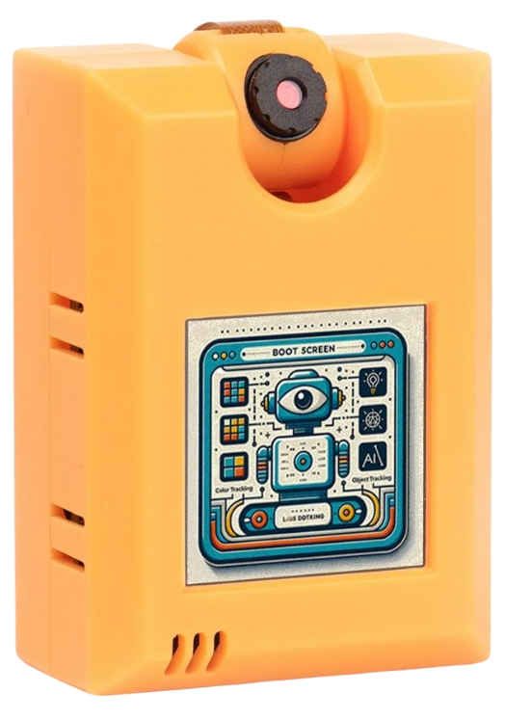

© TURNED-E! Education Limited 育教創科有限公司 2025
KOI2 AI Lens smart city
Lesson1：AI and KOI AI lens

Slide 2


© TURNED-E! Education Limited 育教創科有限公司 2025
Agenda
AI and Machine Learning
KOI2 lens and Robotbit board
Connect KOI2 with robotbit
Face Tracing
Experience task

Slide 3




Rules
請尊重你的同學和導師
Be respectful.
Respect your classmates and teacher.
請正確使用器材
Use equipment
only for class activities.
盡情享受課堂樂趣吧！
Be creative, active
and have fun!
© TURNED-E! Education Limited 育教創科有限公司 2025

Slide 4

AI and Machine Learning
© TURNED-E! Education Limited 育教創科有限公司 2025

Slide 5


What is AI？
Do you know what is AI？
© TURNED-E! Education Limited 育教創科有限公司 2025

Slide 6
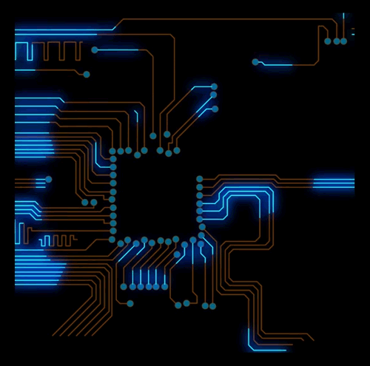
Artificial Intelligence
Artificial Intelligence (AI) is a field of computer science that focuses on solving common cognitive problems related to human intelligence, such as learning, problem-solving, and pattern recognition.
Simply put, the goal of artificial intelligence is to enable computers to think and act like humans.
© TURNED-E! Education 育教創科 2025

Slide 7
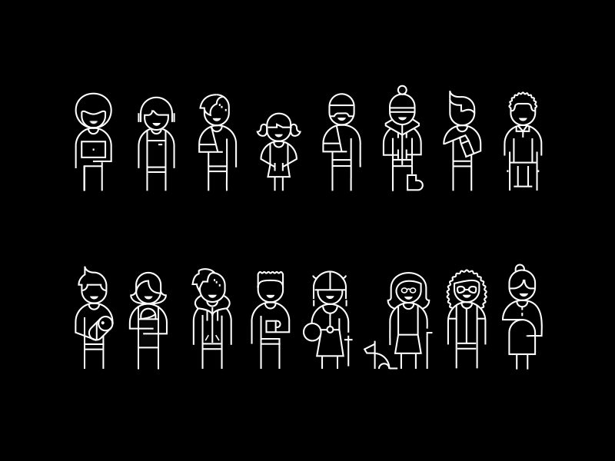
To achieve the goal of thinking and acting like humans, three key elements are needed.
Computing Systems
Data and Data Management
Advanced Artificial Intelligence Algorithms (Code)
The closer the expected results are to those of humans, the higher the requirements for the amount of data and processing capabilities.
© TURNED-E! Education 育教創科 2025

Slide 8
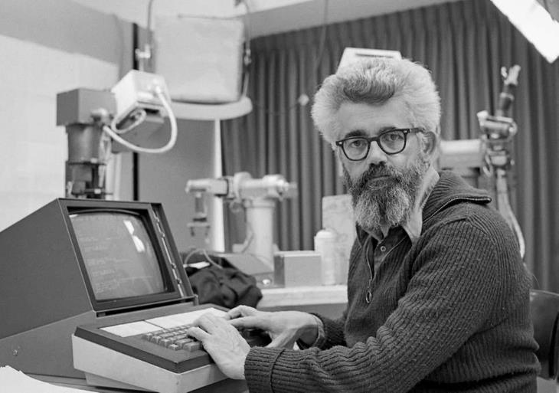
The Origins of Artificial Intelligence
Humans have been interested in the feasibility of creating machines to simulate the human brain since at least the first century BC. In modern times, McCarthy coined the term "artificial intelligence" in 1955. In 1956, McCarthy and others organized a conference called the "Dartmouth College Summer Artificial Intelligence Research Project."
John McCarthy (約翰·麥卡錫)
American computer scientist
© TURNED-E! Education Limited 育教創科有限公司 2025

Slide 9
The Origins of Artificial Intelligence
Starting from this point, machine learning, deep learning, and predictive analytics emerged and have evolved into the normative analytics we know today. In addition, a completely new research field has also arisen data science.
John McCarthy (約翰·麥卡錫)
American computer scientist
© TURNED-E! Education Limited 育教創科有限公司 2025

Slide 10

What is Machine Learning
Machine learning (ML) is a branch of artificial intelligence (AI) that enables computers to learn from data, identify patterns, and make decisions or predictions with minimal human programming.
© TURNED-E! Education Limited 育教創科有限公司 2025

Slide 11


Applications of Machine Learning
Recommendation Systems: Suggesting products on Amazon or movies on YouTube.
Computer Vision: Facial recognition, medical image analysis, autonomous vehicles.
Natural Language Processing (NLP): Language translation, chatbots, sentiment analysis.
Finance: Fraud detection, stock market prediction
© TURNED-E! Education Limited 育教創科有限公司 2025

Slide 12

The Importance of AI
Today, the sheer volume of data generated by humans and computers far exceeds our capacity to absorb, interpret, and make complex decisions based on it.
Artificial intelligence forms the foundation of all computer learning and represents the future of all complex decision-making.
© TURNED-E! Education Limited 育教創科有限公司 2025

Slide 13
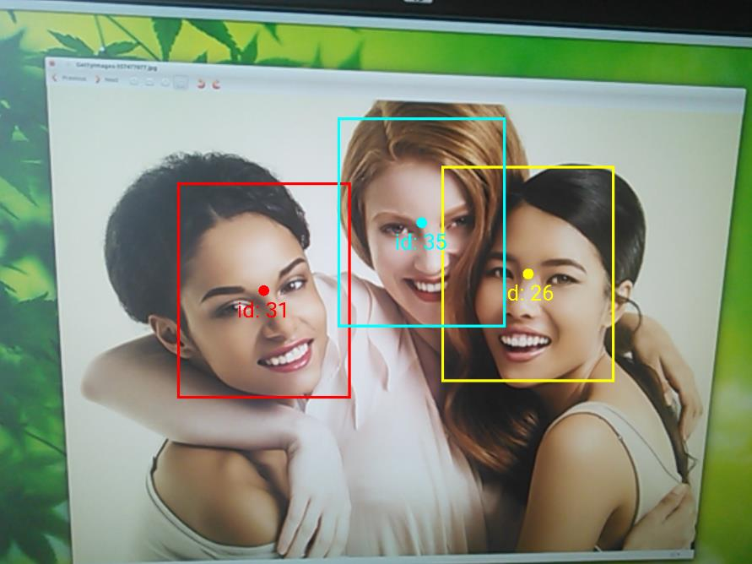
What is Computer Vision?
Computer vision enables computers to recognize and understand objects and people in images and videos. Like other types of AI, computer vision attempts to perform tasks that mimic human abilities and automate these tasks.
Computer vision attempts to mimic how human vision works and how humans interpret what they see.
https://developers.google.com/vision/documentation/android/face-tracker-tutorial
© TURNED-E! Education Limited 育教創科有限公司 2025

Slide 14
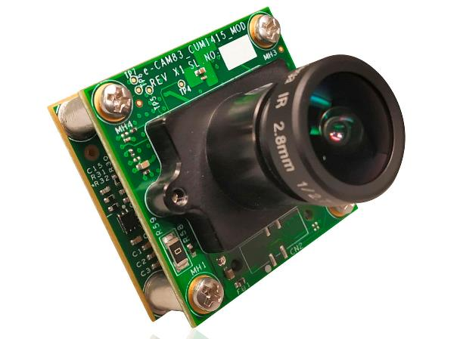
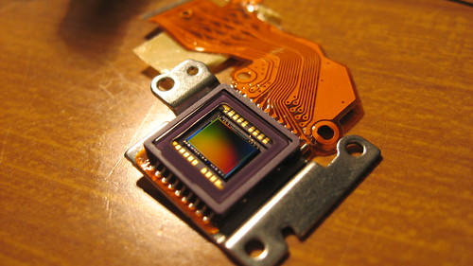
How to Recognize Images?
A webcam works similarly to a traditional camera, using an optical lens to focus light onto a sensor.
Webcams typically use CMOS or CCD sensors which composed thousands of tiny photosensitive elements. Each photosensitive element measures the brightness and color of light and converts it into electrical signal.
The sensor converts the captured image into a set of digital signal. Circuits and chips then process and optimize the image signal before finally transmitting it to the computer.
© TURNED-E! Education Limited 育教創科有限公司 2025

Slide 15

KOI 2 Lens and Robotbit
© TURNED-E! Education Limited 育教創科有限公司 2025

Slide 16
What is KOI 2 Lens
KOI 2 lens is an offline AI camera released by Kittenbot at 2024, it has 5 main abilities:
Visual recognition
Face Detection and Recognition
Object Classification
Speech Recognition
Text to Speech
© TURNED-E! Education Limited 育教創科有限公司 2025

Slide 17
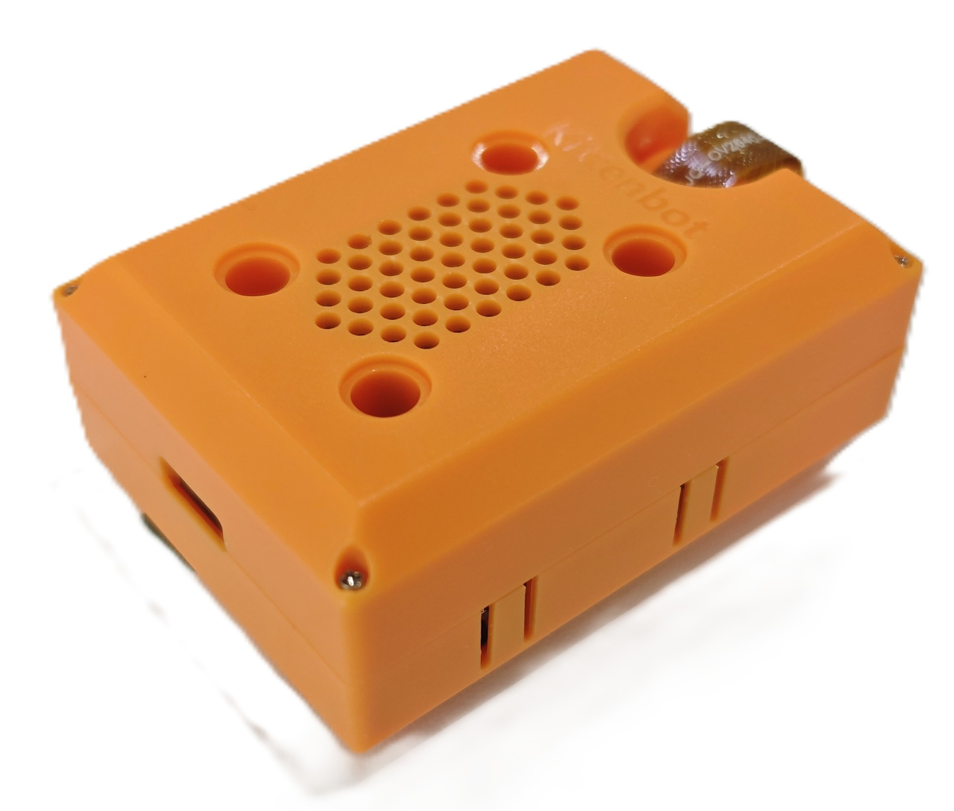
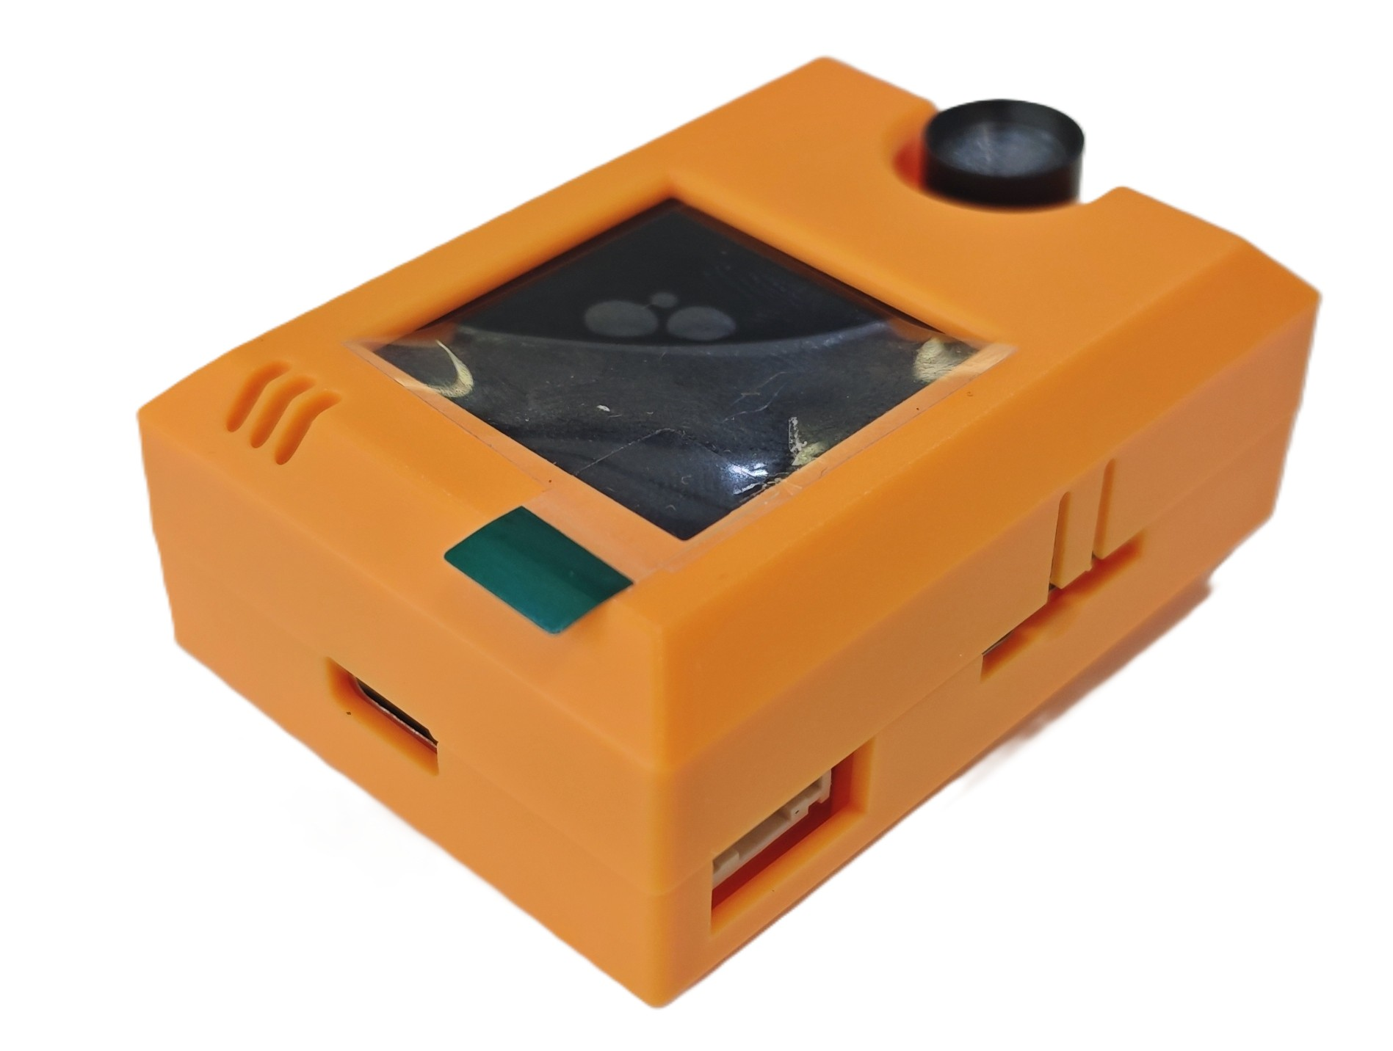
Details about KOI2
Speaker
Screen
Lens
LEGO Holes
microphone
Button B
Type-C
USB port
TF card
Button A
Serial port
Reset Button
© TURNED-E! Education Limited 育教創科有限公司 2025

Slide 18
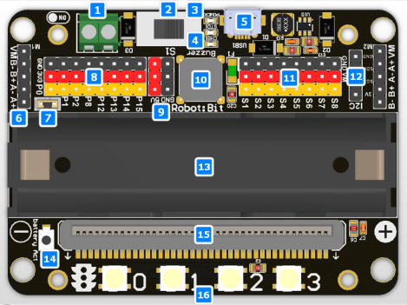
Details about Robotbit
External Power Input
Power Switch
Power Indicator
Battery Level Indicator
MicroUSB Charging Port
2 Motor Ports for a total of 4 DC Motors or 2 28BYJ Stepper Motors
Buzzer Toggle Jumper
8 IO Pins(Corresponds to P0-P2, P8, P12-P15)
5V Output Pins
Buzzer
Servo Ports for 8 servos
I2C Port
18650 Li-ion Battery Holder
Battery Indicator
Micro:bit slot
Programmable RGB LED x 4
© TURNED-E! Education Limited 育教創科有限公司 2025

Slide 19
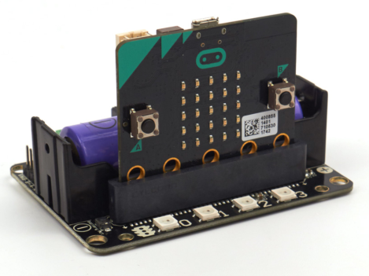
Details about Robotbit
Correct orientation: The A and B buttons of the Micro:bit should face outwards.
© TURNED-E! Education Limited 育教創科有限公司 2025

Slide 20

Connect KOI2 with Robotbit
© TURNED-E! Education Limited 育教創科有限公司 2025

Slide 21
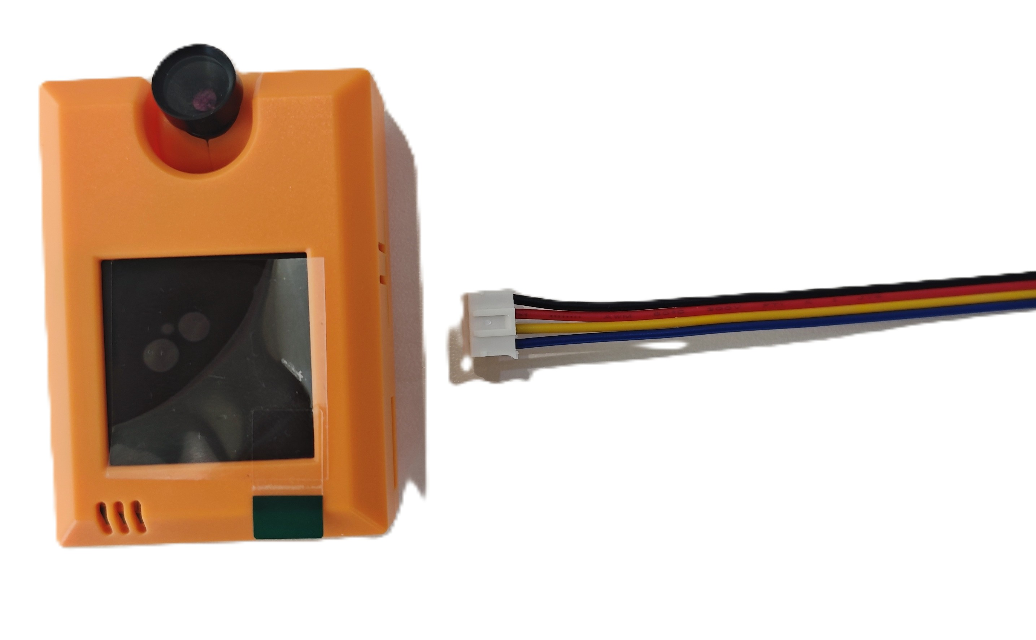
KOI2 Connection
Use specialized thread for splicing. Pay attention to identifying the interface and the corresponding thread color.
© TURNED-E! Education Limited 育教創科有限公司 2025

Slide 22
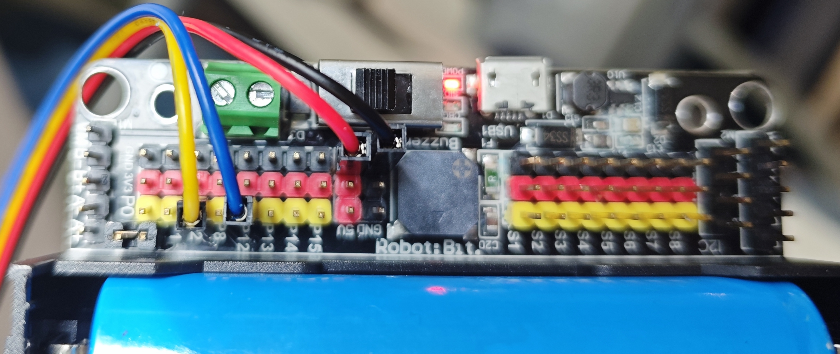
KOI2 Connection
color​ | Pins | functions​
Red​ | 5V | Positive power supply​
Black | GND​ | Negative power supply
Yellow | RX(P2) | Serial clock line​
​Blue | TX​(P12) | Serial data cable
© TURNED-E! Education Limited 育教創科有限公司 2025

Slide 23

Face Recognition Programming
© TURNED-E! Education Limited 育教創科有限公司 2025

Slide 24
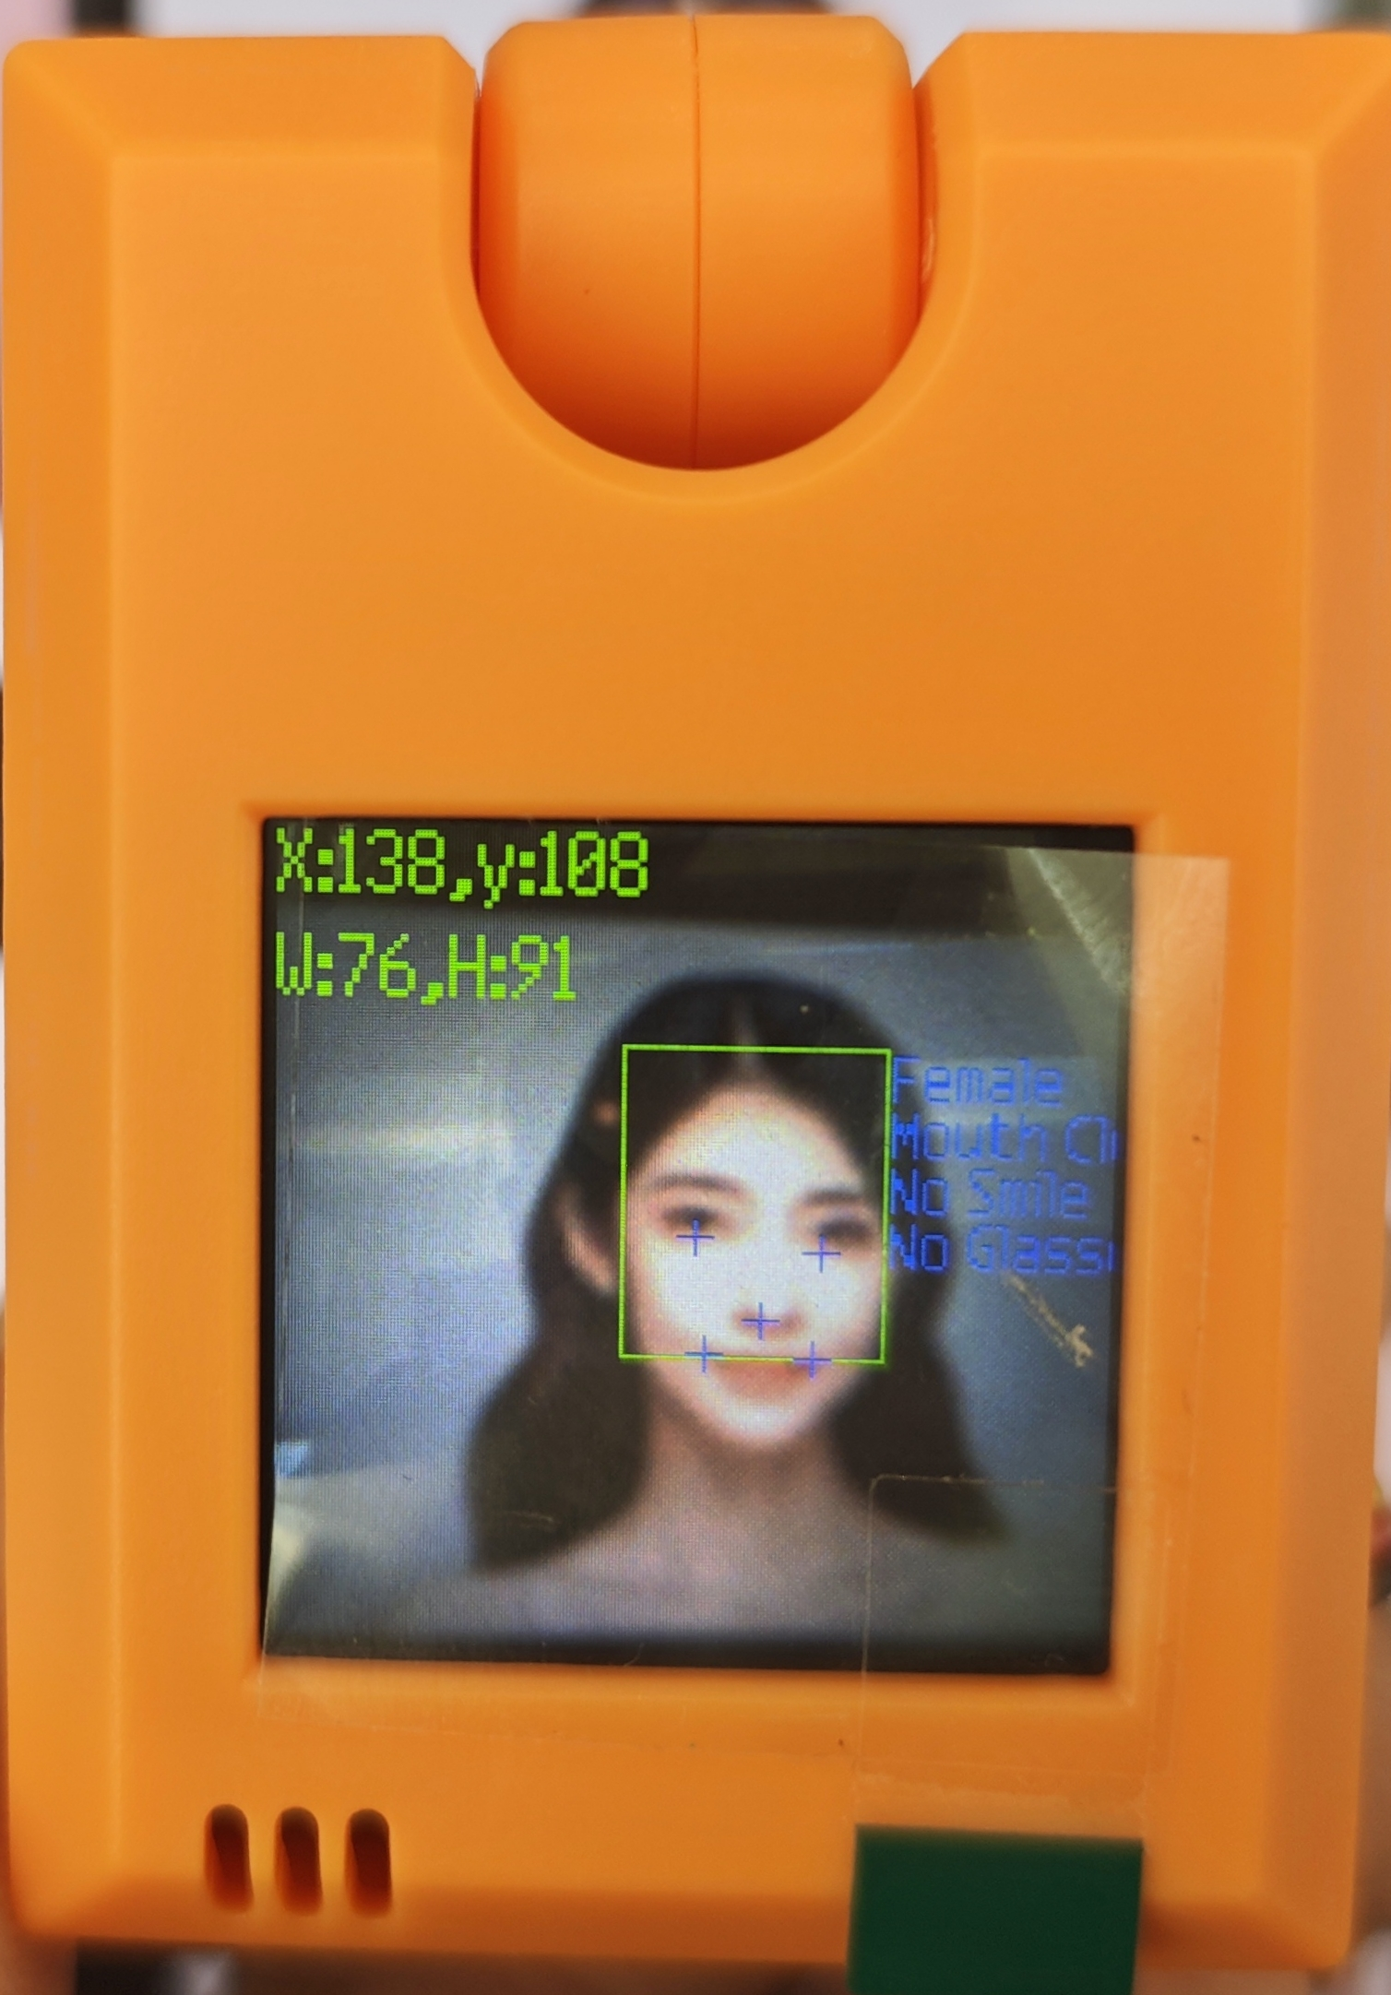
Face Recognition
We can use KOI2 to show whether it sees a face and the position of the face on the screen.
© TURNED-E! Education Limited 育教創科有限公司 2025

Slide 25
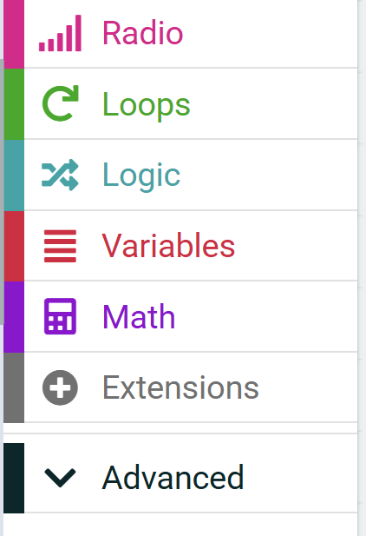
Use KOI and Robotbit in MakeCode
Open the extension tab in MakeCode.
1
© TURNED-E! Education Limited 育教創科有限公司 2025

Slide 26
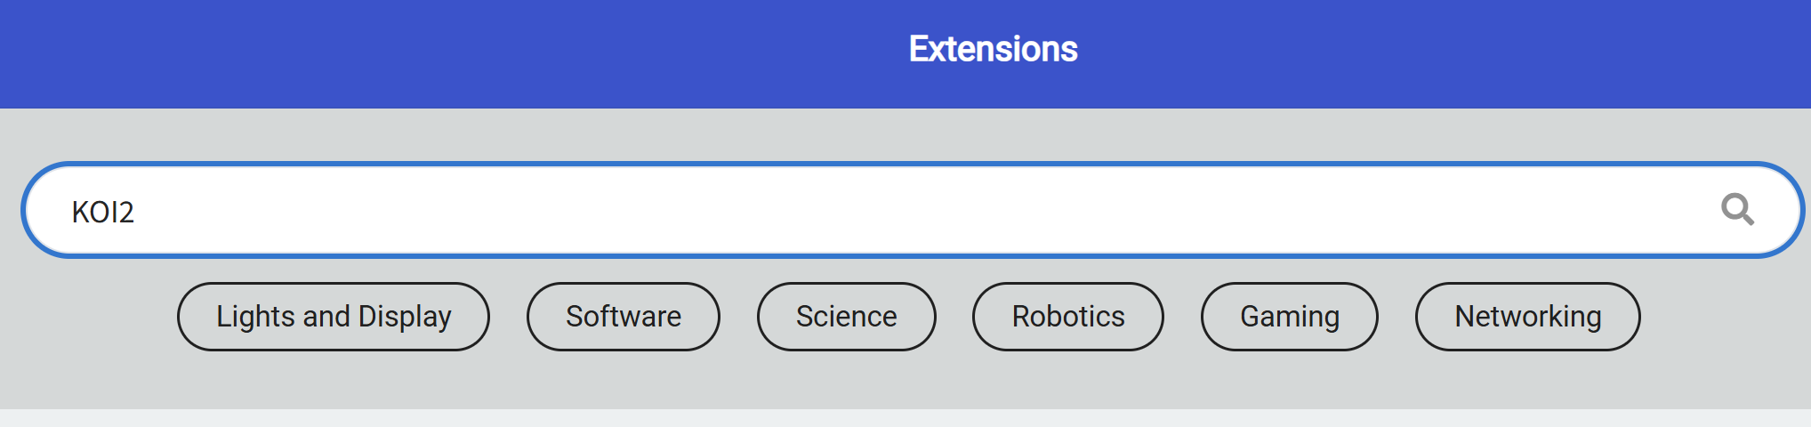
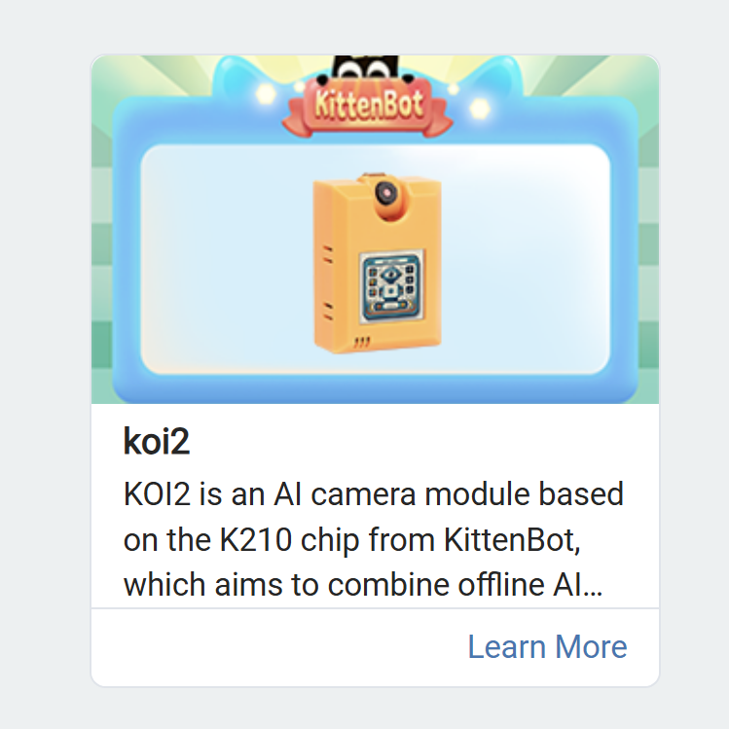
Add KOI2 Extensions
2
3
Search for KOI2 in the search bar, and select KOI2 extension
© TURNED-E! Education Limited 育教創科有限公司 2025

Slide 27
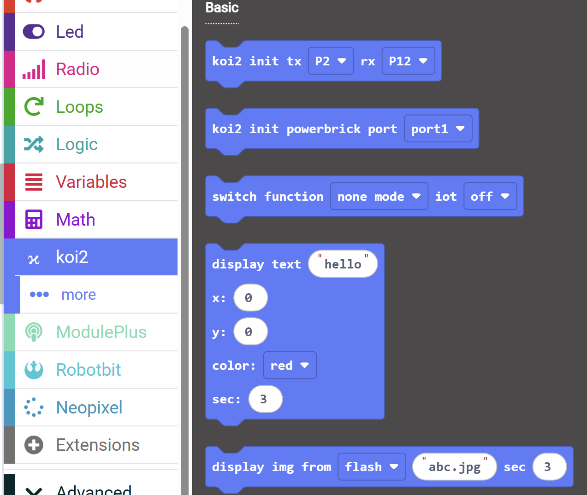
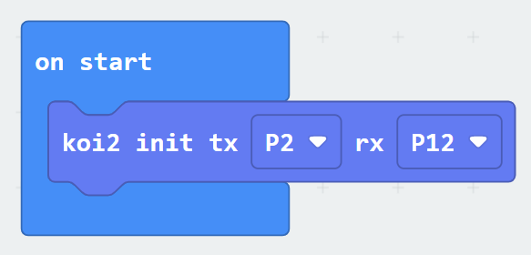
Initialization the KOI2
5
4
Open the koi2 tab in MakeCode platform.
And drag the first block in the on start block.
© TURNED-E! Education Limited 育教創科有限公司 2025

Slide 28
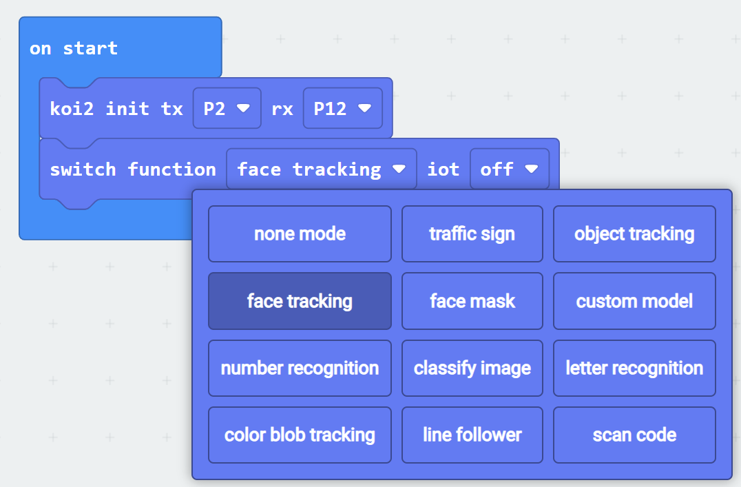
Try the Face Tracking Function
7
6
Drag the third block to on start, and change the “none mode” to “face tracking”
© TURNED-E! Education Limited 育教創科有限公司 2025

Slide 29
Observe the Result on the Screen
8
Point the camera at your desk mate and observe the data displayed in the upper left corner of the screen.
© TURNED-E! Education Limited 育教創科有限公司 2025

Slide 30
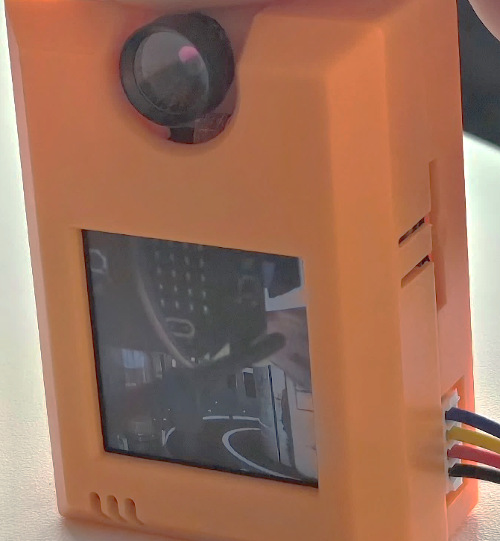
Some Problems
If you flip the camera to the side of the screen, you'll find that the image displayed on the screen is upside down.
© TURNED-E! Education Limited 育教創科有限公司 2025

Slide 31
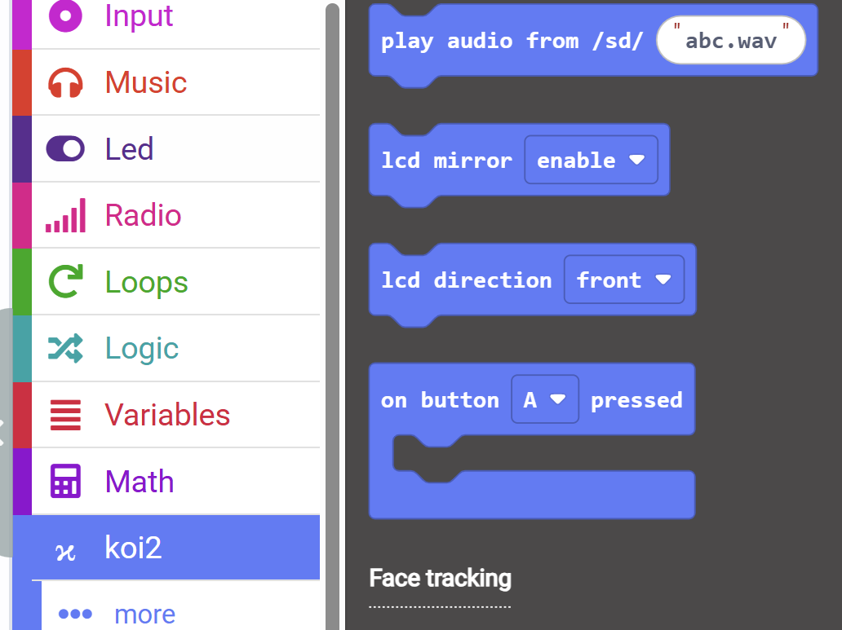
Change the Direction of Screen
9
To solve this problem, we need to change the direction of the screen.
Chose the last two blocks above face tracking
© TURNED-E! Education Limited 育教創科有限公司 2025

Slide 32
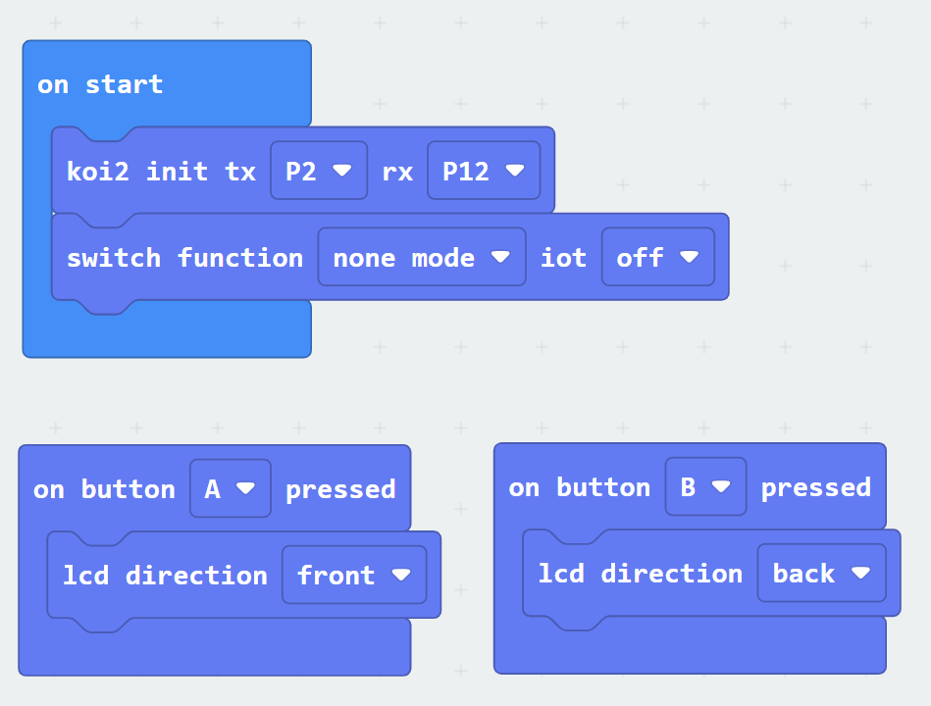
Change the Direction of Screen
10
Pressing the button A on KOI2 will rotate the screen forward; pressing the button B will rotate the screen backward.
© TURNED-E! Education Limited 育教創科有限公司 2025

Slide 33

Experience Facial Tracing
© TURNED-E! Education Limited 育教創科有限公司 2025

Slide 34
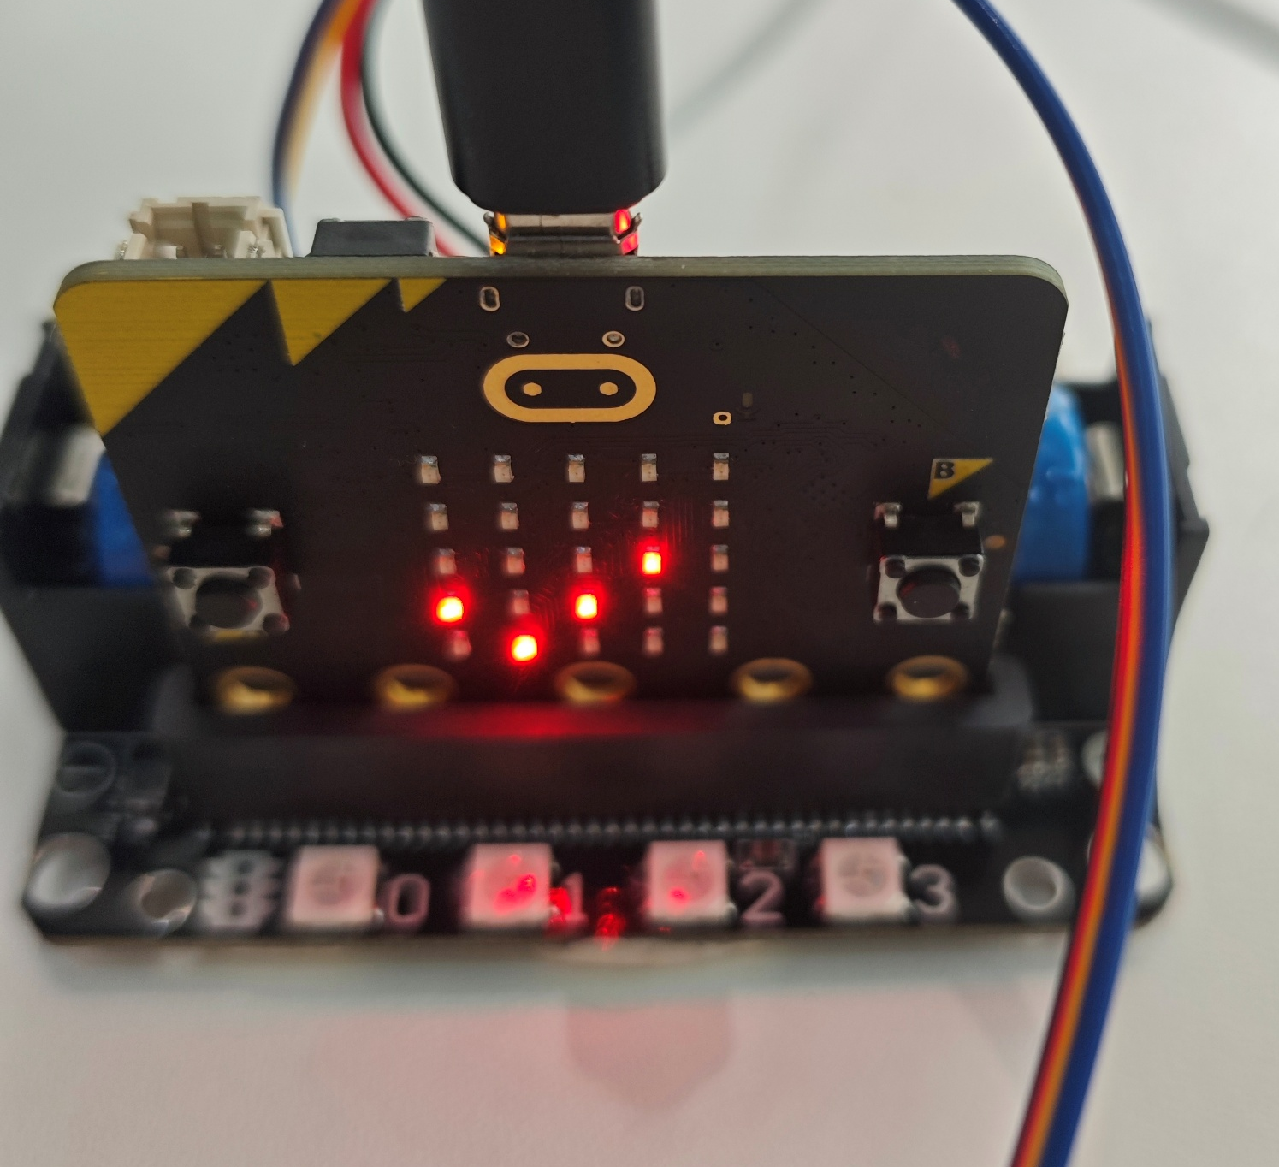
Facial Tracing Task
Attempting to implement the following function:
Display a checkmark(√) in micro:bit when a face is in the center of the, otherwise display an error mark (X).
© TURNED-E! Education Limited 育教創科有限公司 2025

Slide 35
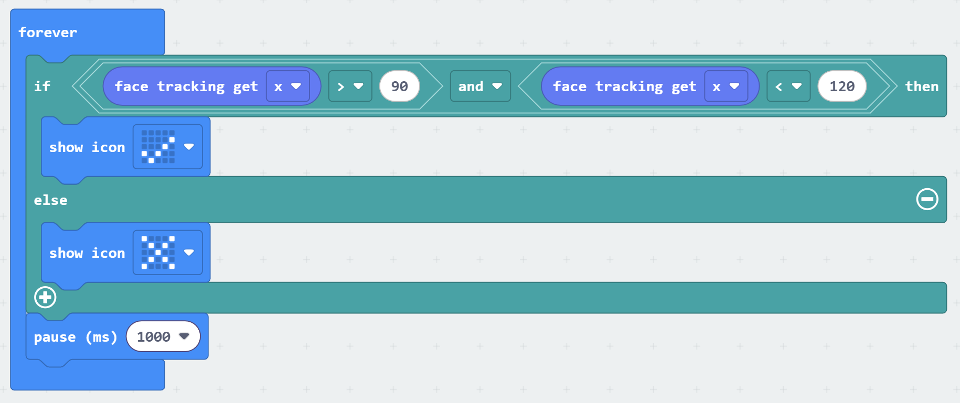
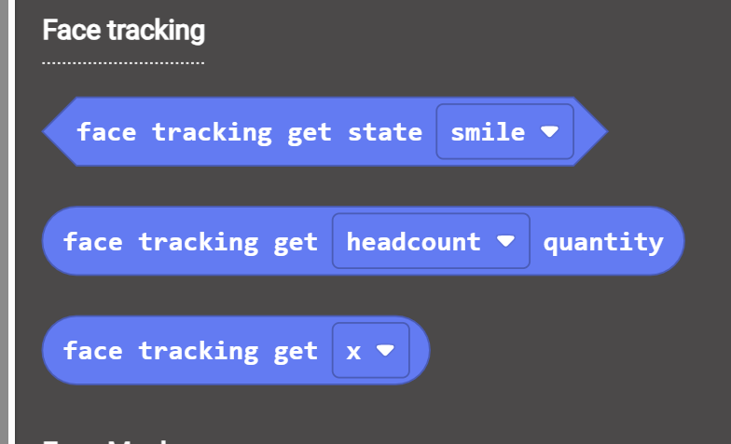
Facial Tracing Task
Use the “face tracking get x” to determine whether the face is at center
© TURNED-E! Education Limited 育教創科有限公司 2025

Slide 36

Free Creating Time
© TURNED-E! Education Limited 育教創科有限公司 2025

Slide 37

Summarize
© TURNED-E! Education Limited 育教創科有限公司 2025

